Slide 1
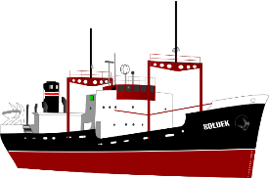
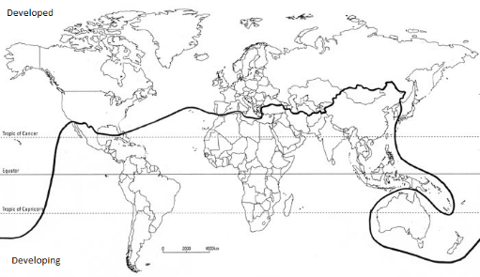
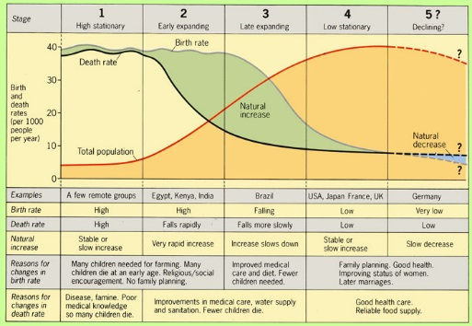
Measuring Development
Development measures how economically, socially, culturally or technologically advanced a country is. It suggests: advancement, evolution, expansion, growth, improvement, increase, maturity, progress, changes for the better.
Development Indicators
GNI | Gross National Income (Money earned by residents of a country including money earned abroad).
HDI | Human Development Index. Calculated using life expectancy, education, and per capita income.
Infant mortality | How many children per 1000 die before they are 1.
Literacy rate | The % of adults that read and write acceptably.
You must know advantages and disadvantages of each of these measures.
Factors Causing Uneven Development
Physical Environment | Health
Soil erosion, desertification, climate (and climate change), overgrazing and infertile soils affect farming. Areas without fertile land, natural resources, water and energy suffer. Natural hazards make little progress with development e.g. Haiti. | Diseases can make people too weak to work or go to school. 80% of all developing world disease is water-related. 2 million die a year. LIC’s are unable to invest in good quality health care
Trade | History
Trade blocs favour member states. Primary products sold by LICs are sold for cheap prices that can fluctuate. HICs make more expensive products so earn more. Poor infrastructure or conflict means some people cannot sell their goods at all. | Colonialism: Many countries in Asia, South America and Africa have spent a lot of time and money on civil wars and political struggles for power since being made separate from European superpowers. Many LICs haven’t had time to develop fully.
UK Links
Ports | Air | Roads
The UK’s port industry is the biggest in Europe due to our large coastline. There are 120 ports in the UK. Dover is the largest and Teesport is the 3rd biggest. 12 million people and 700,000 freight lorries travel from Dover a year. | Heathrow is the UK’s busiest airport with 1 plane taking off every 45 seconds. 300,000 people are employed in UK aviation. As well as large international airports small centres e.g. Cambridge airfield allow internal flights. | The first motorway the UK was opened in 1958. By 2008 there were 2,200 miles of motorways allowing rapid movement around the country. The A1 is the longest road in the UK and connects London and the north-east.
Classifying the World’s Development
 | An HIC has an GNI per capita of over $12,000. A NEE has an economy that is rapidly progressing. A LIC has a GNI per capita of below $800.
In the 1980’s, Dr Brandt classified the world into the rich north and the poor south. He drew this line called the Brandt Line or the North-South Divide. However, over time countries in the south began to develop e.g. Singapore and China, and the line became outdated.
UK Global Links
Political | Commonwealth - In 1922 Britain ruled over an empire of 458 million people (about 20% of the world’s population and 53 countries). - Many expats (Brits who live abroad) live in these ex-colonies. - Many of these ex colonies are part of the Commonwealth, choosing to keep close ties. EU - The UK joined the EU in 1973 with the aim of becoming part of the common market and improving trade between countries. - The UK opted to leave in 2016. Brexit negotiations are ongoing and outcomes are unsure. - About 50% of exports and imports are to the EU. Other links - The UK is a member of the G8, a group of 8 countries whose leaders meet to discuss important issues. - The UK is a member of NATO (North Atlantic Treaty Organisation) a group of European countries and the USA. Leaders meet to keep peace. - The UK is a member of the UN Security Council in which 15 countries meet to keep peace.
Trade | 50% of the UK’s exports go to EU countries, and 50% went to non-EU countries such as the USA and China. The USA takes the most. A lot of trade is now finance and communications following deindustrialisation.
Transport | More than 750,000 international flights depart from the UK annually to 400 airports in 114 countries. Heathrow is the 4th busiest airport in the world. Eurotunnel links Britain to Europe.
Culture | Spoken English has helped create strong links with countries. British exams can be sat abroad; recognised for their quality. UK TV productions have a global audience. We are a culture of immigration leading to a unique and multicultural society.
Technology | The UK is a centre for submarine internet cables connecting the whole world. 18 million British businesses run from home.
Unit 2b
The Changing Economic World
Solutions to Uneven Development
TNC investment | Aid
Industrial Development | Intermediate Technology
Fair Trade | Debt Relief
Microfinance loans | Tourism
Key terms
Standard of living refers to the economic level of a person’s daily life. Quality of life is a social measure of well being.
Tourism in Tunisia
Located in Northern Africa, bordering Algeria. Coastal region situated on the Mediterranean sea. Has a Mediterranean climate, jot summers and mild winters. Accessible from the rest of Europe. | Worked with Tomas Cook to offer package holidays, in 2009 the industry provided 370,000 jobs. Tunisia offers lots of history and culture and its landscape offers beaches, mountains and the Saharan Desert.
Positive Impacts | Negative Impacts
- Tourism counts for 10% of Tunisia’s GDP. - 370,000 jobs are directly created by tourism - Increased literacy rate in Tunisia (66% to 79%) improved education for girls, helped connect Tunisia to the rest of the world | - Economic: jobs in tourism are often poorly paid. Many hotels are owned by TNCs and much of the profit goes to HICs (Thomas Cook) - Social: Investment in water supplies and sanitation are focussed on tourist areas, not locals. Terrorist attacks in 2015. - Environmental: Tourism generates waste. Ad pollution on beaches
Measuring Population
The demographic transition model shows how a country’s population changes as it becomes more developed, from subsistence farming cultures (LICs) to HICs.
Population pyramids change over time too – from having a lot of babies (a wide base), to good healthcare and more elderly people (a wide top).
Sustainable Tourism
Sustainable tourism aims to support local communities socially and economically whilst causing no harm to the environment e.g. small scale lodge developments employing local people and using local foods in Kenya.

Slide 2
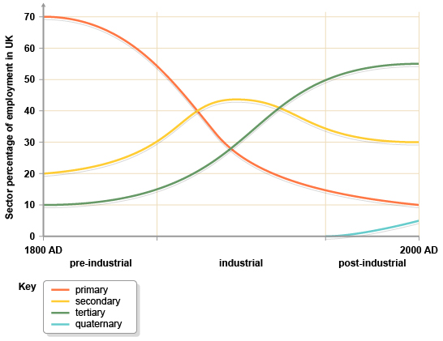
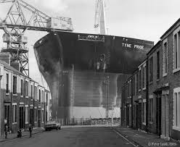
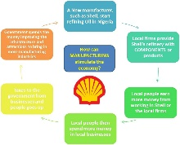
Economic and Industrial Change in Nigeria
History and Landscape
-Is a country in West Africa. Bordering Benin, Niger, Chad and Cameroon. It has a tropical climate with variable rainy and dry seasons in different parts of the country. It is hot and wet most of the year in the south, but inland there is a long dry season. -Known as the ‘Giant of Africa’ with a population of 184 million people. -Nigeria is predicted to have the worlds highest average GDP growth for 2010-2015 Nigeria supplies 2.7% of the worlds oil (12 largest producer). Politically Nigeria has a significant role as the 5th Largest contributor to UN peacekeeping missions around the world
Changes in Employment Structure |  | Industry
 |  | -Since 1999 there has been major changes in the country’s industrial structure -Industrialisation and economic growth under a stable government has increased employment in oil production, manufacturing, sugar refining, paper and pharmaceuticals. -Regular paid work= more secure income and helps to improve other sectors such as cars clothes and electrical appliances -Manufacturing industries stimulate growth through close links with each other- e.g. parts to make cars -Oil processing has created chemical by-products. Growth of a huge chemical industry such as soaps, detergents and plastics.
- Today, 53% of people in Nigeria are employed in the tertiary sector. - A large number of people in rural areas are still employed in the primary sector, although this sector is continuing to decrease with migration. - Secondary industry contributes greatly to the country’s GNI. - Increased investment in infrastructure has encouraged tourism and manufacturing.
TNCs in Nigeria: Shell
A Transnational corporation (TNC) is a large company that operates in several countries. A TNC usually has its headquarters in one country with production plants in several other countries. Transnational companies locate in foreign countries in order to take advantage of : Tax incentives, cheap labour, laxer environmental laws, access to a wider market: E.G SHELL IN NIGERIA
Social issues: - workers are able to afford their own home. - Workers rights are sometimes breached in order to make greater profits. | Economic issues: - Workers are paid 40% less than factory workers in China. -become dependent on TNC taxes. This makes TNCs powerful. |  |  | Environmental issues: - Waste disposal - chemicals buried underground leak into water courses.
Aid to Mexico
Aid to Mexico is controversial because of their high GDP. It is suggested that the government should do more to hep themselves. - Short term emergency aid was sent to the country after the 1985 earthquake that affected Mexico City. - Long term development aid projects include Casa y Ciudad, an NGO scheme supporting residents build safe homes and learning a trade as a plumber and carpenter. The scheme improves quality of life and economic wellbeing. - The International Monetary Fund (IMF) provided Mexico with debt relief (cancellation of debt) in the 1980s. This multi-lateral aid provided a $4 billion bailout. This bailout was not free, Mexico was forced to remove trade tariffs.
Impacts of Development in Mexico
Improvements in quality of life (see table). Regional inequality leads to rural to urban migration. This leads to rapid population growth (300,000 per year) in Mexico City, which leads to the growth of slum settlements. President Trump is endeavouring to reduce manufacturing in Mexico in order to increase secondary industry in the USA. In 2015 this led to Ford relocating their manufacturing plant away from Mexico.
Economic and Industrial Change in the UK
Industrialisation took place in the UK during the 1800s. Most early manufacturing industry took place in areas with coal fields which provided energy. This was a break of bulk location, reducing transport costs. |  | De-industrialisation is the decline in secondary (manufacturing) industries, and the subsequent growth in tertiary and quaternary employment. The UK has experienced de-industrialisation changing into a post-industrial economy; with more tertiary & quaternary industries. Secondary industries has moved to cheaper countries e.g. China.
Industry in the North East of England was characterised by heavy industry, including coal mines, iron and steel industry and ship building and petrochemicals. As raw materials were used up, and it became cheaper to produce steel and ships abroad, these heavy industries fell into decline. The ICI plant in Middlesborough closed making 30,000 people redundant. The Easington colliery (coal mine) closed in 1993 making 1400 people in a town of 5,000 unemployed. A lack of transferable skills made it hard for these people to find jobs.
De-industrialisation has many socio-economic impacts. High unemployment leads to the decline of services in affected areas. Reliance on benefits leads to a decline in housing quality. Life expectancy in de-industrialised areas is lower than the national average. Average GCSE grades are also lower in these areas.
Modern industrial developments in the UK
For years the UK thrived due to its secondary industries. However it is now a post industrial economy; one where most manufacturing jobs have been replaced by jobs in the service industries. A new sector that is growing rapidly is the quaternary industry. Quaternary jobs are those that involve highly skilled people who carry out research, provide information and give advice e.g. financial advisers, research scientists.
Located to the north-east of Cambridge the site is home to over 1,500 IT and bio-technology (quaternary) companies. Location factors include closeness to a major junction of the A14 which provides rapid access to the M11, and thereafter Heathrow and London. It is on cheaper land at the edge of the city. This land is flat and there is room for expansion. The proximity to Cambridge University promotes strong working relationships and access to the best University graduates. |  | Toyota, Burnaston 1.5 million cars are manufactured in the UK by 7 large TNCs. Toyota are attempting to become more sustainable in a number of ways. - They have installed 17,000 solar panels and introduced more efficient practices. They aim to reach zero carbon emissions at the plant by 2050. - They are reducing water use, using rainwater harvesting methods and ensuring that all water used is purified before being returned to the environment.
The North-South Divide
Most areas affected by de-industrialisation are in the north and west of the UK. The areas of industrial growth tend to be in the south and west. The divide has led to social and economic differences. Unemployment in the north east is 5.5% higher than the south east. Average pay is £4,000 higher in the south and life expectancy is 2.5 years longer. In attempt to reduce the differences between the north and south governments have supported a number of schemes.
HS2 / HS3 HS2 and 3 are High Speed rail links that will run from London to Birmingham, and then on to Manchester and Leeds. Benefits - reduced travel times to the north will encourage the location of industry in the north. 100,000 jobs will be created. Problems - The scheme will cost over £50 billion, lead to 600 homes being demolished, and 150 nature sites being affected. |  | Roads £6 billion will be invested in northern roads to reduce congestion. Benefit - This will encourage industrial location as it will reduce the cost associated with longer transport times. Problem - We should be discouraging road use.
Other UK Transport Improvements
London Gateway Only 30 miles from Central London. It should handle 3.5 million containers per year. Benefit: It will reduce the need for over 2,000 lorries to collect and deliver from Southampton port. |  | Heathrow Expansion Heathrow is operating at full capacity with 480,000 flights each year. A third runway, costing £20 billion will allow more flights. Benefit - Encourage more industry to locate in the UK. Problems - Cost, noise pollution and one village demolished.
Year | Life Expectancy | GNI per Capita | Fertility Rate
1980 | 67 | $680 | 5
2015 | 77 | $9,830 | 2.5

