Slide 1
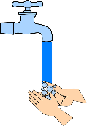
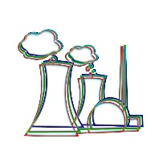
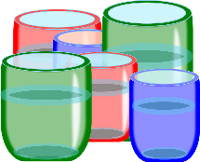
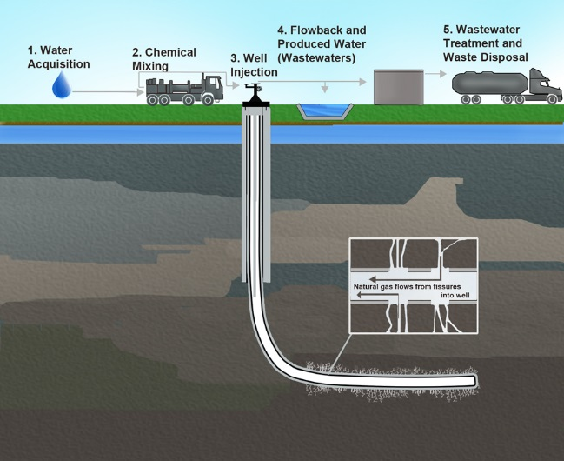
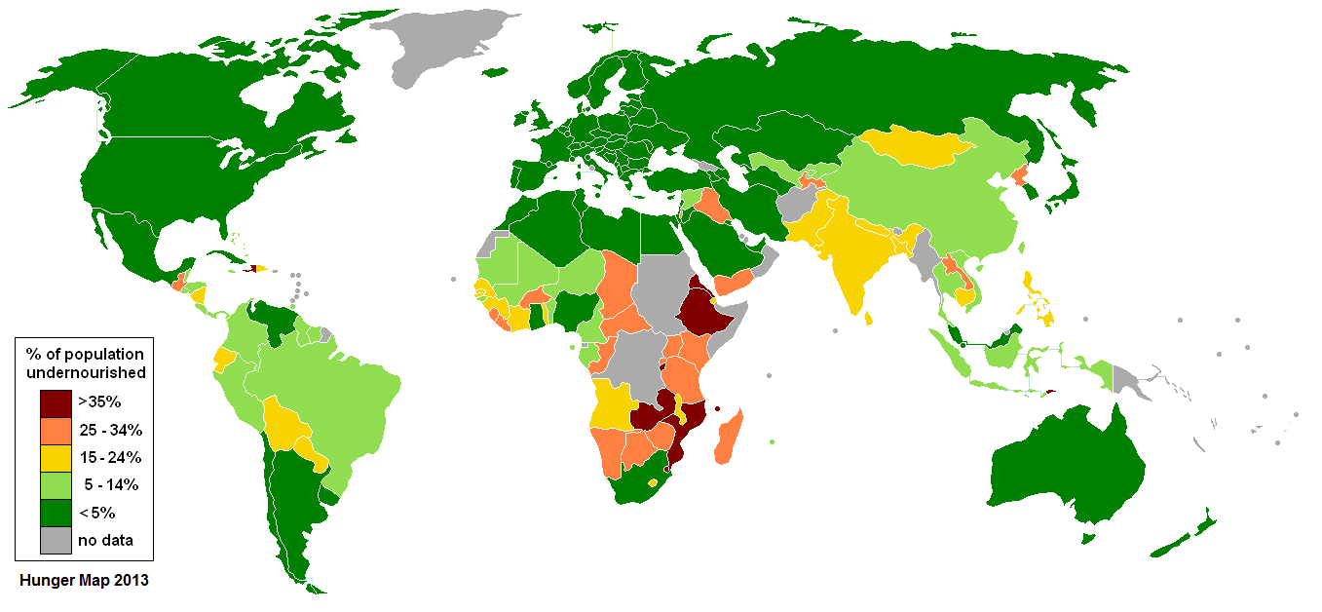
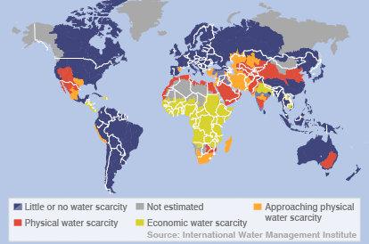
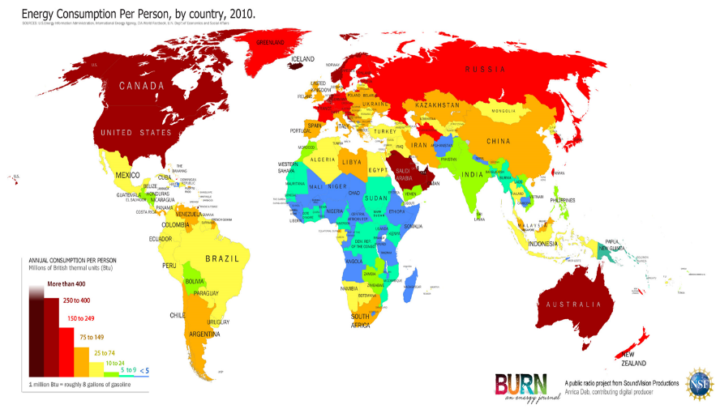
What are Resources?
Key term | Definition
Resources | Materials that have value for people. They may be needed for basic survival e.g. water, or appreciated as something that improves quality of life e.g. coffee.
Resource management | The control and monitoring of resources so they don’t become depleted or exhausted.
Surplus | When there is more of a resource than is needed to meet demand.
Deficit | When there is not enough of a resource to meet demand.
The significance of food, water and energy to economic and social well being
Water food and energy are key for human wellbeing. All lead to social and economic benefits, which all increase the standard of living and quality of life.
Food | Calories provide energy. Availability of food depends on climate, soil and level of technology. Malnourishment leads to disease and death. In children it can lead to underperforming at school which decreases economic wellbeing in life. In adults they will be less productive (less able to work). Globally more than 1 billion people are malnourished. 2 billion are undernourished (poor diet). Obesity is an issue in some areas, mainly HICs.
Water | Used for survival, washing, food production, industry. Clean, safe water enables development and allows people to break free from the cycle of poverty. Globally 2 billion people drink from contaminated water sources. Over 500,000 people a year die because of diarrhoeal diseases ana linked to contaminated water supplies.
Energy | Traditionally we get energy from oil, coal and wood. Many different sources are generated by changing technology. Used for electricity production, heating, transport and for water supply (e.g. wells). Supports industrialisation and development.
Changing demand for food in the UK creates opportunities and challenges
The growing demand for high value food exports from LICs and all year demands for seasonal food and organic produce. | Food used to be seasonally and locally sourced. Now we eat globally sourced foods all year. In 2013 47% of UK food was imported. More disposable income has led to an increased demand for greater quantities and wider choice. Not all foods can be grown the UK, and some foods can only be grown at certain times e.g. strawberries in July and August. High quality products are five times the price of similar products e.g. Madagascan vanilla, gourmet coffee. Positive impacts : Jobs and wages for those in LICs, more tax income leads to a better quality of life. Negative impacts – less land for locals to farm for themselves, high water use and exposure to chemicals (pesticides and fertilisers). Organic – no pesticides or fertilisers used. Since the 1990s there has been an increase in demand. Now worth £2 billion a year in the UK.
Larger carbon footprints due to the increased number of food miles travelled. | Food can be grown more cheaply elsewhere. Production and transport create a carbon footprint. 17% of the UK’s carbon footprint is due to food. Tomatoes have less of a carbon footprint being grown in Spain and imported to the UK than if we grew them in the UK where greenhouses would have to be heated. Annual food miles travelled by UK food imports is 18.8 billion miles. 68% of food imported to the UK is from within the EU, 32% from the rest of the world. UK are now encouraging buying local and having an allotment.
A trend towards agribusiness. | Agribusiness is a farm run as a business with the main aim being profit. Agribusiness has significant impacts on the environment as they are associated with heavy use of pesticides and fertilizers leading to reduction in wildlife and eutrophication. East Anglia has a lot of agribusinesses.
Global inequalities in the supply and consumption of resources
Food | Average UK calorie consumption is 3200 calories per person per day. Average calorie consumption in Mali is 2590 calories per person per day. Areas of greatest population growth have highest levels of undernourishment. Demand depends on changing diets and increasing population. Supply depends on climate, soil and level of technology.
Water | Fresh water is unequally distributed. Water footprint is the amount of water used per day. Global average is 1240 litres per day Bangladesh is 896 litres per day, USA is 2483 litres per day. Water scarcity (where demand is greater than supply) can be physical e.g. reduction in rainfall or economic e.g. lack of money to enable access to water. 1 in 5 (more than 1.2 billion people) live in areas of water scarcity. 1 in 3 (2.4 billion people) have no access to clean drinking water.
Energy | The richest 13% of people globally use 50% of the world’s energy. The poorest 13% of people globally use 4% of the world’s energy. Countries import and export energy. Some countries do not have their own sources of energy.
Changing demand for Energy in the UK creates opportunities and challenges
The changing energy mix | UK Energy mix in 2015 : Fossil fuels (65%) Coal 31%, Gas 25%, Nuclear 19%, Renewable sources 22%. In 1970 91% from fossil fuels. The UK has invested in renewable energy e.g. solar energy and subsidies are given by the government.
Decreasing domestic supply of oil, coal and gas. | Reserves of North Sea oil and gas are declining. EU regulations on gas emissions has led to a decrease in fossil fuel use. Energy efficient appliances and industry mean less energy is used in homes and industry.
Economic and environmental issues linked to energy use. | It is cheaper to import coal into the UK than to mine it. Nuclear Power Stations are being decommissioned and all current plants will close by 2023 – there are issues of contamination and disposal of nuclear waste. Economic issues – costs, jobs, set up costs, research, reliability. Environmental costs – ecosystems, waste, noise, emissions, pollution, radiation leaks.
Fracking – Opportunities and Challenges
Opportunities Shale gas is readily available in UK. - Will act as a bridging fuel until alternative technologies are developed. - Increased cost of of fuel makes fracking now affordable. | Challenges - Contaminated water is pumped back into the ground and can affect water supplies. - Fracking uses a lot of energy. - 3% of gas extracted is lost to atmosphere; this is methane, a greenhouse gas.
Unit 2c
The Challenge of Resource Management
Distribution of malnourishment
Distribution of water scarcity
Distribution of malnourishment

Slide 2
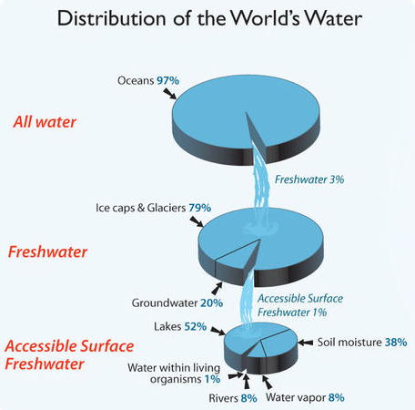
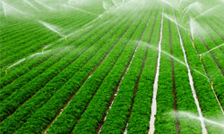
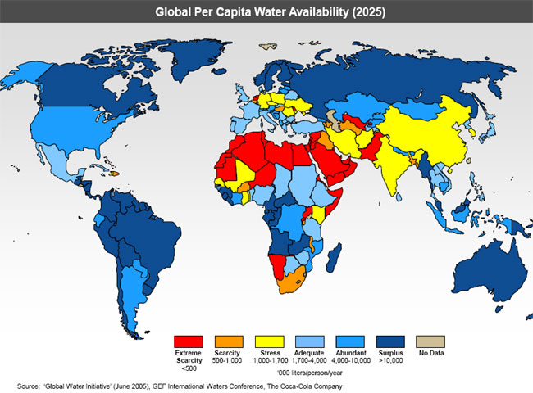
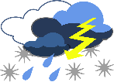
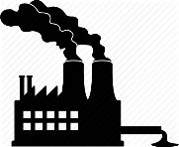
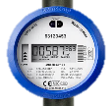
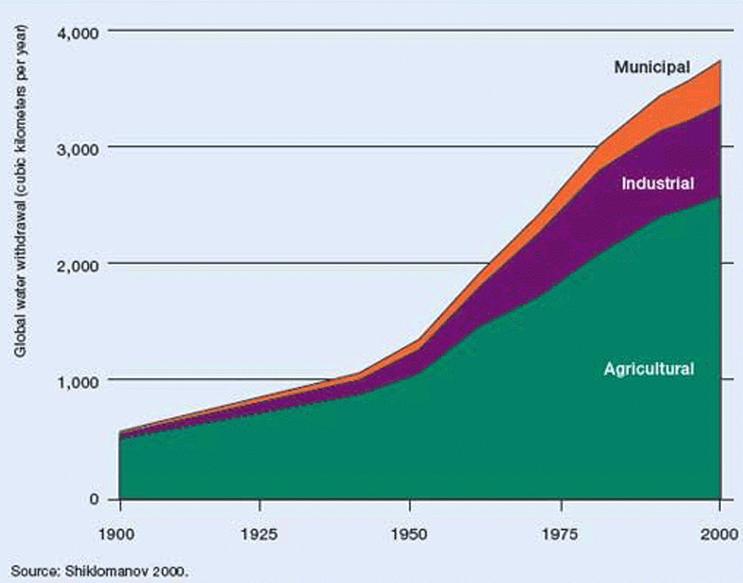
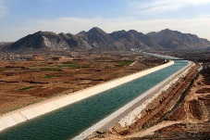
Resource Security
Key term | Definition
Water security | When the demand for water is lower than the supply of water there will be a surplus. This means that a location is water secure.
Water insecurity | When the demand for water is greater than the supply of water there will be a deficit. This means that the location is water insecure. This may also be referred to as water scarcity.
 | Security and insecurity can be used to describe access to energy and food as well.
Water availability
Only 3% of all the water on Earth is fresh water. The rest is saline (salt). Only 1% of the fresh water is readily available for use. The rest of it is stored in glaciers, and groundwater reserves. Fresh water is required for drinking, food production, and hygiene. In HICs it is also used for cleaning cars, watering gardens, golf courses and swimming pools, | Definition
Impacts of water insecurity
Water pollution | Waterborne diseases | Food production | Industrial output | Conflict
Too many chemicals from agriculture and industrial waste. Lack of water prevents chemicals being flushed away. Poor quality water affects aquatic ecosystem e.g. eutrophication. | Chemicals, raw sewage, manufacturing waste, human and animal remains end up in the water supply. With limited flow the river can’t remove it quick enough and it becomes unfit for human consumption. Dirty water leads to waterborne diseases e.g. cholera, dysentery, typhoid. | Most agriculture relies on irrigation to maintain high crop yields. If there is insufficient water of a high quality then crops can’t be grown. Safe water is needed for livestock. Reduced yields can lead to social and economic issues. | Water is needed for cooling and other industrial processes. If less water is available, or the cost of water increases, the profitability of industry decreases. Coal, gas and nuclear power need large quantities of water. Water insecurity can affect energy supplies. | When water is limited it becomes a valuable commodity. International competition can lead to tension or even “water wars”. Tensions are inevitable in large river basins which are shared by two or more countries e.g. India and Bangladesh share the Ganges.
Global Per Capita Water Availability (2015)
Factors affecting water supply
Climate | · Levels of precipitation are affected by global circulation (if air is rising or falling) and proximity (closeness) to the sea. · Areas with higher rates of precipitation are likely to have a higher supply.
Geology | · High infiltration of water (where water soaks into the soil) in places such as deserts means that water is not stored on the surfaces in lakes so is not able to be used by people easily. · Percolation of water (water soaking into the bedrock) leads to water storage in permeable rock (aquifers).
Pollution of supply | · Waste from industry causes pollution of water supplies. This may affect places a long way from the source of pollution. · HICs have laws preventing pollution of water supplies. Even if laws exist in LICs they are not always enforced. · Where sanitation is poor, human waste enters rivers and lakes. This can cause a rapid spread of cholera and typhoid.
Over-abstraction | · When water is pumped from the ground at a rate which is faster than it recharges (fills again due to precipitation percolation) the ground water level drops and wells dry up.
Limited infrastructure | · LICs have limited money to provide the infrastructure needed for water (pumping stations and pipes). This is a particular problem in rural areas.
Poverty | · Nearly one billion people do not have access to clean, safe water; 1/8th of the population. ·If people do not have money they are not able to buy clean water or filtration systems, this means they often have to walk for miles to collect water from unsafe sources. · Unclean water leads to higher rates of illness and less time available for children to go to school and adults to work. · An inability to work or become educated means that people cannot afford clean water. This becomes a vicious cycle.
Strategies to increase water supply
Diverting supplies - Rainwater can be used to recharge aquifers. This helps support a clean supply of water that has been filtered by percolation. | Dams and reservoirs - Damming a river allows water to be stored in a reservoir and controls river flow. This is a long term solution, but very expensive.
Water transfer - Water from areas of surplus is transferred to areas of deficit through canals and pipes. The infrastructure required can be expensive and areas that previously had a surplus may go into deficit. | Desalination - saline (salt) water is taken from the sea. This passes through a desalination plant to create fresh water. Water supplies cannot run out, but it uses a lot of energy and is expensive.
Sustainable water management
Water conservation - Using less water. The use of more efficient white goods and toilets reduces water use. Water meters charge for the water used. | Groundwater management - water can become polluted by fracking and mining. Governments can safeguard groundwater by creating protection zones.
Grey water / Water recycling - Water that has either been lightly used (e.g. shower water or sink water) or it is untreated rainwater. After filtering it can be used for toilet flushes.
Distribution · North America, South America and Oceania have at least adequate supplies of water. · Central Africa, northern Asia and western Europe have at least adequate supplies of water. · Several countries in southern Asia suffer from water stress. · Most countries with extreme scarcity are in the far north of Africa and the Middle East. | Explanation · Areas along the equator receive high (convectional) rainfall. · Areas between 45°N and 60°N receive high (frontal) rainfall and lower temperatures reduce evaporation. · Extreme scarcity is associated with 30° N and S, where rainfall is low (associated with high pressure zones). Temperatures increase evaporation.
A large scale water transfer scheme
South-North Water Transfer Project, China
The scheme will transfer 45 billion cubic meters of water a year from the Yangtze River in the south to the Yellow River basin in the arid (dry) north. | · 53 million people in the north benefit from access to better water supplies. · Agricultural yields have improved. · Water can be used for industry.
· Cost $62 billion. · 330,000 people were relocated because of the project. · Water loss is high due to evaporation from open channels. · Vast amounts of concrete have been used.
Water consumption
Rising population has been responsible for an increase in water use in all areas. Wealthy countries use more water, associated with domestic goods, toilets and industry. Industrial development requires water.
A local scheme to increase sustainable water supplies
in Mali
· WaterAid is an NGO that relies on charity. · They provide small scale schemes, in Mali, using appropriate technology, to provide clean water, sanitation and hygiene education. | Clean water in villages: · Improves health. · Improves productivity. · Improves education opportunities. · Reduces time used in water collection. · Increases crop yields.

