Slide 1
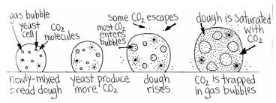
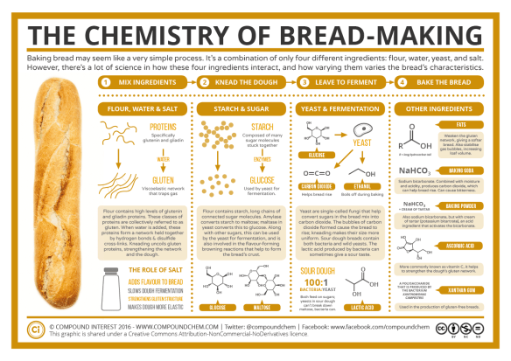
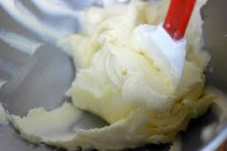
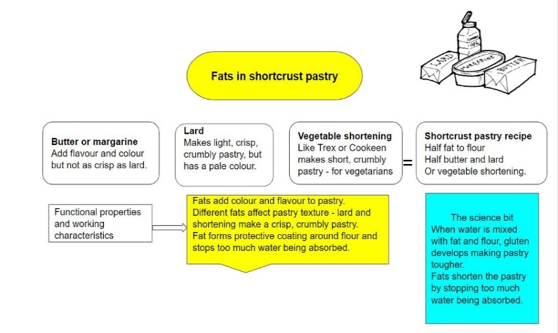
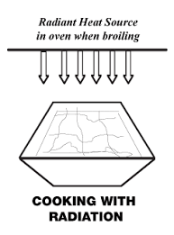
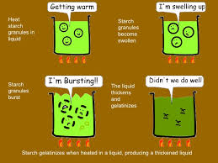
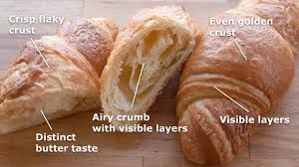
Year 9 Food Preparation and Nutrition – Knowledge Organiser LP1. Skills Focus Module
Science of bread making
Reduction is performed by simmering or boiling a liquid such as stock, fruit or vegetable juices, wine, vinegar, or a sauce until the desired concentration is reached by evaporation. This is done without a lid, enabling the vapour to escape from the mixture.
Gelatinisation – starch based sauce
Laminated dough is a culinary preparation consisting of many thin layers of dough separated by butter, produced by repeated folding and rolling. Such doughs may contain over eighty layers.
Wider thinking/further reading:
www.foodafactoflife.org.uk
Notes:
++

Slide 2
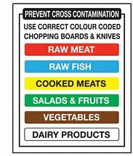
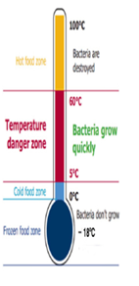
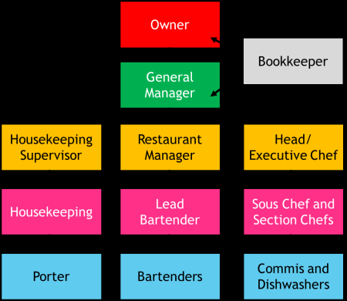
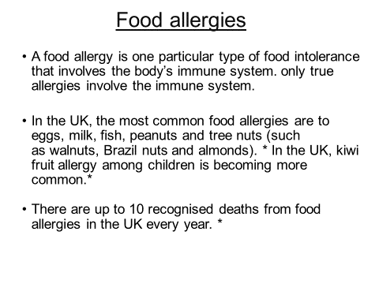
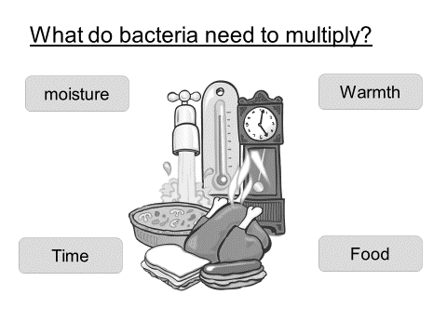
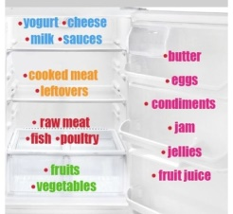
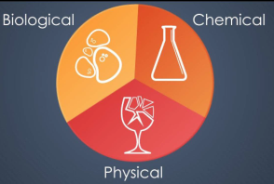
Year 9 Food Preparation and Nutrition – Knowledge Organiser TERM 1
Macronutrients and micronutrients
There are 5 main groups of nutrients. These 5 groups can be divided into 2 groups
Macronutrients which are needed by the body in large amounts.
Micronutrients which are needed by the body in small amounts.
Vitamin | Role in the body | Food examples
A | Helps to keep the eyes healthy and strengthen the immune system. | Dark green leafy vegetables, carrots, liver
B | Helps to release the energy from the food we eat. | Bread, milk, cereals, fish, meat
C | Help with skin healing and healthy skin. Help with the absorption of Iron. | Fresh fruit, broccoli, tomatoes
D | Important for absorbing calcium and help with healthy bone structure | Oily fish, eggs, butter, Sunshine
Mineral | Role in the body | Food Examples
Calcium | Important for strong teeth and bones. It also helps with blood clotting. | Milk, yoghurt, soya, dark green leafy vegetables
Iron | Needed for red blood cells which help to transport oxygen around the body. | Nuts, whole grains, dark green leafy vegetables, meat, liver
What are Nutrients? Nutrients are the building blocks that make up food and have specific and important roles to play in the body. Some nutrients provide energy while others are essential for growth and maintenance of the body.
Macro Nutrient | Role in the body | Food Example
Carbohydrate | The main source of energy for the body. | Bread, rice, pasta, potatoes
Protein | Provides the body with growth and repair. | Meat, poultry, beans, eggs, lentils, tofu, fish
Fat | Provides the body with insulation and a small amount protects vital organs. Provides essential fatty acids for the body. | Butter, oil, cheese, cream, nuts, oily fish, crisps
Factors affecting food choice
Biological | Hunger appetite and taste
Economic | Cost of food, income, availability
Physical | Access to shops, food skills, education, time
Social | Family, culture, meal patterns
Attitudes | Knowledge about food and beliefs
Seasonality | The food is locally grown at certain times, cheaper
Religion | Certain religions restrict certain foods
Ethical | Your beliefs prevent you from eating some foods
Medical | Some illnesses dictate your diet like diabetes
Age | Activity levels and mobility affect requirements
RESTAURANT STAFF
METHODS |  | EQUIPMENT
Knead Sauté Deep fry Bake Braise Boil Roll Enrobe | Fold Simmer Bake Chop Grate Combine Baste Roast | Bread Knife Vegetable knife Grater Bain Marie Whisk Pastry brush Rolling pin Pasta machine | Colander Table spoon Teaspoon Dessert spoon Spatula Fish slice Saucepan Frying pan
You should store meat and poultry on the bottom shelf of the fridge to prevent liquid dripping on to other food. Store in a clean, sealed container. Keep cooked and raw meats separate to avoid cross contamination. The fridge temperature should be between 1 and 4 degrees Celsius.
Wider thinking/further reading:
www.foodafactoflife.org.uk
www.wjec.co.uk/qualifications/hospitality-and-catering
www.food.gov.uk
Food Hazards
Notes:
++

