Slide 1
Do now task
How much can you remember?
Name the case ‘Brown vs………?’
How many blocks did Linda Brown have to walk to school?
What was the name of the court in which the case took place?
What ‘organisation’ helped the Browns take the board of education to court?
Pencil cases out
Coats and bags off

Slide 2
The Greensboro sit-in
Learning objectives
Today I will examine the events of the Greensboro sit-in.
Today I will evaluate the significance of the Greensboro sit-in.
Key words
-Greensboro
-sit-in
Segregation

Slide 3
Read it:
Significant
Define it:
sufficiently great or important to be worthy of attention
Deconstruct it:
Latin- signum= ‘token’
Example:
The Battle of Hastings was a significant event.
WOW
Link it:
Important, special, noteworthy
Digging deeper:
Somebody's partner can be referred to as their significant other

Slide 4
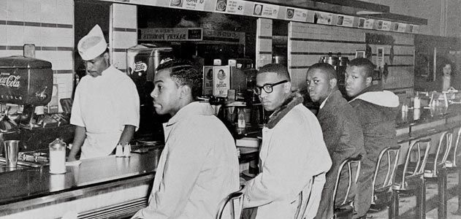
Starter – Do now
Examine this picture.
What do you see?
What does this tell you about protesting?
What does this have to do with segregation?
Notes:
Students to interpret and come up with their own answers
Greensboro sit-in at a lunch counter which did not serve black people at the counter. A peaceful non-violent protest.

Slide 5
Watch the video clip and answer the questions
https://www.youtube.com/watch?v=f82cAuXM4IE
What type of people were the protesters doing the sit-in?
What was the reaction to the protesters?
How did the protesters react?
Notes:
Watch video clip is under 2 mins may have to play twice
Young, black, students
Violent, aggressive, angry
Peacefully – non violent

Slide 6
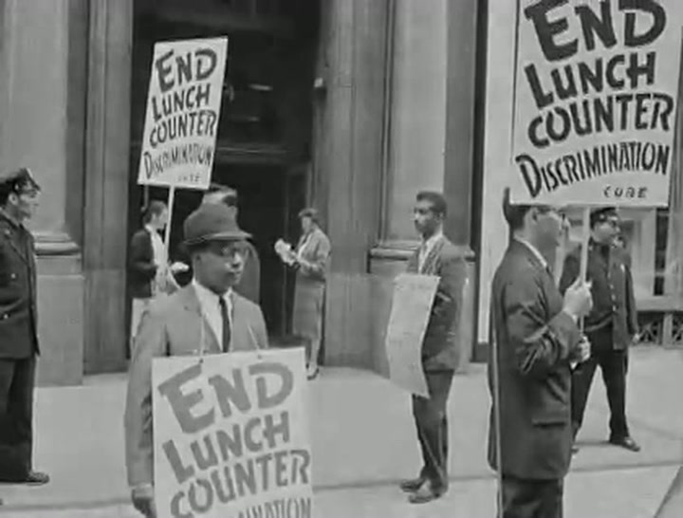
This campaign started in Greensboro, Alabama on the 1 February 1960.
Four black students (Izell Blair, Franklin McCain, Joseph McNeil & David Richmond) ordered food at a white people only lunch counter and were refused service.
Events
They refused to move and returned to the same lunch counter the next day with more protesters.
The idea of sit-ins spread quickly and within weeks thousands of people took part.
Impact
The sit-ins were broadcast throughout the US on TV news, gaining more publicity.
Many white people joined civil rights groups and took part in the sit-ins with the black protesters.
Challenge
Why do you think getting publicity on TV was important to the Civil Rights Movement?
Notes:
Read, explain, discuss and can note take key info.

Slide 7
Significance of Greensboro sit-in
It attracted many other protests across US.
The media reported it and the world watched it on TV.
Significance of Greensboro
Sit-in
Challenge
What do you think was the most significant outcome from the Greensboro sit-in?
White people joined civil rights groups and joined the sit-ins.
Lead to the desegregation of the lunch counters.
Notes:
Ask the class (oracy) What do they think was the significance of the Greensboro sit-in?
Pull ideas together and list/record in a spider diagram or note form.

Slide 8
Storyboard – on a new page divide it into six boxes
1 Feb 1960 Greensboro 4 black students sat at the lunch counter. | Lunch counter was segregated and staff refused to serve them. | Next day 25 students arrived and sat at the counter in shifts.
Word spread and the sit-ins spread across US and became national news. | Some protesters were attacked, insulted and arrested. | 25 July 1960 the lunch counters were desegregated in Greensboro.
Notes:
Storyboard task – students to complete in their books
Record the sentence in each box and draw the scene.

Slide 9
Explain the significance of the Greensboro sit-in (6 marks)
The Greensboro sit-in was significant because …
It was also significant because …
It was significant because it led to …
Finally, the Greensboro sit-in was significant because …
Notes:
Explain question 6 marks
Sentence starters on the slide, students can use their spider diagram to assist them and structure strips in folder.

Slide 10
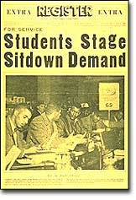
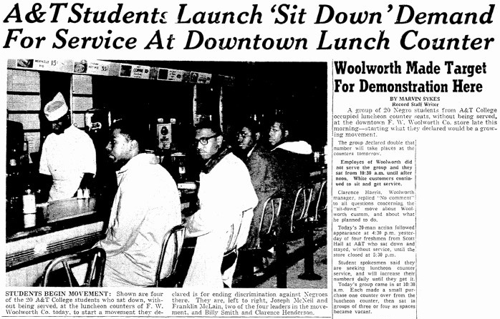
Plenary – Write a newspaper article about the Greensboro sit-in
Your newspaper article must have:
-A main heading
-A sub-heading
-A picture
-It must explain what is happening
-It must explain why is it happening
Include the following words
-Segregation
-Integration
-Civil Rights
-Greensboro
Notes:
Plenary or a homework task

