Slide 1
WALT
Know how to calculate density
Wilf
Recall the density equation and density units
Calculate density using the equation
Rearrange the equation to find mass and volume

Slide 2
Do Now
What are the units of mass?
What are the units of force?
What do we mean by emit?
What do we mean by absorb?
Which surface is the better emitter and absorber of IR radiation?

Slide 3
Density
Density is a measurement of how much matter is in a given space
Density = Mass
Volume
Mass can be in g or kg
Volume can be in m^{3 or} cm³
Density units are kg/m3 or g/cm3

Slide 4
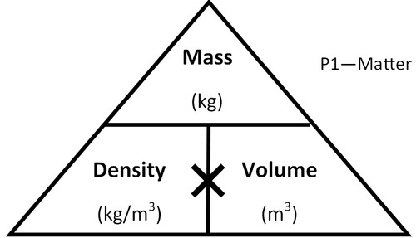
Example
An object has a mass of 2kg and a volume of 3m³
Calculate the density of the object
What am I finding ? - density
So I cover up p and it leaves me with….
Now I need my triangle
m/v
2/3
Don’t forget the units – I’m going to need them!
So now I substitute my values?
Now calculate
2/3= 0.67
kg/m³

Slide 5
Trickier:
An object has a mass of 2500g and a volume of 0.5m³
Calculate the density of the object in kg/m³
What am I finding ? - density
So I cover up p and it leaves me with….
Now I need my triangle
m/v
2.5/0.5
Don’t forget the units – I’m going to need them!
So now I substitute my values?
No!!! Convert g to kg – how?
2500/1000 = 2.5kg
Now calculate
2.5/0.5= 5
kg/m³

Slide 6
You try:
An object has a mass of 200g and a volume of 50cm³
Calculate the density of the object in g/cm³
What am I finding ? - density
So I cover up p and it leaves me with….
Now I need my triangle
m/v
200/50
Don’t forget the units – I’m going to need them!
So now I substitute my values?
Yes – units in g and cm³
Now calculate
200/50= 4
g/cm³

Slide 7
How can you use the triangle to find volume?
Rearranging the equation:
How can you use the triangle to find mass?
So I cover up m and it leaves me with….
Now I need my triangle
p x v
So I cover up v and it leaves me with….
m/p

Slide 8
Questions:
Calculate the volume of an object with a mass of 20kg and a density of 1.6kg/m³

Slide 9
Questions:
Calculate the mass of an object with a volume of 30m³ and a density of 0.8kg/m³

Slide 10
Do Now
What is the equation linking mass, volume and density?
Give 2 units we can use for density.
Which state of matter is the least dense? Why is this?
Draw out the density triangle
How do you calculate the volume of a cube?

Slide 11
Required Practical 2
Know how to carry out a practical to measure the density of regular and irregular shapes
https://www.focuselearning.co.uk/s/4ty4g6qmfo3t

Slide 12
Finding the density of a regular shape
Cubes etc.
How would you find the mass ?
How would you find the volume?
Think about the equipment you would use for each of the above.

Slide 13
Results
Object | Mass (g) | Height (cm) | Width (cm) | Length (cm) | Volume (cm³) | Density (g/cm³)

Slide 14
Do now
What happens to the density of a material as it melts?
What happens to the density of a gas as it condenses?
What do we call the process when a liquid becomes a gas?
How do you calculate density?
If a material is a good insulator, does it have a low or high thermal conductivity?

Slide 15
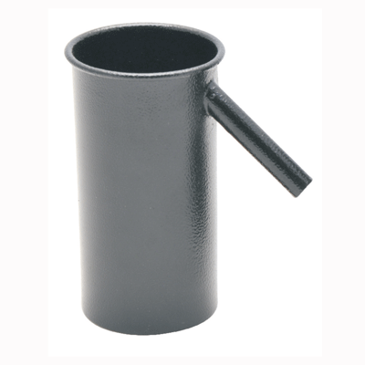
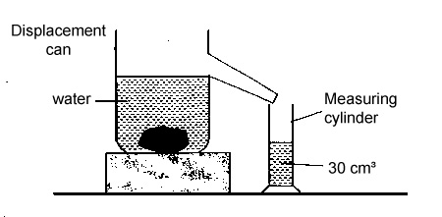
Required practical - Irregular shapes
To find the volume of irregular shapes we use a displacement can.
The volume of water displaced is the volume of the object placed in the water.

Slide 16
Object | Mass (g) | Volume (cm³) | Density (g/cm³)

Slide 17
Task
In your books write a method (can be bullet points) that explains how to find the density of a regular shaped object.
You must include how you are going to use the equipment

Slide 18
Task
In your books write a method (can be bullet points) that explains how to find the density of an irregular shaped object.
You must include how you are going to use the following equipment
Measuring cylinder
Mass balance
Displacement can

