Slide 1
DO NOW
Which of the following are common ways of disrupting an online shopping website?
Choose two options.
Denial-of-Service Attacks
Ransomware
Website Defacement
Stealing Customer Data
Which of the following are non-financial examples of why cybersecurity attacks are performed?
Choose two options.
Overcome personal goals of ‘beating’ an organisation’s cybersecurity measures.
Stealing customer financial data.
Stealing intellectual property from a rival business.
As revenge by employees who feel mistreated by a business.
Notes:
1 A & C
2 A & D

Slide 2
EXTERNAL THREATS

Slide 3
Social Engineering Threats
This is where we trick someone into revealing private information.
This doesn’t even need technology & could be face-to-face.
Common social engineering threats include:
Phishing
We do this by using human psychology and social techniques.
Shoulder Surfing

Slide 4
Phishing
This usually takes place via an email or phone service.
It contains some form of request:
The goal is usually either to:
involves an electronic message being sent to an individual.
Click on a link
Reply with information
Get the user to reveal confidential information
Infect the users computer with malware so data can be stolen later

Slide 5
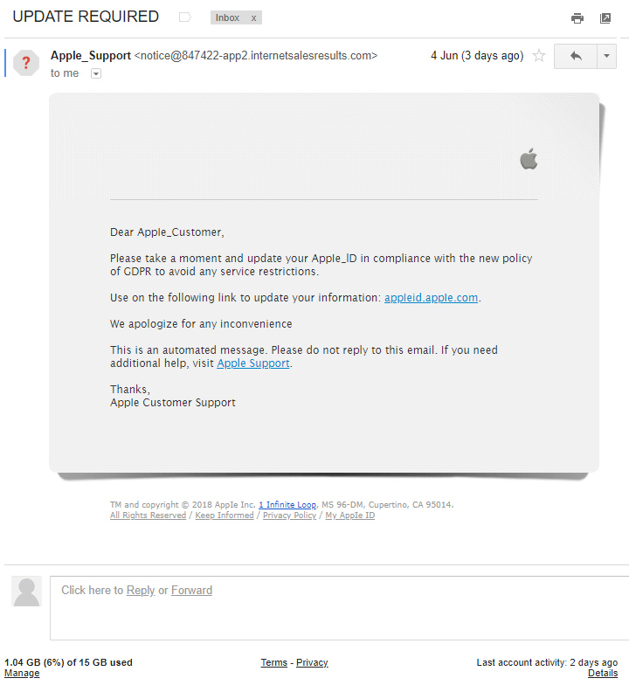
Phishing - Task
Look at the email on the right.
Identify what indicates this is a phishing attempt.
There are some key indicators an email is for phishing.
Try to identify up to 5 possible indicators.

Slide 6
Phishing - Task
Attempts to create urgency
Email obviously not from Apple
Generic greeting line
Spelling, grammar & punctuation errors
Suspicious links

Slide 7
Shoulder Surfing
Involves observing someone entering in information in order to steal it.
It could just as easily be used to observe you typing in your password.
This would be commonly used for stealing a PIN number.
The attacker stands behind at the ATM and watches you enter your PIN.
They can then use this information to gain unauthorised access.

Slide 8
Malware Threats
Malware stands for malicious software.
Common types of malware include:
Virus
We most commonly know the term “virus”.
This is just one form of malware though.
Worm
Botnet
Rootkit
Trojan
Ransomware
Spyware

Slide 9
Viruses, Worms & Trojans
Viruses
Trojans
Similar to viruses, except they do not require the need to attach themselves to programs/files.
Malicious code disguised as a legitimate piece of software but contains a harmful payload.
Worms
Spreads from computer to computer, attached to a legitimate piece of software or file.

Slide 10
Botnets, Rootkits, Ransomware & Spyware
Botnets
Ransomware
Enables an attacker to remotely control your computer.
Secretly encrypts local files then asks for some sort of fee, or other demand, to decrypt the data.
Rootkits
Adds your device to a ‘network’ of computers to carry out a DOS attack.
Spyware
Gains access to the system and works in the background to monitor a user’s actions.

Slide 11
Unauthorised Access/Hacking
Where an individual gains access to a system without permission.
There are two main types of hackers
Hacking doesn’t necessarily involve any clever technical skills.
White hat hackers – security professionals that find exploits in a system to help a business fix vulnerabilities.
Black hat hackers – a malicious individual who gains access in order to steal information.
Often it’s the result of social engineering tricking someone into revealing a password.

Slide 12
Denial of Service Attacks
Where servers are flooded with traffic to overwhelm resources.
This will make the service unbearably slow, or completely unusable.
A special type of this is a DDOS attack.
This is a “Distributed Denial of Service” attack.
This is where the attack comes from many computers.
Usually these computers are forced to launch the attack by botnet malware.
The primary goal is to disrupt a service.

Slide 13
Pharming
This misdirects users to a fake website without the user’s knowledge.
This is where the domain name system table is modified.
Domain name poisoning is a form of pharming.
This usually has the end goal of stealing personal information.
When you type in a URL the DNS system will direct you to a different website.
So you might type www.google.com but get taken to a spoofed site.

Slide 14
Man-in-the-Middle Attacks
Where someone inserts themselves into a communication.
They can then listen/read any data being passed through them.
An example might be setting up a fake WiFi access point.
Anything transmitted on this connection would pass through the access point.
This usually has the end goal of stealing personal information.
People connect to the access point thinking it’s legitimate.
The malicious user could therefore access all that data.

