Slide 1
SELECTION OF CLOUD TECHNOLOGIES

Slide 2
DO NOW
When selecting an online service, which of the following statements are true?
You should choose the service with the most features.
You should choose the service with the features that you require.
You should choose the service with the most complex features available.
You should choose the service with the fewest features.

Slide 3
The Selection of Platforms & Services
A cloud service provider runs data centres filled with cloud servers.
Different cloud service providers offer different services.
There are usually unique characteristics that help choose a service.
The provide access to these cloud servers in return for a fee.
Number & complexity of features
Paid vs Free
Interface Design
Available Devices

Slide 4
Number & Complexity of Features
Depending on what cloud service you select, it will offer different features.
We want to choose a service that provides the features we need.
Some services will offer more features than others.
Some services will offer more complex features than others.
We should avoid services that offer excessive features.
This can make the service complicated and difficult to use.

Slide 5
Paid vs Free
Free cloud services will offer a starting amount of storage or software access.
This will normally give more storage, increased features & better support.
You can normally pay in order to gain more storage & greater features.
Often businesses have their own pricing based on number of users.

Slide 6
Paid vs Free - Task
Research a cloud service provider, such as Google Drive or DropBox.
What business level services do they offer?
What level of service do they offer for free?
What do they offer if you pay more?

Slide 7
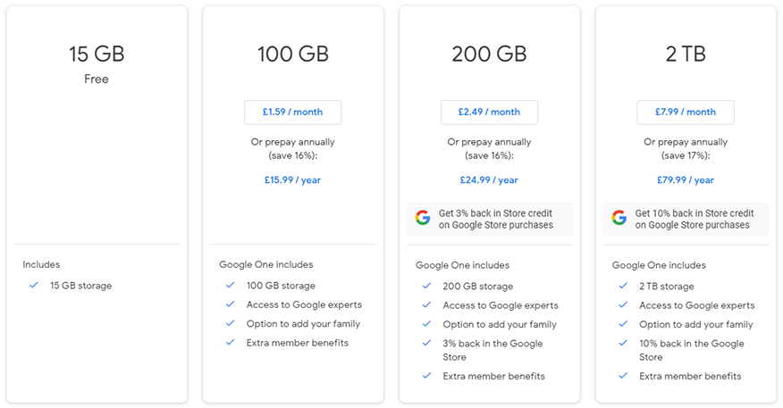
Paid vs Free - Task

Slide 8
Interface Design
The interface design of the cloud service affects how easy it is to use.
Some of the important interface design features to consider are:
You likely would avoid services that are difficult to navigate.
This is especially important when users are not very IT literate.
Layout
Accessibility
Mobile vs Desktop

Slide 9
Interface Design
Layout
Accessibility
Mobile vs Desktop
A user interface’s layout needs to be simple and intuitive to use.
The cloud service should be accessible to those with individual needs.
The interface might need to be used on mobile.
The interface being familiar to other interfaces previously used helps.
This could be making it adaptable & by supporting accessibility technologies.
The interface should be adapted to a mobile display screen in these cases.

Slide 10
Available Devices
Available devices refers to what kind of device the service is available on.
It may be the case that a cloud app is only usable on certain platforms.
Usually we can access cloud service via your web browser.
However, cloud services often have apps that will provide certain features.
Syncing your computer with a cloud storage service.
Providing notifications of events.
This will be platform independent.

Slide 11
Using Cloud & Traditional Systems
Cloud services can often be used alongside traditional systems.
There are certain features help support this.
Many service providers offer apps that help these systems work together.
Device synchronisation
Online/offline working
Notifications

Slide 12
Device Synchronisation
Cloud storage & local storage can be synced together.
It also means your files are automatically backed up to a remote location.
This means we can access local copies for quick loading and saving.
But the files are also kept up-to-date & consistent on multiple devices.
Usually you’ll have a cloud folder on your computer you can save files to.

Slide 13
Online/Offline Working
Cloud services often provide an offline mode so you can use without internet.
Some online software also provide offline modes for working locally.
This means you can continue working even if your internet is down.
Files saved while offline will then be uploaded once the internet is available.

Slide 14
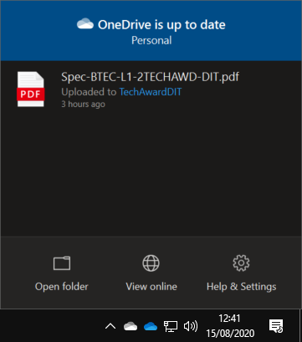
Notifications
Cloud service apps allow notifications to be sent to your PC.
Commonly this might show:
This will often appear in your system tray with an icon for your cloud provider.
Successful syncing with the cloud
Upload/downloads currently taking place
Issues where syncing has failed
Upcoming event from your calendar

