Slide 1
SA
“Do Now”
Name two substances that need to be taken into a plant for photosynthesis
2. What chemical is used to test for protein?
3. Which enzyme breaks down protein?
4. Which gland releases oestrogen?
5. What is ovulation?
Carbon dioxide and water
Buiret
Protease
Ovary
When an egg is released from an ovary

Slide 2
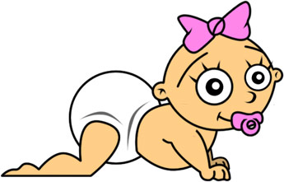
WALT: Understand how fertility is controlled
WILF:
GW; You can identify the hormones that could be used to control fertility.
BI: You can explain WHY they could be used.
EI: You can identify some advantages and disadvantages of both uses of hormones.

Slide 3
What can you remember??
Which gland releases FSH?
Which gland releases oestrogen?
Which hormone thickens the spongy uterus lining?
On which day is LH hormone released?
Which hormone switches off FSH?
Which hormone ripens the eggs?
Which hormone causes ovulation (egg release)?
Which gland releases LH?

Slide 4
Moving on…….
Thinking back to the hormones we looked at last lesson, can you decide which of the four hormones could be used in the following situations?:
a) Increasing the likelihood of pregnancy?
b) Decreasing the chances of a pregnancy?

Slide 5
Brain
3) Next, the Brain releases another hormone called LH, which makes the ripe egg burst from the ovary ready to be fertilised.
2) The ovary releases a hormone called Oestrogen – this stops more FSH being made. It also thickens the uterus lining.
1) A Hormone called FSH is released from the PITUITARY GLAND, which tells an egg to ripen
Ovaries
4) Finally, the ovaries release another hormone called progesterone – this keeps the uterus lining thick.

Slide 6
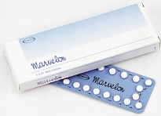
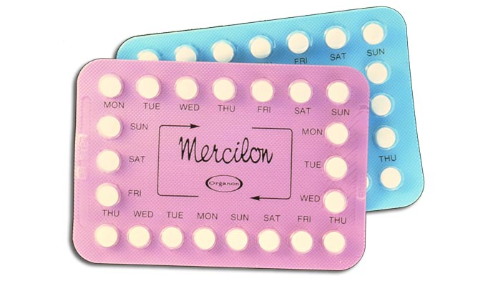
Prevention of pregnancy
Oral contraceptives contain hormones – Oestrogen and Progesterone.
They work because the Oestrogen stops the pituitary gland releasing FSH – no eggs ripen.
The first oral contraceptives contained very large doses of Oestrogen – this meant that there were lots of side effects.
Modern contraceptives contain a much lower dose of Oestrogen

Slide 7
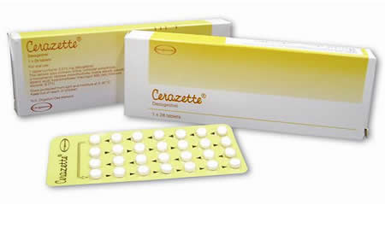
Some oral contraceptives only contain Progesterone, so these have even fewer side effects.
It works by thickening the mucus that is produced by the cervix (entrance to the womb) to stop sperm cells swimming up into the womb and along the fallopian tubes.

Slide 8
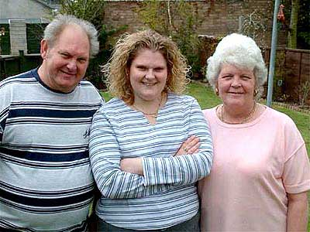
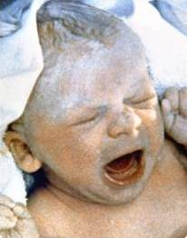
Who is this person and why is she special?
Louise Brown the 1st IVF baby!!

Slide 9
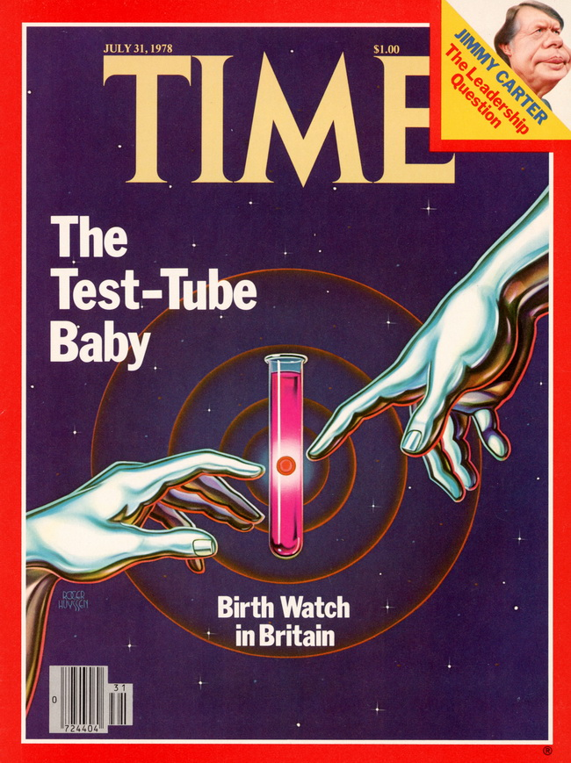
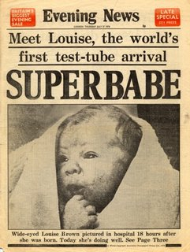
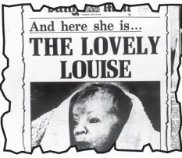

Slide 10
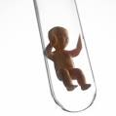
What is IVF?
What is IVF? Write down any ideas you might have about this process.
In vitro fertilisation (IVF): fertilisation that happens in the laboratory outside the mother’s body.
(Latin: ‘in vitro’ literally means ‘in glass.’)
‘Test tube baby’ is a popular term for this process. However…this is not correct as the process never takes place in a test tube!

Slide 11
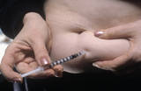
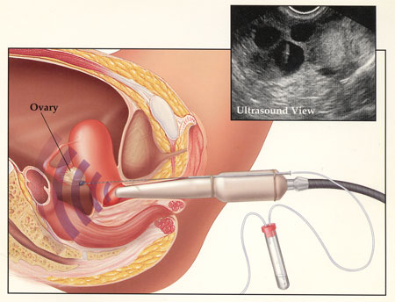
Increasing the likelihood of pregnancy
The female is given large doses of the hormones FSH and LH – these ‘over ride’ her own hormones.
The ripened eggs need harvesting – this is often done using ultrasound and fine needle.

Slide 12
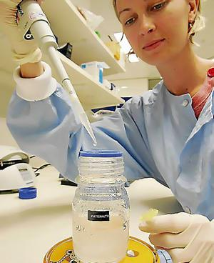
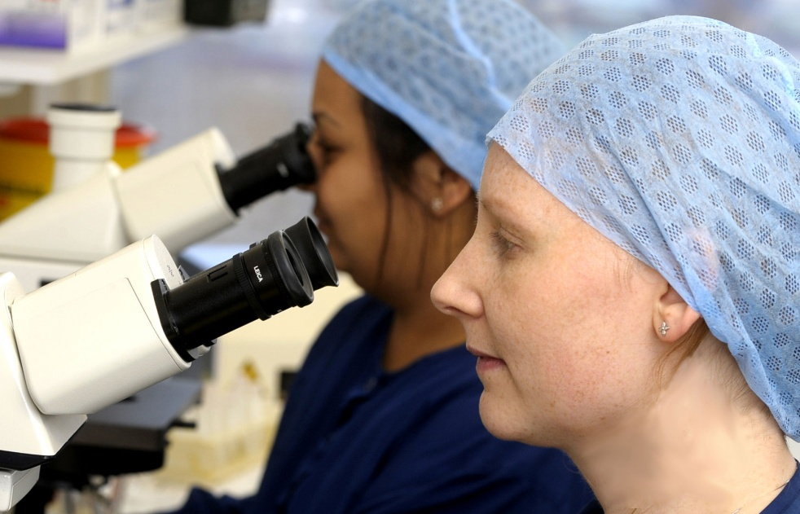
A sperm sample from the father or a donor is obtained – it needs to be kept warm.
The sperm cells are checked under the microscope – only the best looking sperm cell is selected for use.

Slide 13
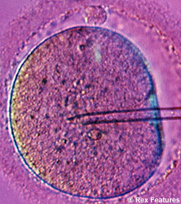
The sperm cell is drawn up into a pipette, which is then pushed through the egg cell membrane. The sperm cell is injected into the egg – fertilisation!

Slide 14
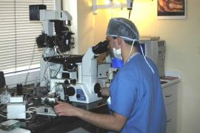
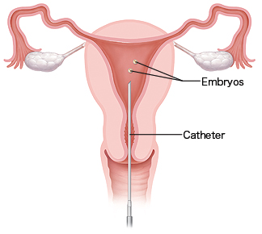
The fertilised eggs are checked to see if they have begun to divide and form embryos.
Two embryos are selected for re-implantation. This is done using a tube called a catheter which contains the embryos
Notes:
RAJO DEVI LOTHAN INDIA AGED 70

Slide 15
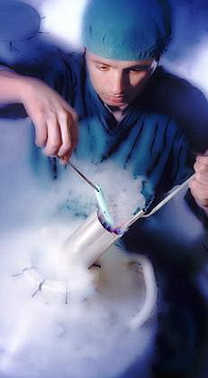
Any un-used embryos may be frozen in liquid Nitrogen and used in the future. They tend to be stored for up to ten years.

Slide 16
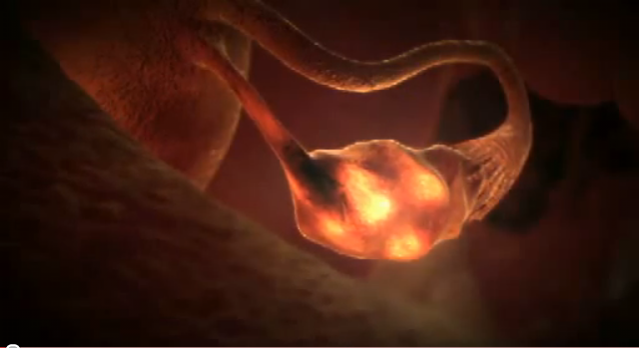
Stages of IVF

Slide 17
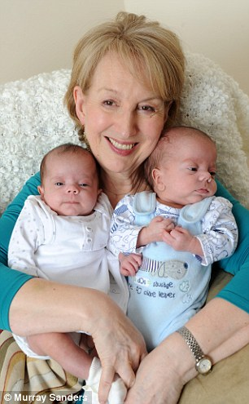
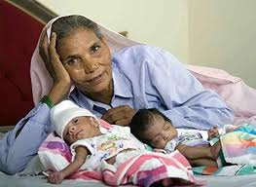
Who should be allowed?
Omkari Panwar from India gave birth to twins, a boy and a girl via emergency Caesarean section, on June 27, 2008, at the age of 70.
Carole Hobson was 58 when she became Britain’s oldest mother of IVF twins in 2010.

Slide 18
 | Advantages of controlling fertility | Disadvantages of controlling fertility
The Pill
IVF

Slide 19
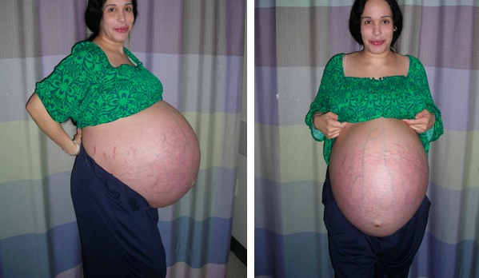
What are some of the other issues?

Slide 20
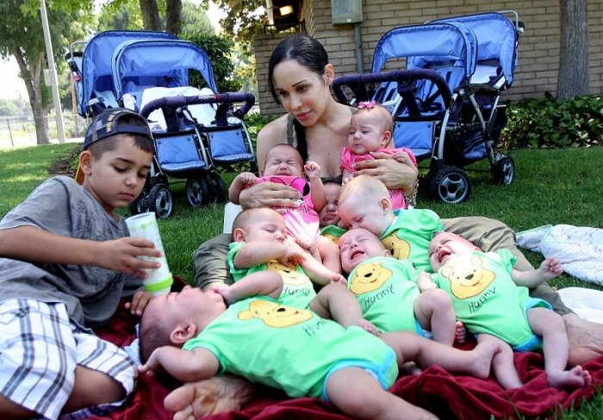
Caring for multiple babies is expensive and a lot of hard work!

Slide 21
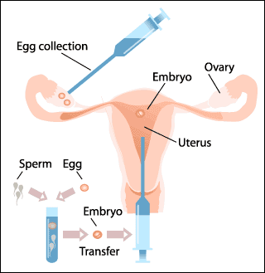

Slide 22
A sample of semen containing sperm cells is collected from the man.
The eggs are placed in a special solution to keep them alive.
FSH is injected into the women. This stimulates the eggs to mature within the ovaries. They are then collected (harvested)
When the fertilised eggs have formed embryos, one or two are placed back inside the uterus of the mother.
The eggs are checked under the microscope to check whether they have been fertilised by the sperm cells.
The eggs and sperm are placed in a petri dish together.

Slide 23
Controlling fertility summary
The pill contains h________ called O_______ and p______ which stop the pituitary gland releasing any F___. This means that no e_____ can m________ or be released.
F______ drugs contain h_______ called FSH and LH. The FSH makes l______ of e______ ripen in the o_______ all at once.
eggs progesterone fertility hormones ovary oestrogen lots FSH mature

Slide 24
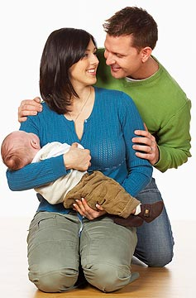
Controlling fertility - Advantage or disadvantage??
There are lots of different opinions about whether controlling fertility is a good or bad thing – look at each of the opinions and decide whether they are ADVANTAGES or DISADVANTAGES to society
1) IVF has allowed many childless couples, like us, to have children of their own and achieve what they want.

Slide 25
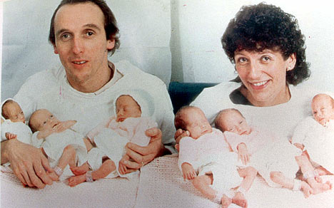
2) IVF can produce multiple pregnancies e.g. Twins or triplets or more. Parents may struggle to cope physically, mentally and financially with lots of babies.

Slide 26
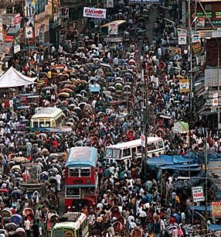
3) The contraceptive pill can help to control the populations of some countries such as China and India, which have too many mouths to feed.

Slide 27
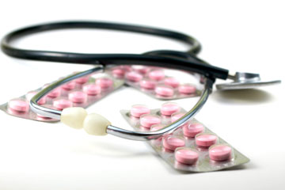
4) The pill can cause health problems such as high blood pressure and blood clots, so it does has some health risks for women.

Slide 28
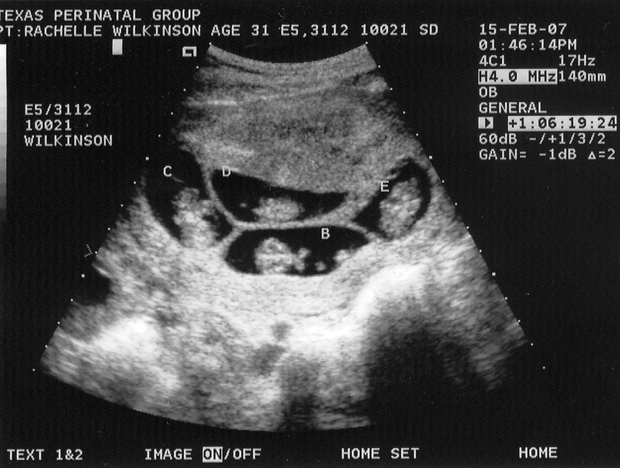
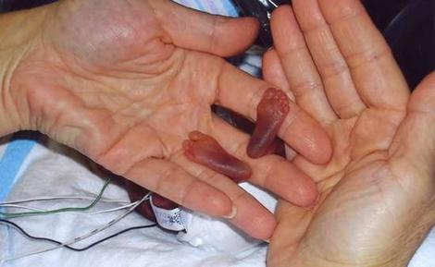
5) IVF can create multiple pregnancies and it can be tragic for parents if some of the babies do not survive. It also costs hospitals lots of money to keep tiny premature babies alive.

Slide 29
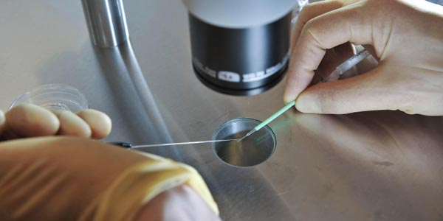
6)IVF treatment costs the NHS a lot of money and it is not always a success the first time round. Sometimes more than one attempt is needed.

Slide 30
7) The pill has given women like me greater control over their own lives – they can choose when they are ready to have a child.

Slide 31
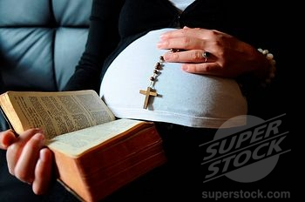
8) Many religious groups think that preventing a woman from becoming pregnant is denying the creation of life

Slide 32
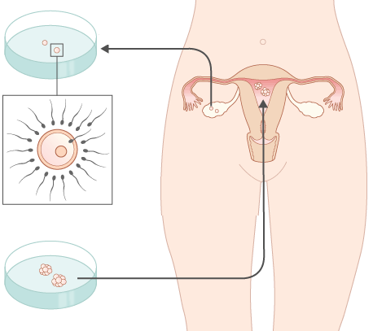
What happens to create an IVF baby?

