Slide 1
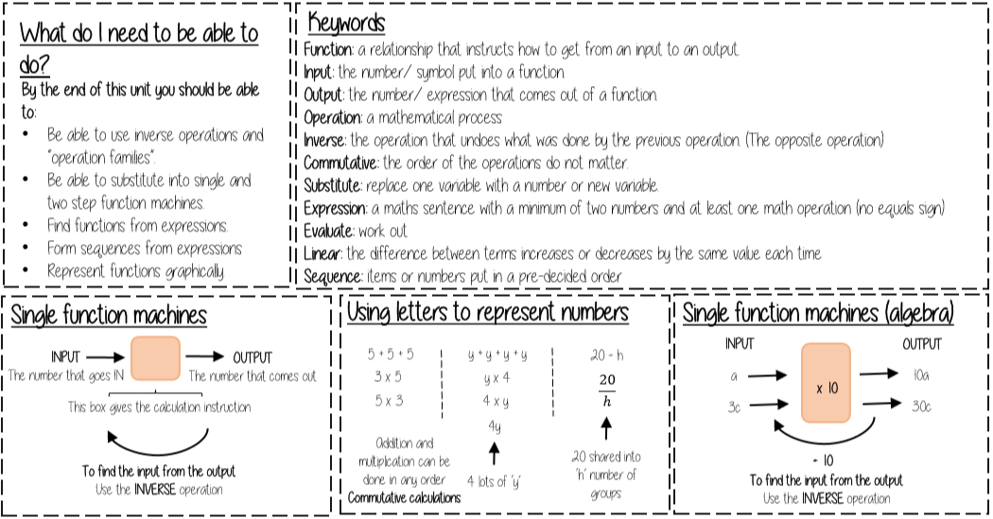
Y7 Knowledge Organiser – Algebraic Notation
Key Information
Key Information

Slide 2
