Slide 1
Do now task
How much can you remember?
How are tropical storms measured?
How would tourism in the UK change due to climate change?
What does interdependence mean?
What is the brain drain?
Pencil cases out
Conduct cards in pencil cases
Coats and bags off

Slide 2
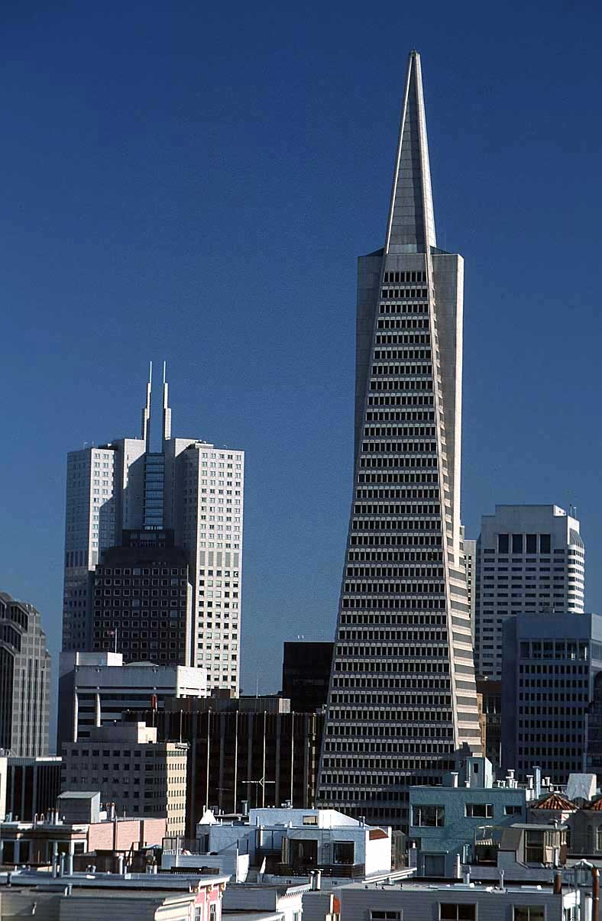
What are the 3Ps of tectonic hazards?
Learning Outcomes
LO1: Apply knowledge of plate boundaries to a 6 mark exam question.
LO2: Assess the extent to which prediction is the most important factor when reducing the impacts of earthquakes.

Slide 3
Activate – Statistics in Geography
Year | Death Toll
2009 | 1001
2010 | 5003
2011 | 315
2012 | 627
2013 | 349
2014 | 3504
2015 | 202
Calculate the interquartile range.
Range the values in order from highest to lowest.
Upper quartile – n + 1 divided by 4.
Lower quartile = n + 1 divided by 4, x3
Subtract the two figures to get the interquartile range.
N = Number of values.

Slide 4
Activate: Why do people still live in earthquake areas?
Think. Pair. Share. List some reasons why you think people would still choose to live in earthquake prone areas.
A pleasant environment (San Francisco)
Beaches, warm weather
Modern city (Kobe, San Francisco)
Lots of facilities, entertainment,
Prepared for earthquakes (Japan, California)
New buildings have strict regulations, emergency services, people aware of what to do in an earthquake
Economy (Haiti – prospect of jobs in Port au Prince)
Employment opportunities
Family and friends
Can’t afford to leave (Haiti)
Willing to take the risk (Haiti – no earthquake for 200 years before 2010 quake)
Devastating earthquake may not happen in their lifetime

Slide 5
Demonstrate: 3Ps
Predict
How we monitor earthquakes to know if they will occur.
Prepare
Knowing how to act in an earthquake in order to save lives. Having a clear plan in place to deal with the hazard.
Protect
What the government can do to stop the earthquake being as damaging e.g. to buildings

Slide 6
Protection – Earthquake Proof Buildings
You researched this for homework.
In your book, bullet point the ways in which buildings can be made more earthquake proof.

Slide 7
Prediction
Foreshocks: An increase in the frequency of small earthquakes (foreshocks) have been used to predict large earthquakes. However, only about 5% of foreshocks lead to bigger earthquakes so there can be a lot of false alarms.
Seismic History: Seismologists can study the seismic history of earthquakes and try and make predictions of when future earthquakes are likely to happen. For example El Salvador has a major earthquake roughly once every ten to twenty years. However, at best this can only give a rough time frame and can certainly not pinpoint the time or location of an earthquake.
Animal behaviour: Some scientists believe that small animals e.g. cats, toads and dogs are able to detect pre-seismic activity and alert people to an imminent earthquake. Some scientists believe that it is low frequency electromagnetic signals that they are responding to.
Radon: The release of radon has been studied as a precursor to a major earthquake.
1. Reduce it: Summarise the key ways in which we can predict earthquakes into no more than 100 words.
2. Do you think it is possible to accurately predict when and how big an earthquake will be?
3. Is prediction more or less effective than protection at preventing loss of life? Give reasons for your answer.

Slide 8
Preparation
People could nail furniture to the walls so it has less chance of falling on top of them.
Japan practises earthquake drills every year - Some of these drills consist of ducking under desks to escape falling objects and evacuating from buildings. “Drop, cover, hold.”
Governments can have disaster plans in place so that the emergency services have enough medical supplies and that hospitals have the capacity to cope with a large disaster.
Evacuation centres can be prepared.
People can have a “survival kit” of food, water, blankets, first aid etc in their homes in case they are waiting to be rescued after the event.
1. Reduce it: Summarise the main methods used to prepare for earthquakes in no more than 100 words.
2. Explain the advantages and disadvantages of earthquake drills.
3. Explain the importance of disaster plans being in place – how could this help save lives?

Slide 9
Consolidate: Prioritise it
Do you think prediction, preparation or protection is the most effective way of reducing the impacts of earthquakes? Why?

Slide 10
Homework: Decision Making Activity
You are a member of the Haiti government and have just been given billions of pounds to invest in a long term solution to tectonic hazards in Haiti. Taking into consideration the recent earthquake of 2010, you have to decide between three options:
Option A: Invest in prediction technology - such as seismometers and radon gas sensors.
Option B: Invest in preparation procedures – this would involve training emergency services, creating planned evacuation routes/centres, planning earthquake drills, educating the public about keeping safe.
Option C: Invest in protection – this would involve strengthening buildings with earthquake proof technology.
Structure:
1. State your chosen option.
2. Explain the advantages of your chosen option.
3. Explain any disadvantages of your option.
4. Explain any advantages and disadvantages of the options you rejected.
5. Explain why your option is more sustainable than the other two.

Slide 11
You are a member of the Haiti government and have just been given billions of pounds to invest in a long term solution to tectonic hazards in Haiti. Taking into consideration the recent earthquake of 2010, you have to decide between three options:
Option A: Invest in prediction technology - such as seismometers and radon gas sensors.
Option B: Invest in preparation procedures – this would involve training emergency services, creating planned evacuation routes/centres, planning earthquake drills, educating the public about keeping safe.
Option C: Invest in protection – this would involve strengthening buildings with earthquake proof technology.
Structure:
1. State your chosen option.
2. Explain the advantages of your chosen option.
3. Explain any disadvantages of your option.
4. Explain any advantages and disadvantages of the options you rejected.
5. Explain why your option is more sustainable than the other two.
___________________________________________________________________________________________________________________________________________________________________________________________________________________________________________________________________________________________________________________________________________________________________________________________________________________________________________________________________________________________________________________________________________________________________________________________________________________________________________________________________________________________________________________________________________________________________________________________________________________________________________________________________________________________________________

