Slide 1
Translate these into English.
DO NOW

Slide 2
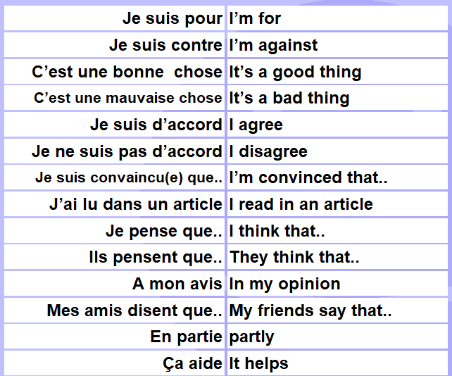
DO NOW

Slide 3
Classwork
L’école chez nous, l’école chez vous
L.O. | To compare schools in the UK and France To use the pronouns ILS and ELLES
DEVOIRS | K.O. 3 + 15 Using the vocabulary on the last slide as well as slides 5 and 6 , prepare a short presentation about the differences between school in the UK and school in France. Aim for 80 words.

Slide 4
Key points about school in France
In “collège” we count years backwards!
Year 7 is called SIXIEME (6th year)
Year 8 is called CINQUIEME (5th year)
Year 9 is QUATRIEME (4th year)
Year 10 is TROISIEME (3rd year) (they have a small exam called BREVET DES COLLEGES)
Then you go to LYCEE (college)
Year 11 is SECONDE (2nd year)
Year 12 is PREMIERE (1st year)
Year 13 is TERMINALE (Final year)
A-levels are called LE BAC (short for baccalaureat) and you mostly specialise in either Science A-Levels or Literary A-levels

Slide 5
Foundation

Slide 6
HIGHER

Slide 7
Foundation
Read the quiz and choose the correct letter.

Slide 8
Answers

Slide 9
HIGHER

Slide 10
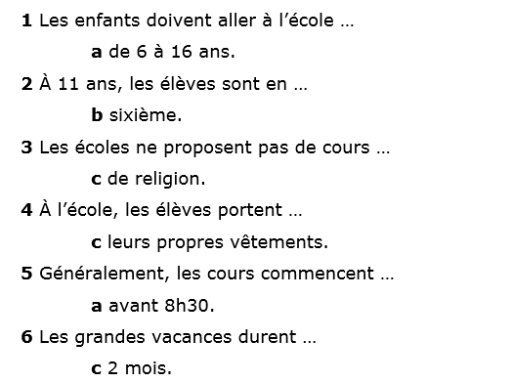
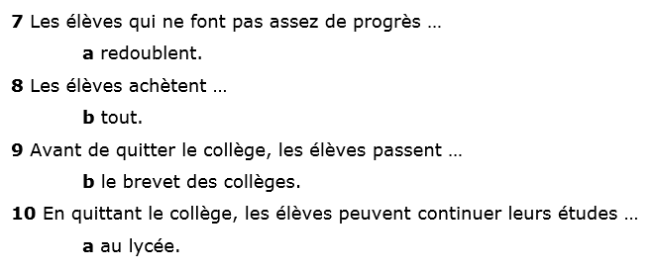

Slide 11
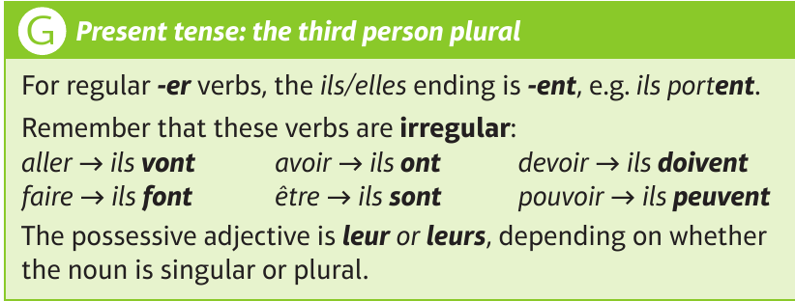

Slide 12
Read the messages and answer the questions in French.

Slide 13
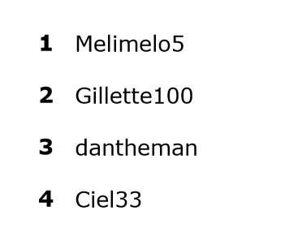
Answers

Slide 14
Homework vocab

