Slide 1
Do now task
How much can you remember?
What happens when a tropical storm hits land?
What is the north south divide?
How to emergent trees adapt to the TRF?
How does development affect health and wealth?
Pencil cases out
Conduct cards in pencil cases
Coats and bags off

Slide 2
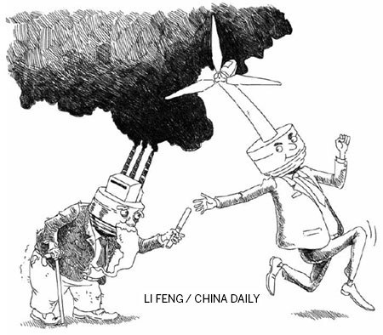
Managing climate change- Adaption
Starter: By looking at the image, how can we manage climate change?
Lesson Objectives
- To explore a variety of ways that humans can go about managing climate change. - To be able to categorise these management strategies into forms of mitigation and adaptation.

Slide 3
Knowledge Organiser –Climate Change KS4
The global climate has been changing since time began and will continue to change into the future. The Earth's temperature has fluctuated in the last few hundred years. However, since around 1950 there has been a dramatic increase in global temperatures. This increase is known as global warming.
Casestudies
Key Words
Causes of Climate change
Human
Greenhouse effect: Gases that trap solar radiation and warm the Earth.
Burning fossil fuels: Fossil fuels release greenhouse gases in the atmosphere when burnt.
Deforestation: Trees absorb carbon dioxide during photosynthesis. If they are cut down there will be higher levels of carbon dioxide in the atmosphere.
Waste in landfill: Decomposition of waste produces carbon dioxide and methane.
Agriculture: Practices, such as cattle ranching, need large spaces of land, increasing deforestation in the area. Furthermore, cattle release high amounts of greenhouse gases, particularly methane.
Natural
Orbital changes: The Earth has natural warming and cooling periods called Milankovitch cycles.
Volcanic activity: During a volcanic eruption greenhouse gases are emitted into the atmosphere (e.g. carbon dioxide)
Solar output: There can be fluctuations in the amount of radiation from the sun. If there is a high amount emitted then Earth’s temperatures will increase.
1 | Climate change | The change of Earth’s climate, either increasing or decreasing.
2 | Global warming | The rise in the average temperature of the Earth's surface.
3 | Solar radiation | The amount of energy from the sun. The warmer temperatures are, the higher the solar radiation.
4 | Quaternary period | The period of geological time from about 2.6 million years ago to the present.
5 | Greenhouse effect | The retention of heat (solar raditation) in the atmosphere caused by the build-up of greenhouse gases (carbon dioxide, methane, water vapour and methane).
6 | Enhanced green house effects | The warming of the earths atmosphere due to human activity increasing the layer of green house gases.
7 | Milankovitch cycles | The Earth’s variation of movement around the sun which cause an increase or decrease in global temperatures.
8 | Adaptation | Actions taken to adjust to natural events such as climate change, to reduce the potential damage and limit the impacts
9 | Mitigation | Action taken to reduce or eliminate the long-term effects such as making international agreements about carbon reduction targets.
Evidence of Climate change
Thermometer readings: Scientists have collected data and seen an increase in global temperatures.
Glacier retreat: Photographic evidence of glaciers melting, causing them to retreat.
Ice cores: Snow falls and eventually freezes, trapping atmospheric gases. Scientists drill for ice cores and measure the pockets of gas stored.
Change of seasons: On average, in recent years spring has arrived earlier and winters have been less severe.
Rising sea levels: Between 1901 and 2010 average global sea level rose by 0.19m.

Slide 4
LSQ- Week 2- Mark your homework and sent me your score!
Define climate change. The change of Earth’s climate, either increasing or decreasing.
Define global warming. The rise in the average temperature of the Earth's surface.
What is the quaternary period? The period of geological time from about 2.6 million years ago to the present.
How do glaciers provide evidence for climate change? Photographic evidence of glaciers melting, causing them to retreat.
How do ice cores provide evidence for climate change? Snow falls and eventually freezes, trapping atmospheric gases. Scientists drill for ice cores and measure the pockets of gas stored.
Name the four greenhouse gases. Water vapour, carbon dioxide, nitrous oxide and methane.
Give 2 natural causes of climate change. Orbital changes, solar output and volcanic activity.
Give 2 human causes of climate change. Greenhouse effect, burning fossil fuels, deforestation, waste in landfill and agriculture.

Slide 5
Adaptation
Key definition: Adaptation strategies responds to the impacts of climate change and tries to make populations of people LESS VULNERABLE.

Slide 6
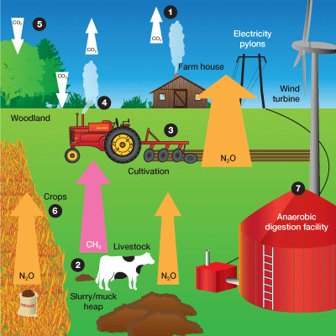
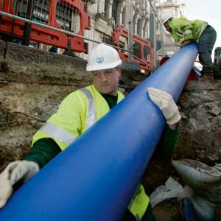
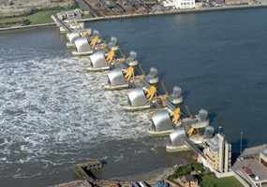
Task: Look at the images and work out what the adaptation is.
Changes in agricultural systems.
Managing Water Supply.
Reducing risk from rising sea levels.

Slide 7
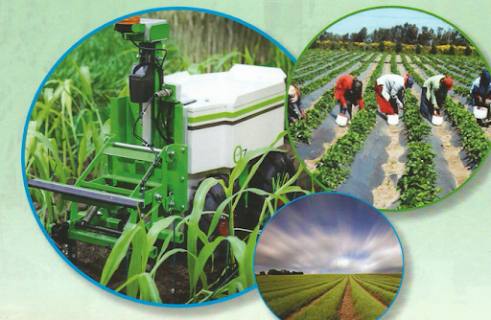
Change in Agriculture.
Change agriculture practices
Only growing crops which suit the new and changing climate.
Genetically mortifying crops to cope with changing climate.
Improve pest, weed and disease control as these may change with the climate.
Expansion of agribusiness with technological advances to improve yield.

Slide 8
Managing water supply
Solutions:
Water transfer schemes could be used. This is where water is transferred from an area of water surplus to an area of water shortage.
Some areas are using desalinisation to recover freshwater from the oceans. Although this is very expensive and so only rich areas (e.g. Dubai) use this method.
Efforts are also being made to increase water saving, reuse and recycling. (e.g. the UK are investing into education and water-saving technology).
Aquifers could be used to tap into groundwater sources as well.
Water is an essential resource. Worryingly, climate change is expected in the future to;
• Make water supplies in some parts of the world increasingly scarce in the future. This includes regions in the sub-tropics such as the Sahel region south of the Sahara, where water is already scarce. • Make some parts of the world wetter and more humid. • Make the air warmer so it can hold more water, which will lead to more and heavier rainfall. • Melt land ice and snow more quickly, many millions of people rely upon this as a water source and will be vulnerable if it disappears
This combined with population growth, rising wealth, water pollution and increased demand from farming is worrying!

Slide 9
Reducing risk from sea levels
Climate change is causing sea levels to rise.
The Intergovernmental Panel on Climate Change (IPCC) predict a rise in global sea levels of between 28 and 43cm by the end of the century. The IPCC projections of sea level rise can be seen below.
In the UK rising sea levels could hit beaches, low lying land and buildings including tourist attractions and historical monuments, with knock-on impacts for businesses that rely on them. Rising sea levels could also flood large parts of our valuable agricultural land

Slide 10
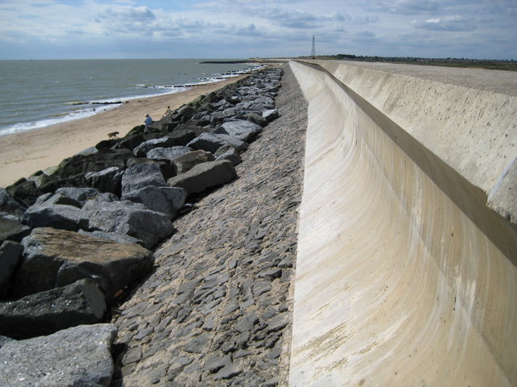
Task: Look at the images and work out the solutions for rising sea levels.
Soft (natural) or hard (manmade) engineering
Although it is expensive, hard engineering is stronger and may last longer. Soft engineering is usually cheaper and looks nicer!
The Thames Barrier defends central London and would need replacing at a cost of £7 billion.
Abandon areas at risk of flooding.
In the UK, a £6000 grant can be given to demolish their home.

Slide 11
Plenary: Sort the solutions into adaptation or mitigation.
Alternative energy
Managing Water Supply.
Changes in agricultural systems.
International Agreements
Replanting Trees
Reducing risk from rising sea levels.
Carbon Capture

Slide 12
Plenary: Sort the solutions into adaptation or mitigation. Mark your answers.
Alternative energy
Managing Water Supply.
Changes in agricultural systems.
International Agreements
Replanting Trees
Reducing risk from rising sea levels.
Carbon Capture

Slide 13
Revise: Mitigation and adaptations of climate change. https://www.youtube.com/watch?v=QjnV8-oo12A

Slide 14
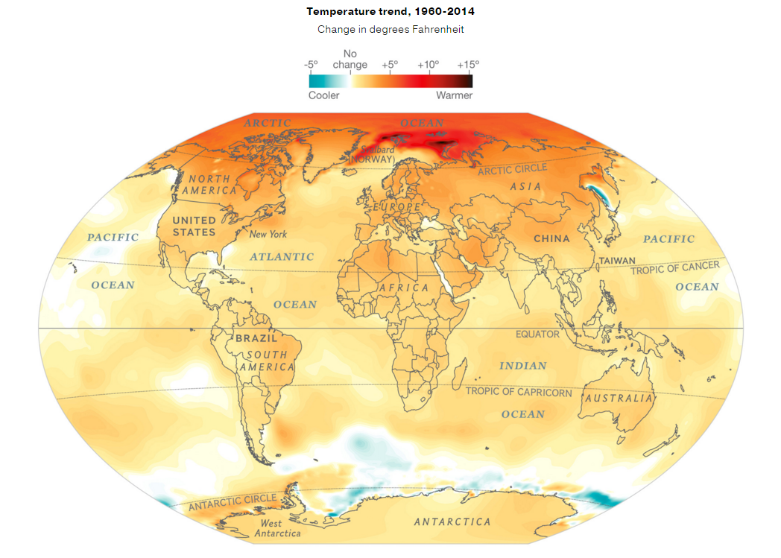
Using the map, describe the changes in temperature since 1960. (3 marks)

