Slide 1
“Do Now”
What occurs in ribosomes?
How do you calculate magnification :
A: Image size x real size.
B: Image size ÷ real size.
C: Real size x magnification.
D: Magnification ÷ image size
3. What is an independent variable?
A variable that we investigate / alter
A variable that we measure
A variable that we keep the same
Barrel
4. Active transport needs energy ? True or false?
5. Plants that reproduce a sexually are genetically different?
Protein synthesis
SA
True
False

Slide 2
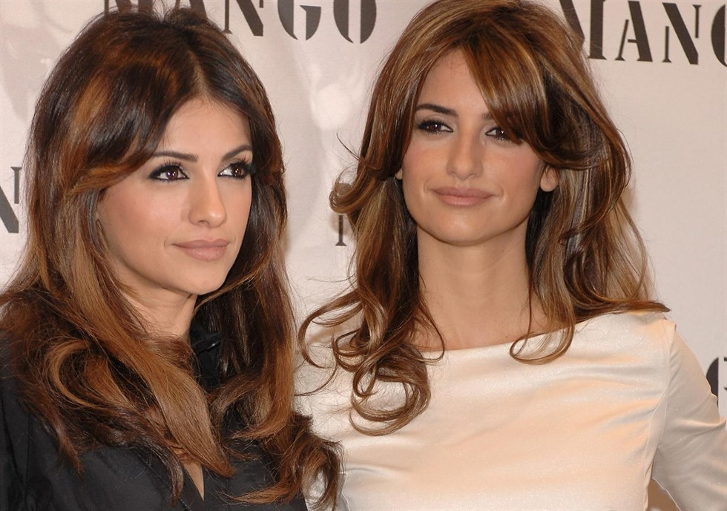
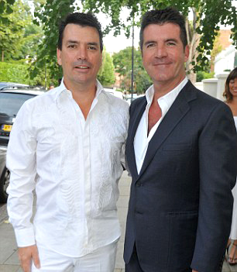
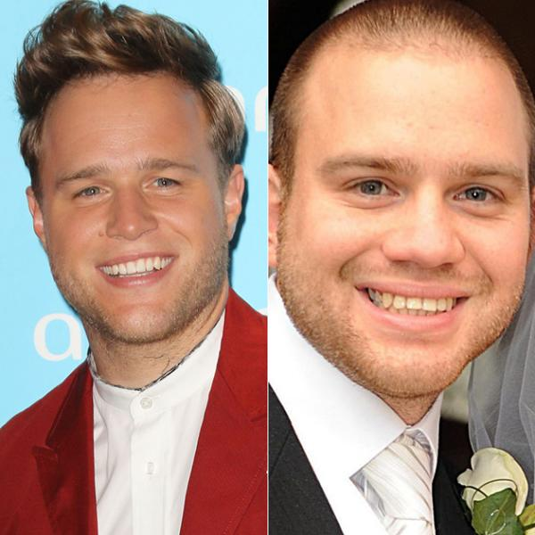
Siblings can show very close (but not identical) resemblance to one another. Non-siblings look very different to each other. Why?
Inherited variation means that siblings can inherit similar genes from their parents, but non-related people inherit different genes and show more variation

Slide 3
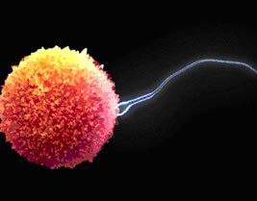
WALT: Understand how characteristics
are inherited
WILF GW: You can recall how genes are inherited and how they work. BI: You can make predictions and calculate the probability of inheriting certain characteristics. EW: You can use key terms correctly
Explain what is happening in this image in as much SCIENTIFIC DETAIL as you can (3 marks)

Slide 4
Model answer
The egg and sperm meet at fertilisation
The nucleus of the egg fuses with the nucleus of the sperm
The chromosomes are paired up so that the first cell of the new life has a full set of genetic information.
How many chromosomes will the new cell have?

Slide 5
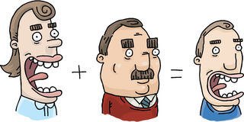
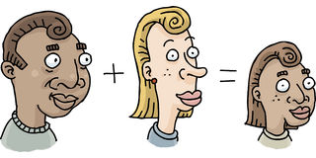

Slide 6
REMINDER: Our genes are small sections of DNA located on the Chromosomes:
This pair of genes could determine whether we have freckles or not
This pair could determine whether we can tongue roll or not.

Slide 7
Different versions of a gene.
There are different versions of the same gene which is what gives us genetic variation.
Different versions of the SAME gene are called ALLELES
Eye colour alleles | Hair colour alleles

Slide 8
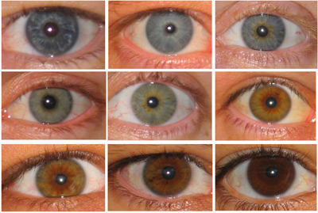
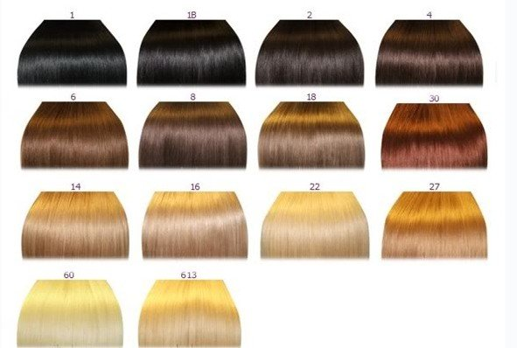
https://www.abpischools.org.uk/full-screen-animation/232/229
Inheriting different versions of the same gene are what makes us all different!

Slide 9
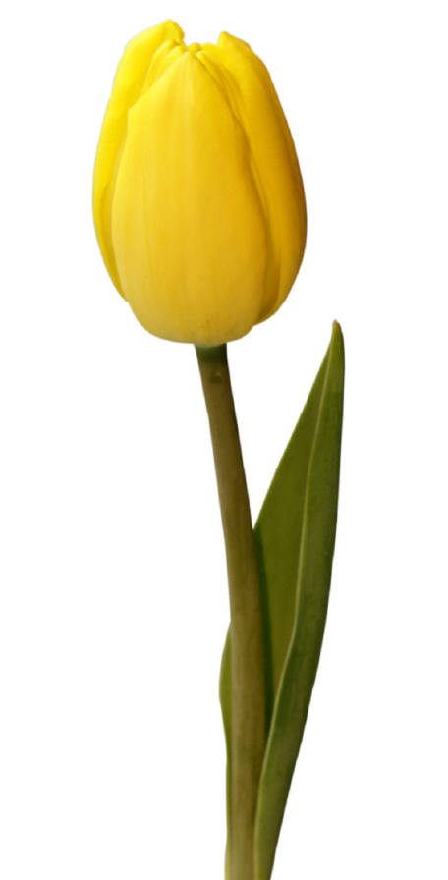
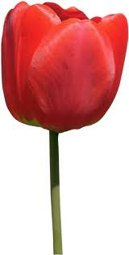
Representing alleles.
Instead of drawing out diagrams of chromosomes and genes – which would take ages, scientists use a shorthand way to represent pairs of alleles.
We use letters...a capital for the dominant allele and the corresponding small letter for the recessive allele.
allele for
red petals
=
R
allele for
yellow petals
=
r

Slide 10
Genotypes each plant has inherited (the genotypes are the pair of alleles shown as letters)
RR
rr
Rr
What phenotype (physical characteristic) will each flower have when we click on it?

Slide 11
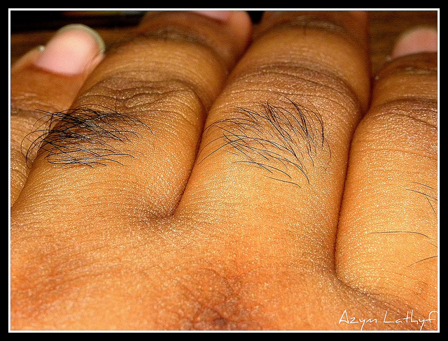
The allele for hairy fingers (H) is dominant over the allele for hairless fingers (h)
To have hairless fingers, what genotype would a person have?
To have hairy fingers, which two possible genotypes could a person have?

Slide 12
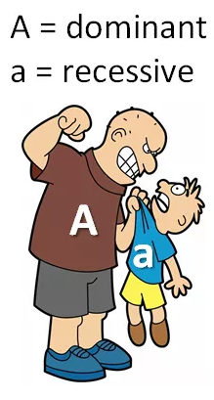
Genetics key points
Some alleles (versions of a gene) are more DOMINANT over other alleles.
The allele that is not dominant is called a RECESSIVE allele.
If you inherit one copy of a dominant allele it will ‘mask’ the recessive allele.
You need to inherit two copies of a recessive allele to express that characteristic.

Slide 13
Other key terms to learn
If a person inherits two of the same allele we say they have inherited a HOMOZYGOUS pair:
b = blue eye colour allele
B= brown eye colour allele
This person has inherited a HOMOZYGOUS DOMINANT pair of alleles
This person has inherited a HOMOZYGOUS RECESSIVE pair of alleles
B B
b b

Slide 14
But what if the egg and the sperm were each carrying a different version of the gene??
If a person inherits two different versions of a gene, what do you think this is called???
This is called a HETEROZYGOUS pair.
What colour eyes will this person have and WHY?

Slide 15
Genotype | Two of the same alleles for the characteristic
Phenotype | Only one copy of this allele would be needed to express the characteristic – it ‘masks’ the other allele.
Allele | Two copies of this allele are needed to produce the characteristic
Homozygous pair | Two different alleles for the characteristic
Heterozygous pair | The pair of genes inherited by an individual for a characteristic
Dominant | Different forms of the same gene e.g. Eye colour, hair colour.
Recessive | The physical characteristics shown by the organism due to the alleles inherited

Slide 16
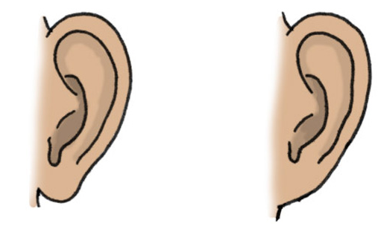
Predicting Inheritance – worked example
The allele for dangly earlobes (D) is dominant over the allele for attached earlobes (d).
Work out the chances of a couple having a child who has dangly earlobes if the mother is Dd and the father is dd.
Eggs Sperm | D | d
d
d
Dangly Attached
The chances of having a child with dangly earlobes would be 2 out of 4 or 50%

Slide 17
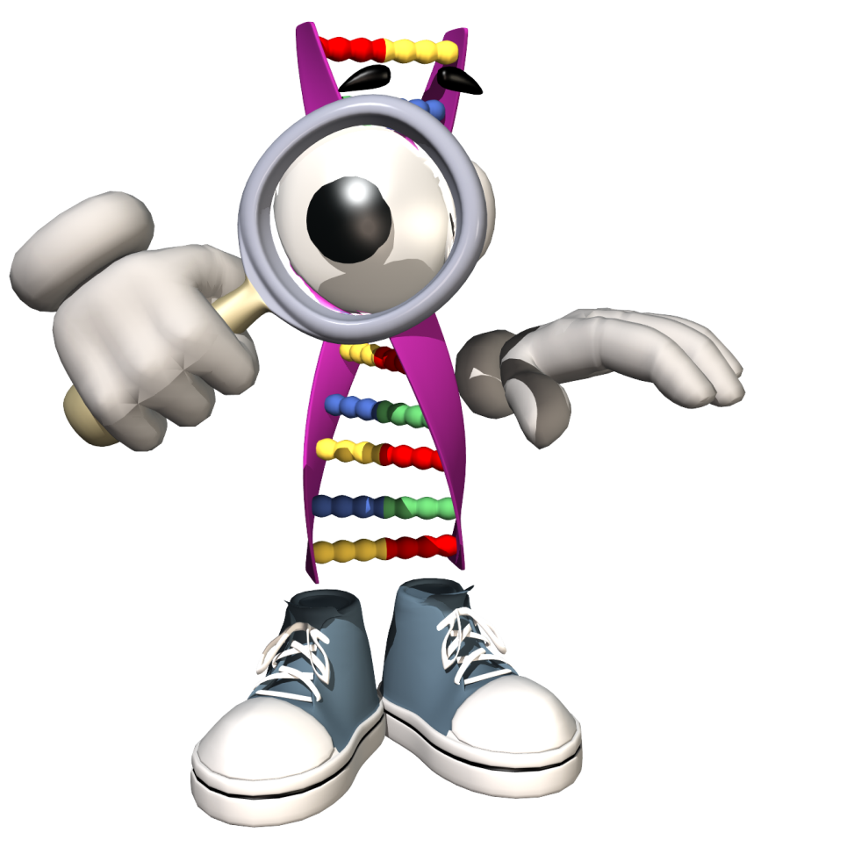
Draw 3x3 genetic squares to work out what the following couples offspring might inherit:
Man Bb x Woman Bb
Man TT x Woman tt
Man Bb x Woman bb
Man Rr x Woman RR
Man CC x Woman cc
B – Brown eyes b – blue eyes C – curly hair c – Straight hair
R – right handed r-left handed T –tongue roller
t – non tongue roller

Slide 18
Genetics quiz – true or false
1) All of our genetic information comes from the egg cell.
The egg and sperm cells contribute half of the genetic information each.
We inherit pairs of chromosomes.
There are 46 pairs of chromosomes in the nucleus of each cell.

Slide 19
Genetics quiz – true or false
We inherit pairs of genes.
We inherit the same form of a gene from both parents.
Different forms of the same gene are called alleles.
Some alleles are more dominant than others.

Slide 20
Genetics quiz – true or false
9) If an allele is dominant, you would need to inherit two copies of it to give you that characteristic.
10) A genotype is the physical characteristic a living thing displays.

