Slide 1
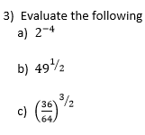

Slide 2
Factorise x² -8x + 5 = 0 by completing the square
x² - 8x + 5 = 0
Half the coefficient of x
(x - 4)²
(x - 4)² = x² - 8x + 16
Simplify
Minimum point
(4, -11)
(x - 4)² – 11 = 0

Slide 3
Factorise x² - 14x – 9 = 0 by completing the square
x² - 14x - 9 = 0
Half the coefficient of x
(x - 7 )²
(x - 7)² = x² - 14x + 49
Simplify
Minimum point
(7, -58)
(x - 7)² – 58 = 0
Solve

Slide 4
1. x² + 8x + 10 = 0
2. x² + 10x + 30 = 0
3. x² - 6x + 1 = 0
4. x² -2x + 2 = 0
5. x² + 6x – 2 = 3
6. x² - 12x + 2 = 5
7. x² - x + 10 = 6
8. x² - 3x + 7.25

Slide 5
1. x² + 8x + 10
= (x + 4)² - 6
2. x² + 10x + 30
= (x + 5)² + 5
3. x² - 6x + 1
= (x - 3)² - 8
4. x² -2x + 2
= (x - 1)² + 1
5. x² + 6x - 5
= (x + 3)² - 14
6. x² - 12x - 3
= (x - 6)² - 39
7. x² - x + 4
= (x - ½)² + 3.75
8. x² - 3x + 7.25
= (x - 1.5)² + 5

Slide 6
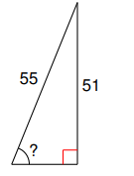

Slide 7
Solve x² + 20x – 13 = 0 by completing the square
x² + 20x - 13 = 0
Half the coefficient of x
(x + 10 )²
(x + 10)² = x² + 20x + 100
Simplify
Minimum point
(7, -58)
(x + 10)² – 113 = 0
Solve
(x + 10)² = 113
x + 10 = ± √113
x = -10 ± √113
Make sure you have both + and – square root!

Slide 8
Solve x² + 6x + 11 = 0 by completing the square
x² + 6x + 11 = 0
Half the coefficient of x
(x + 3 )²
(x + 3)² = x² - 6x + 9
Simplify
Minimum point
(7, -58)
(x + 3)² + 2 = 0
Solve
(x + 3)² = - 2
x - 3 = ± √-2
No Solutions

Slide 9
We may have a expression such as 3x² +12x-6, where
we have a coefficient of x².
3x² +12x-6
Step 1: Factorise out the coefficient of x²
3(x² +4x-2)
Step 2: Complete the square of everything inside the bracket.
3((x+2)² -4-2)
Step 3: Then multiply by the coefficient.
3((x+2)² -6)
3(x+2)² -18

Slide 10
Complete the square and solve to 3.s.f:
a) x² + 10x = 0
b) x² + 4x - 9 = 0
c) x² + 3x - 1 = 0
Complete the square and solve to 3.s.f:
a) x² -7x -1 = 0
b) x² -10x = 5
c) x² = 4 – 6x
Complete the square and solve leaving in surd form:
2x² -10x +18= 0
6x² -6x – 6 = 0
c) 2x² +8x -25=0

Slide 11
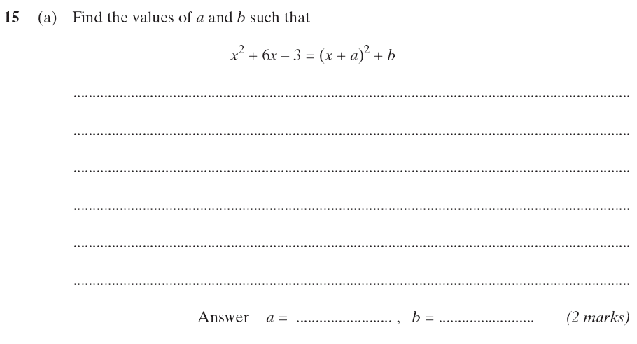
x² + 6x - 3
3 x 3 = 9
But we want -3…
(x + 3)² + b
(x + 3)² - 12
3
- 12

Slide 12
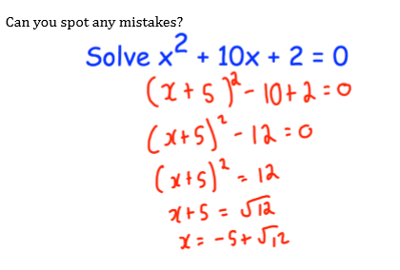

Slide 13
Marlow flips a coin. The height (h)of the coin in the air t seconds after it has been flipped can be modelled by the function h=-6t² +24t -12. What is the greatest height that the coin reaches?
Step 1: Complete the square:
-6t² +24t-12
-6(t² -4t+2)
-6((t-2)² -4+2)
-6((t-2)² -2)
-6(t-2)² +12

Slide 14
Marlow flips a coin. The height (h) of the coin in the air t seconds after it has been flipped can be modelled by the function h=-6t² +24t -12. What is the greatest height that the coin reaches?
The completed square form gives us the coordinates for the maximum of this function
-6(t-2)² +12
Therefore the greatest height the coin reaches is 12m (when t = 2).

Slide 15
Can you rearrange ax²+bx+c in completed square form?
Can we put x²-4x+15 in surd form? Why not?

