Slide 1
“Do Now”
SA
Where does respiration occur?
Where in the body would you find the adrenal glands?:
the neck
in the brain.
just above the kidneys
Which food good is needed for growth and repair?
4. Which is a faster response : endocrine or nervous?
5. What does IVF stand for?
Mitochondria
Protein
Nervous
In-vitro fertilisation

Slide 2
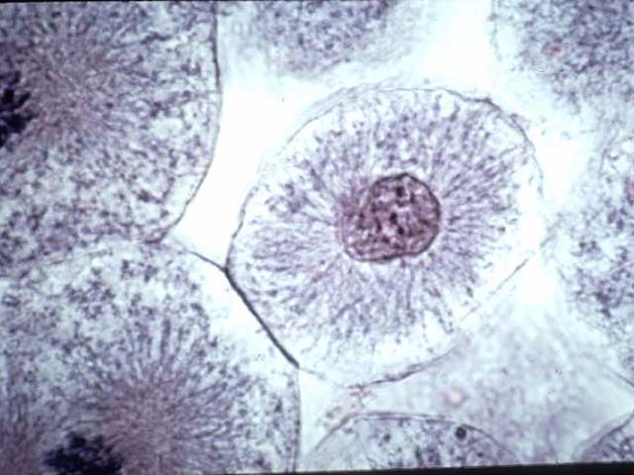
WALT: Describe the molecule of inheritance
WILF: GW: You can describe how the genetic material in a cell is arranged. BI: You can state the importance of the genetic material EW: You can describe why it is important to study genetic material
Part A
Part C
Part B
Write down the name of each part of the cell you can see above and along with its name, see if you can write the function (job) of that part.

Slide 3
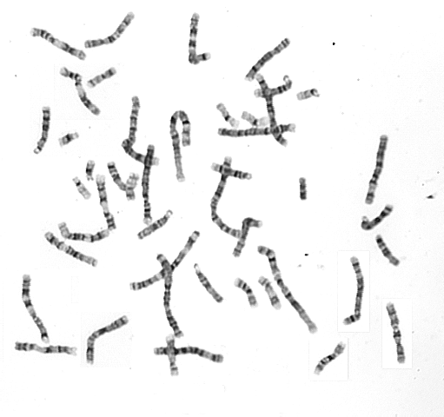
Inside a human nucleus
If we were to open up and look inside just one nucleus, we would see the following structures – any ideas what they are??

Slide 4
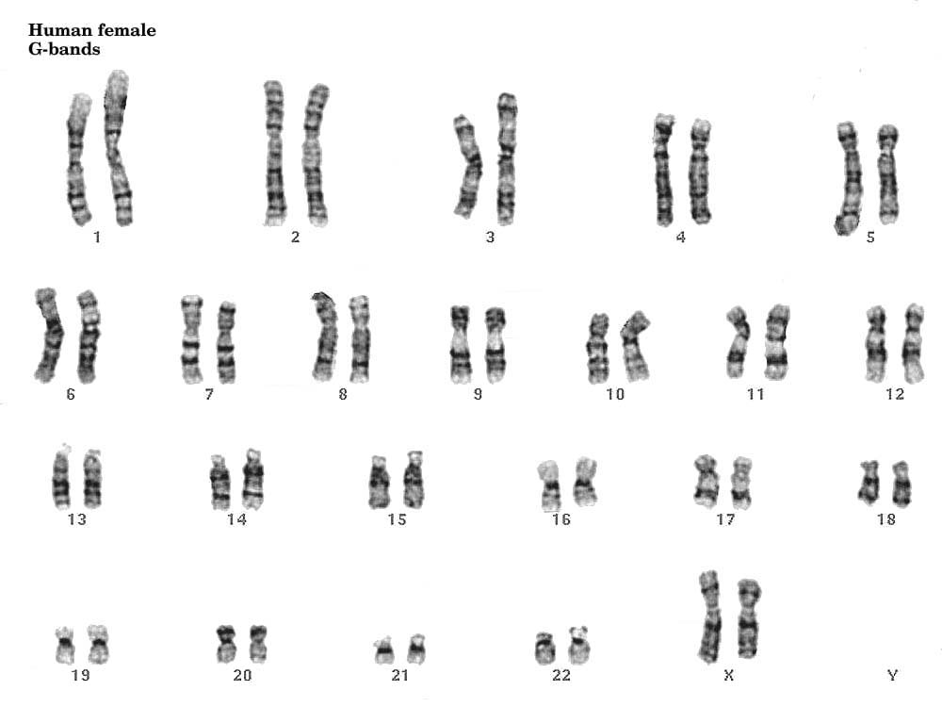
Inside each body cell of a human, there are 23 pairs of chromosomes. A full set of chromosomes from one nucleus is called a KARYOTYPE.

Slide 5
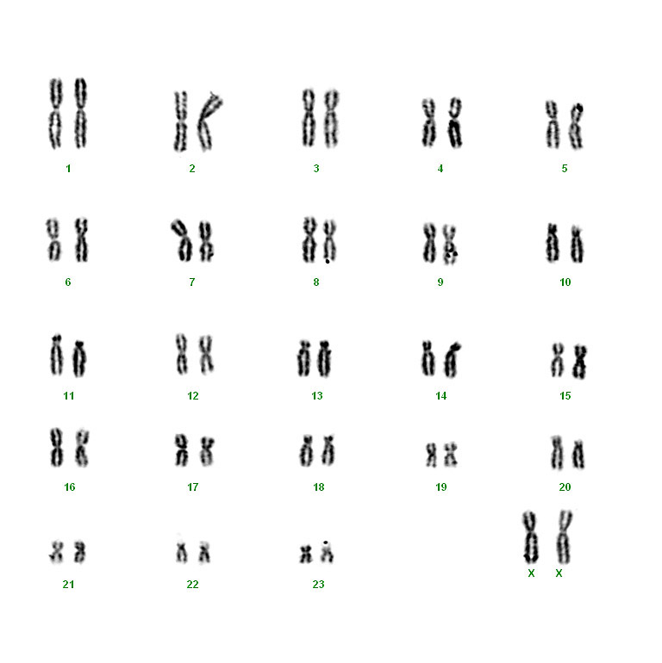
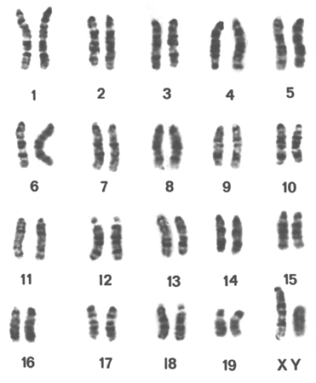
Different organisms karyotypes
A mouse karyotype – Mice have 20 pairs of chromosomes inside the nucleus
A Gorilla karyotype – Gorillas have 24 pairs of chromosomes inside the nucleus

Slide 6
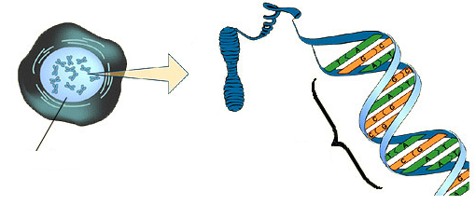
There are 46 of these inside every human body cell
Is the chemical that chromosomes are made out of.
Chromosome
DNA
Gene
Nucleus
Is a section of a chromosome that controls a certain characteristic
Contains strands of genetic information called Chromosomes

Slide 7
What are genes?
A gene is a short section of DNA that contains the instructions for a characteristic of an organism.
They work by providing the code for a sequence of amino acids which join together to make a particular protein.
Chromosomes come in PAIRS – so this means that our GENES also come in PAIRS.
This pair of genes could determine our hair colour
This pair of genes could determine which hand we write with

Slide 8
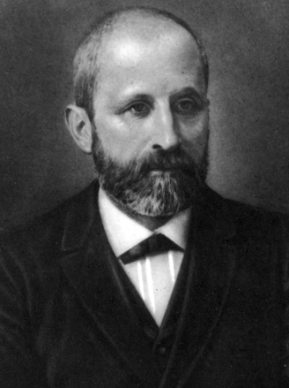
What is DNA?
I was the first person to discover genetic material, when I was studying white blood cells.
I extracted material from the nucleus of the cells and it had properties unlike any other protein I had ever encountered.
I called the substance ‘Nuclein’
Johann Freiderich Meischer 1860s

Slide 9
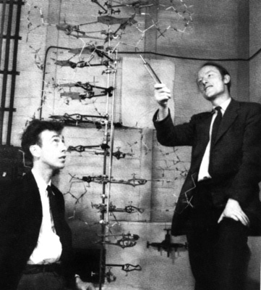
James Watson and Francis Crick – worked out the structure of the DNA molecule in 1952

Slide 10
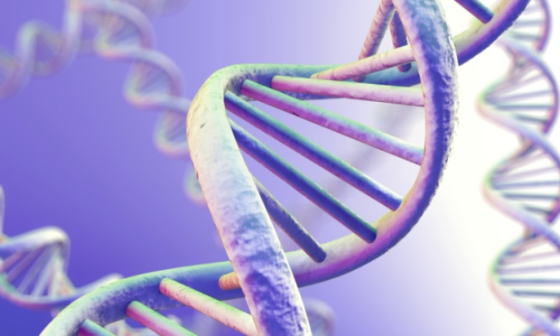
The DNA molecule is a polymer made up of two strands.
It is twisted to form a double helix.

Slide 11
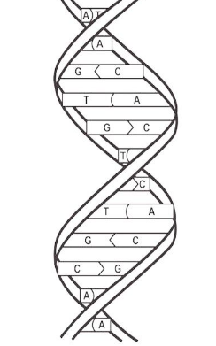
DNA Structure
Sugar phosphate backbones
Pairs of bases
Thymine
Adenine
Cytosine
Guanine

Slide 12
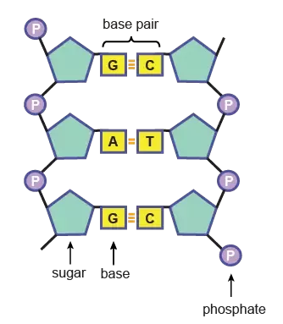
The sugar phosphate is attached to a base. All together these things are called a NUCLEOTIDE

Slide 13
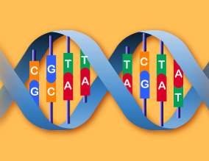
Base paring rule
What do you notice about the way in which the base pairs join together?
A always pairs with T and C always pairs up with G.

Slide 14
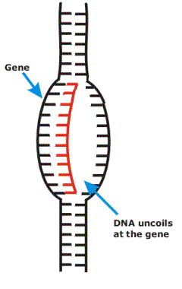
DNA is the code to make proteins
When the cell needs to make proteins, the DNA (inside the nucleus) uncoils at the specific gene that needs to be ‘read’
A copy of one half of the DNA strand is made.
The copy is then taken out into the CYTOPLASM of the cell.

Slide 15
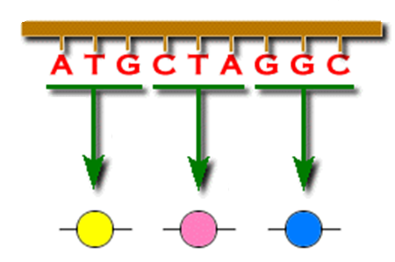
DNA is the code to make proteins
In the cytoplasm the DNA strand is ‘read’ in groups of three – which we call TRIPLETS.
The amino acids are then joined together to form long chains of PROTEIN.
Triplets
Each triplet is a specific code for a particular amino acid

Slide 16
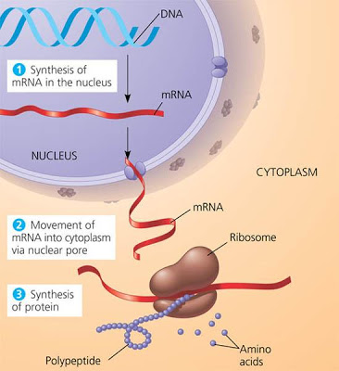
Recall of earlier Biology work……!!
Which ORGANELLE found in the cytoplasm do YOU think is responsible for reading the triplets and joining the amino acids together to SYNTHESIZE PROTEINS?

Slide 17
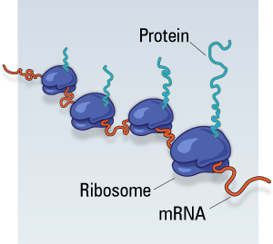
The RIBOSOMES are the place in the cell where the proteins are made by the cell.

Slide 18
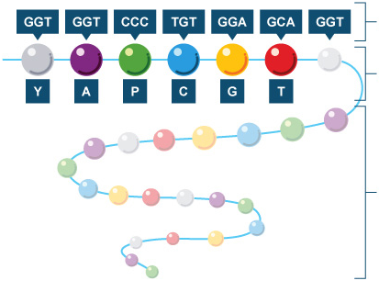
Triplets
Amino acids
Form a protein chain
Which types of important chemicals that are made by our cells are made out of proteins?
ENZYMES and HORMONES are examples of biologically important proteins.

Slide 19
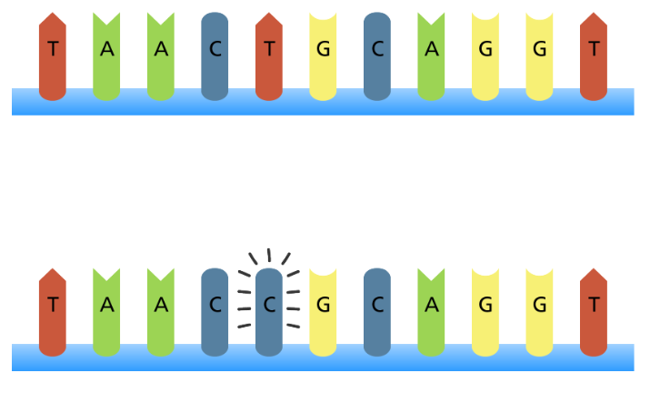
What if there is a ‘mistake’ in the DNA code?
If there is a change in the DNA code, we call this a MUTATION.
Causes of mutation include:
This makes the TRIPLET different, which can then lead to the wrong amino acid being included in the protein chain.
If the protein chain is incorrect, how might this affect an ENZYME’S structure?
An incorrect protein structure might mean the active site of an enzyme is not the correct shape and therefore cannot bind to its substrate.

Slide 20
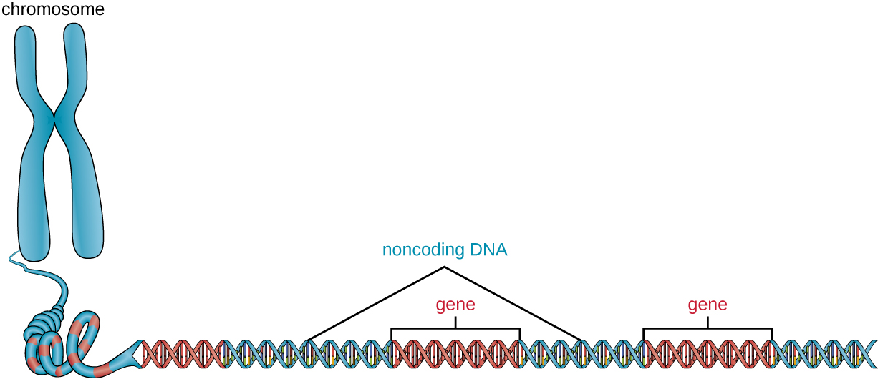
If the mutation happens within a gene, it can affect the protein that is created when the ribosome assembles the amino acid chain.
If the mutation happens within a non coding section of the DNA, it can affect how well the genes are expressed.

Slide 21
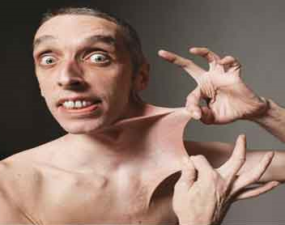
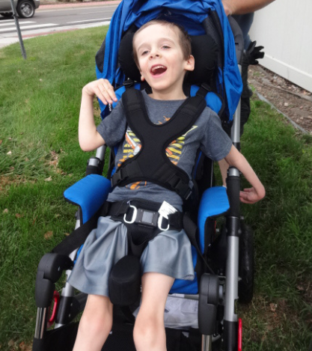
This condition is called Ehlers-Danlos syndrome and has been caused by a mutation in the gene responsible for collagen production. Collagen ‘binds’ other tissue together – so if it is not correctly produced it can prevent body tissues adhering together.
This condition is called Duchenne muscular dystrophy and has been caused by a mutation in the gene responsible for a protein called Dystrophin. Dystrophin binds muscle fibres together, so if it missing it leads to weakened muscles which progressively gets worse

Slide 22
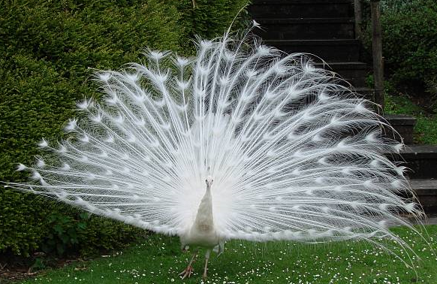
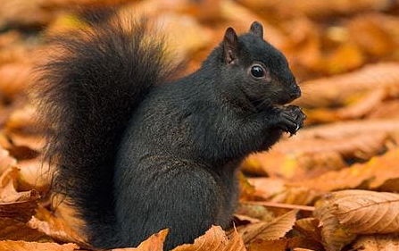

Slide 23
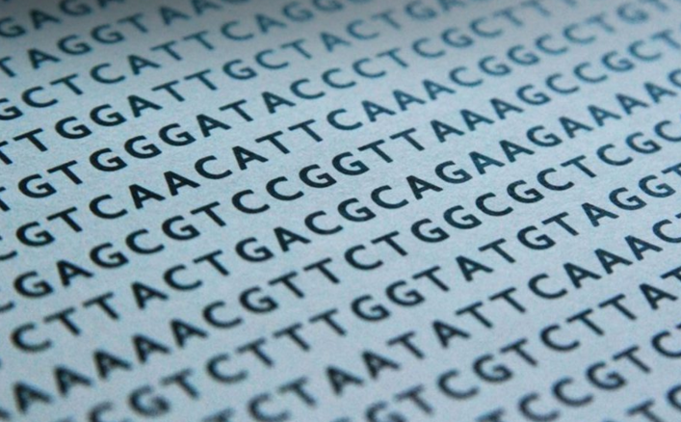
What is a GENOME?
What do you think a GENOME might be? Discuss with people who are sitting with you.
A GENOME is the entire set of genetic material of that organism.

Slide 24
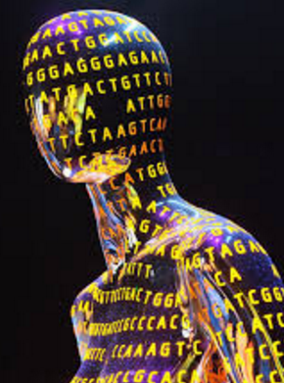
The human genome project (HGP)
The entire human genome has now been mapped, in a project known as the human genome project. It was completed in 2003.
The Human genome project is important as it allows us to:
Search for genes that are linked to different types of diseases.
Understand how genetic diseases are inherited and how we can treat them.
Trace the origins of humans and where they migrated in the past

Slide 26
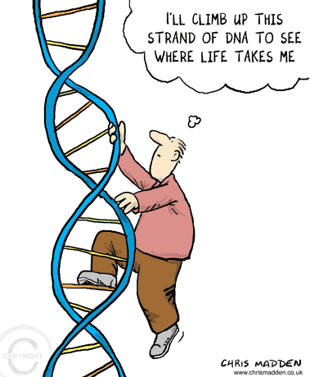

Slide 28
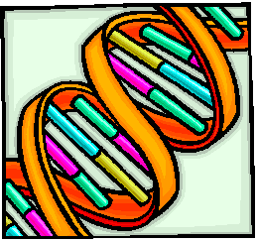
Maths task
Organism | How many chromosomes you find inside a cell | How many pairs of chromosomes?
Human | 46
Turkey |  | 41
Yeast | 32
Pineapple | 50
Cabbage |  | 9
Cow |  | 30
Mosquito | 6

