Slide 1
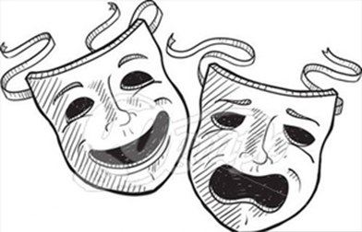
DO IT NOW!
How many words can you make from the letters:
PERFORMING ARTS
What's the longest work you can make?
There is a prize for the most interesting word.

Slide 2
DO IT NOW!
Here are some of the words I found:
PERFORMING ARTS
Transformer
Manifesto
Manifest
Form
Rare
Sing

Slide 3
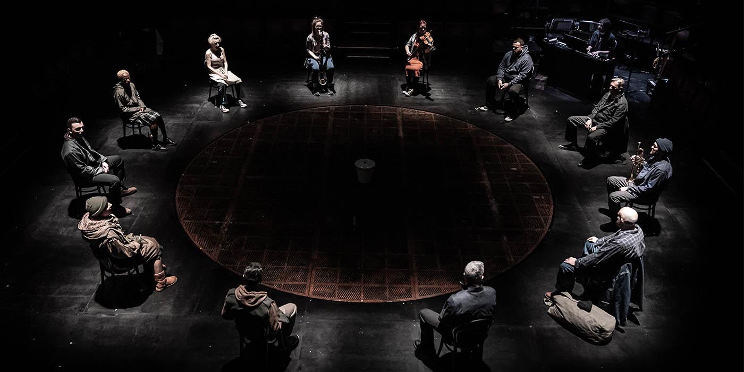
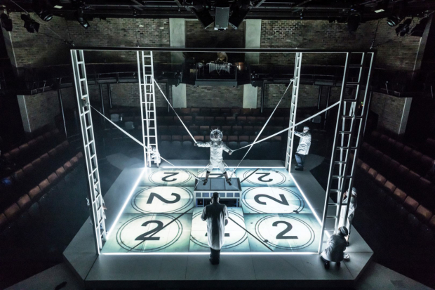
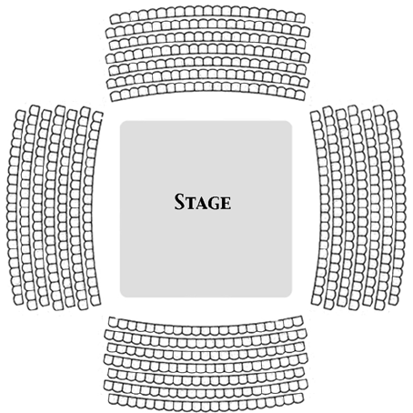
DO IT NOW!
What should a performer consider when performing in the stage type
“IN-THE-ROUND”?

Slide 4
DO IT NOW!
On your white board, draw and finish labelling
the places on this stage
STAGE RIGHT | CENTRE STAGE
 |  | DOWNSTAGE LEFT
AUDIENCE

Slide 5
DO IT NOW!
On your white board, draw and finish labelling
the places on this stage
UP STAGE RIGHT | UPSTAGE | UP STAGE LEFT
STAGE RIGHT | CENTRE STAGE | STAGE LEFT
DOWN STAGE RIGHT | DOWN STAGE | DOWN STAGE LEFT
AUDIENCE

Slide 6
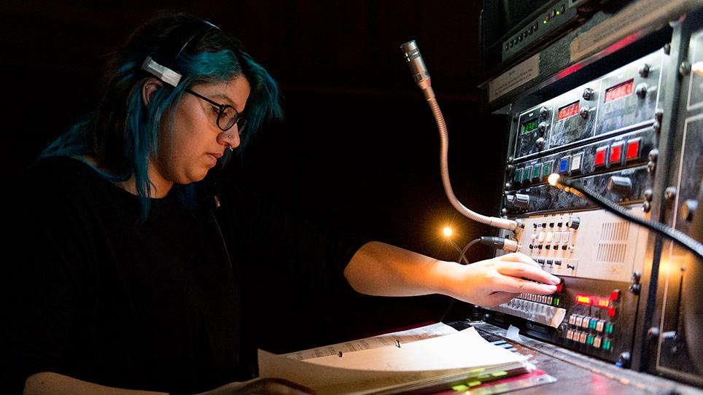
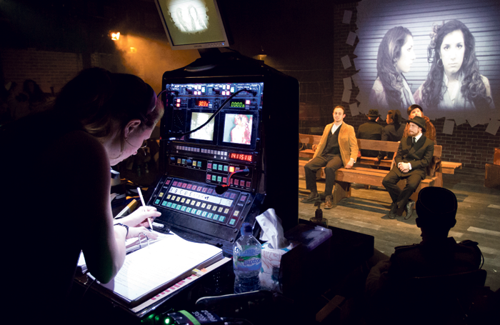
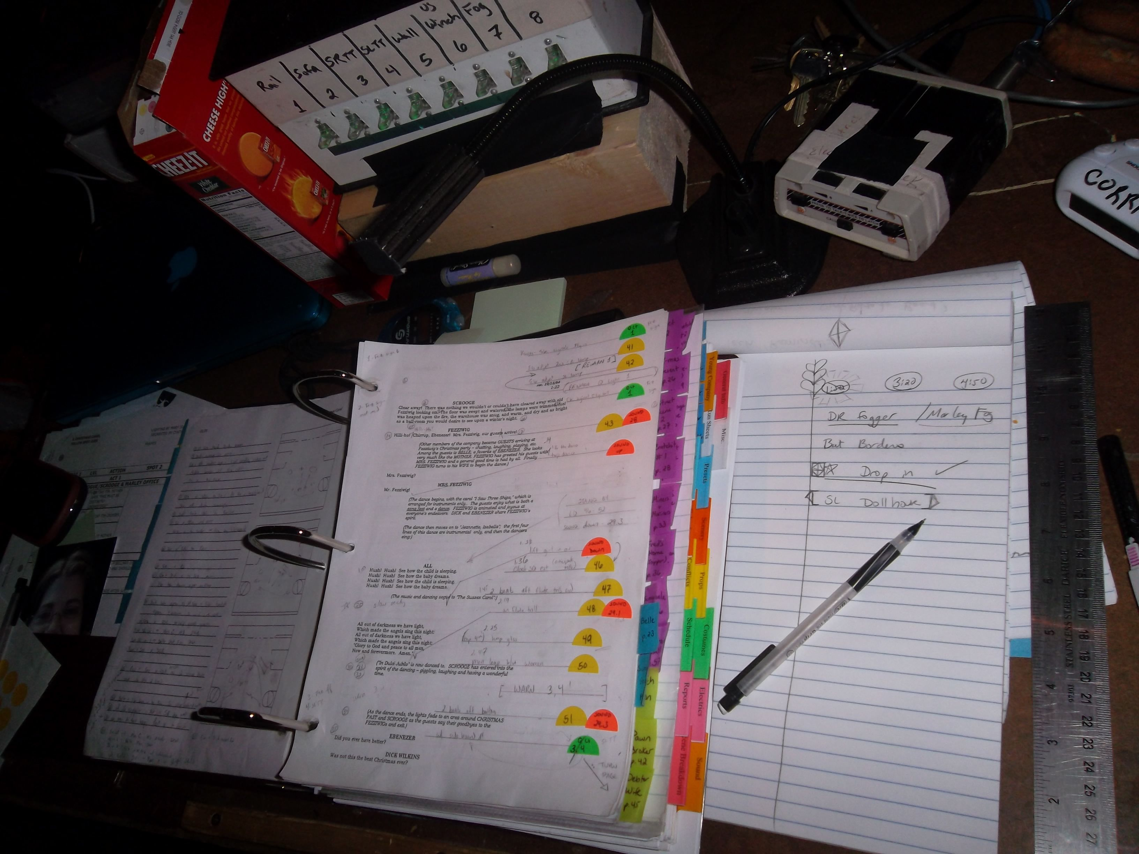
DO IT NOW!
On your whiteboard, write down three responsibilities of the Stage Manager.

Slide 7
DO IT NOW!
Some of the Stage Managers responsibilities are:
Scheduling and running rehearsals
Communicating the director's wishes to designers and crafts people
Co-ordinating the work of the stage crew
Calling cues and possibly actors' entrances during performance
Overseeing the entire show each time it is performed
Misconception:
The Stage Manager is not to be confused with the Theatre Manager, who oversees the ‘Front of house’

Slide 8
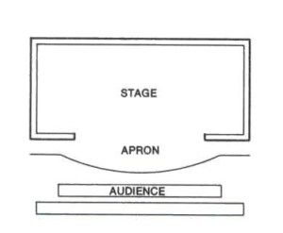
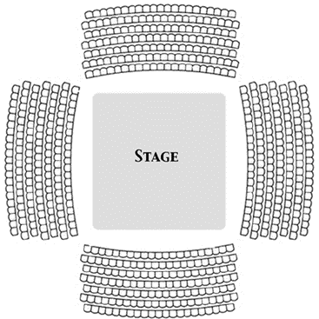
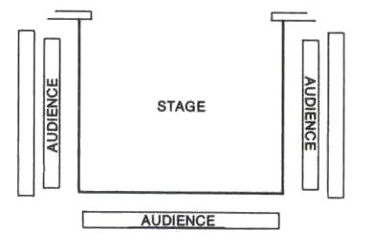
DO IT NOW!
On your whiteboard, Match the stage diagrams to their names.
A
B
C
End on/ Proscenium
In the round
Thrust

Slide 9
DO IT NOW!
On your whiteboard, Match the stage diagrams to their names.
A
B
C
2. In the round
3. Thrust
1. End on / Proscenium

