Slide 2
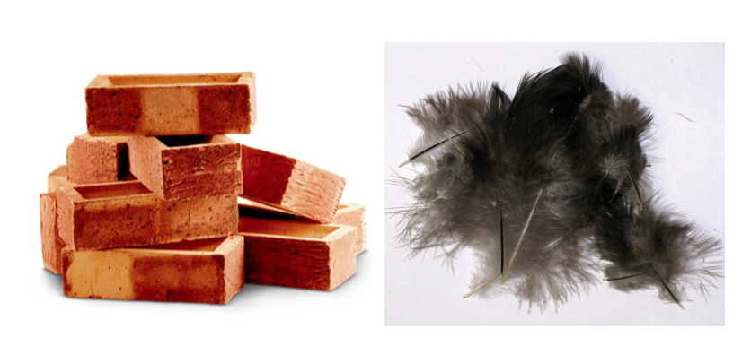
Which is heavier a tonne of bricks or a tonne of feathers?

Slide 3
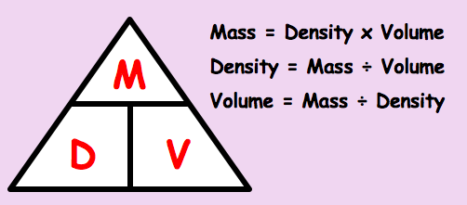
Key Concepts

Slide 4
Worked Example - I
A piece of metal weighs 40g has a volume of 4cm³. What is it’s density?
What is the volume of a piece of rock that has a mass of 72kg and a density of 9kg/m³?
A sponge has a volume of 200cm³ and a density of 1g/cm³. What is the mass of the sponge?

Slide 5
Worked Example - We
A piece of wood weighs 7kg has a volume of 30m³. What is it’s density?
What is the volume of a piece of cake that has a mass of 150g and a density of 5g/cm³?
A cuboid door stop has length 15cm, 3cm, 5cm and a density of 15g/cm³. What is the mass of the door stop?

Slide 6
A cuboid has dimensions of
9 cm x 3 cm x 12 cm.
It has a mass of 194.4 g.
Find the density of the cuboid.
Volume = 9 x 3 x 12
= 324 cm³
Density = Mass ÷ Volume
= 194.4 ÷ 324
= 0.6

Slide 7
SDT
MDV
An atlas stone has a density of 27 kg/ m³ and a volume of 10cm³. Work out the mass of the atlas stone.
2 . A desk has a density of 3 kg/ m³ and a mass of 27 kg. Work out the volume of the desk.
3. A nail has a volume of 4 cm³ with a density of 12 g/ cm³ workout the mass of the nail.
4 . A whelp has a density of 20 g/ cm³ with a mass of 2220 g. work out the volume of the whelp.
Understand what we mean by a numeric expression.
Understand what we mean by an algebraic expression.
To understand the difference between an equation and an expression.
Understand how to calcite speed from distance and time.
To understand what units speed is measured in.
To understand what is being measured, speed, distance or time in a worded question.
5. A cuboid has dimensions of
5 cm x 3 cm x 10 cm.
It has a mass of 450 g.
Find the density of the cuboid.
Expression, Equation, coefficient, variable, numeric, algebraic

Slide 8
SDT
MDV
An atlas stone has a density of 27 kg/ m³ and a volume of 10cm³. Work out the mass of the atlas stone.
2 . A desk has a density of 3 kg/ m³ and a mass of 27 kg. Work out the volume of the desk.
3. A nail has a volume of 4 cm³ with a density of 12 g/ cm³ workout the mass of the nail.
4 . A whelp has a density of 20 g/ cm³ with a mass of 2220 g. work out the volume of the whelp.
270 kg
Understand what we mean by a numeric expression.
Understand what we mean by an algebraic expression.
To understand the difference between an equation and an expression.
Understand how to calcite speed from distance and time.
To understand what units speed is measured in.
To understand what is being measured, speed, distance or time in a worded question.
9 m³
48 g
111 cm³
5. A cuboid has dimensions of
5 cm x 3 cm x 10 cm.
It has a mass of 450 g.
Find the density of the cuboid.
3 g/cm³
Expression, Equation, coefficient, variable, numeric, algebraic

Slide 9
The density of aluminium is 2590kg/m³.
The density of lead is 11400kg/m³.
A block of aluminium has a volume of 0.5m³.
A block of lead has a volume of 0.1m³.
Which of the two blocks has the greater mass and by how
many kilograms?
The aluminium block by 155kg.

Slide 10
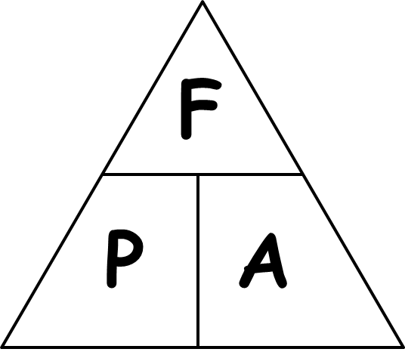
Compound Measure
Key Concepts
Pressure is a measure of how much force is applied over a unit of area
Gets bigger if force gets bigger
Gets bigger if force is more concentrated
Gets smaller if force is more spread out

Slide 11
Compound Measure
Units
Pressure = force/area
e.g. N/m²

Slide 12
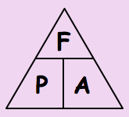
Compound Measure
Worked Example - I
A car of weight 6 400 N has four wheels. Each wheel has an area of 80 cm² touching the road. Find the pressure the car puts on the ground.
Total area = 4 x 80 = 320
Pressure = 6 400
320
= 20 N/cm²

Slide 13
Compound Measure
Worked Example - We
An ostrich of weight 450 N has two feet. Each foot has an area of 200 cm² touching the field. Find the pressure the ostrich puts on the ground.
Total area = 2 x 200 = 400
Pressure = 450
400
= 1.125 N/cm²

Slide 14
A table of weight 600 N has four legs. Each leg has an area of 12 cm² touching the floor. Find the pressure the table puts on the floor.
= 12.5 N/cm²

Slide 15
Pressure Force and Area
We Do
We Do
F
Understand what we mean by a numeric expression.
Understand what we mean by an algebraic expression.
To understand the difference between an equation and an expression.
Understand how to calcite speed from distance and time.
To understand what units speed is measured in.
To understand what is being measured, speed, distance or time in a worded question.
A student uses a glue stick with an area of 4 cm², putting a pressure of 4 N/cm² on her book. Calculate the force she puts on the glue stick.
Calculate the area of a dart which hits the dartboard with a force of 80 N and pressure of 20 N/m².
P
A
formula triangle
Expression, Equation, coefficient, variable, numeric, algebraic

Slide 16
SDT
Pressure Force and Area
In each of the following questions find the force or area. State the units of your answer.
Force= 50 N, pressure = 10 N/cm²
2. Pressure = 10 N/cm² , Area =40 cm²
3. Force= 21 N, Pressure = 7 N/cm²
4. Pressure = 13 N/cm², Area = 3 cm²
5. Calculate the area of a dart which hits the dartboard with a force of 10 N and pressure of 100 N/cm².
6. Calculate the force of a golf ball which hits the floor with a area of 5 cm² and pressure of 21 N/cm²
7 . Calculate the force of a arrow which hits a target with a area of 0.1 m² and pressure of 360 N/m²
Understand what we mean by a numeric expression.
Understand what we mean by an algebraic expression.
To understand the difference between an equation and an expression.
Understand how to calcite speed from distance and time.
To understand what units speed is measured in.
To understand what is being measured, speed, distance or time in a worded question.
Expression, Equation, coefficient, variable, numeric, algebraic

Slide 17
SDT
Pressure Force and Area
In each of the following questions find the force or area. State the units of your answer.
Force= 50 N, pressure = 10 N/cm²
2. Pressure = 10 N/cm² , Area =40 cm²
3. Force= 21 N, Pressure = 7 N/cm²
4. Pressure = 13 N/cm², Area = 3 cm²
5. Calculate the area of a dart which hits the dartboard with a force of 10 N and pressure of 100 N/cm².
6. Calculate the force of a golf ball which hits the floor with a area of 5 cm² and pressure of 21 N/cm²
7 . Calculate the force of a arrow which hits a target with a area of 0.1 m² and pressure of 360 N/m²
Understand what we mean by a numeric expression.
Understand what we mean by an algebraic expression.
To understand the difference between an equation and an expression.
5 cm²
400 N
3 cm²
39 N
0.01 cm²
110 N
36 N
Understand how to calcite speed from distance and time.
To understand what units speed is measured in.
To understand what is being measured, speed, distance or time in a worded question.
Expression, Equation, coefficient, variable, numeric, algebraic

Slide 18
Exam Practice

