Slide 1
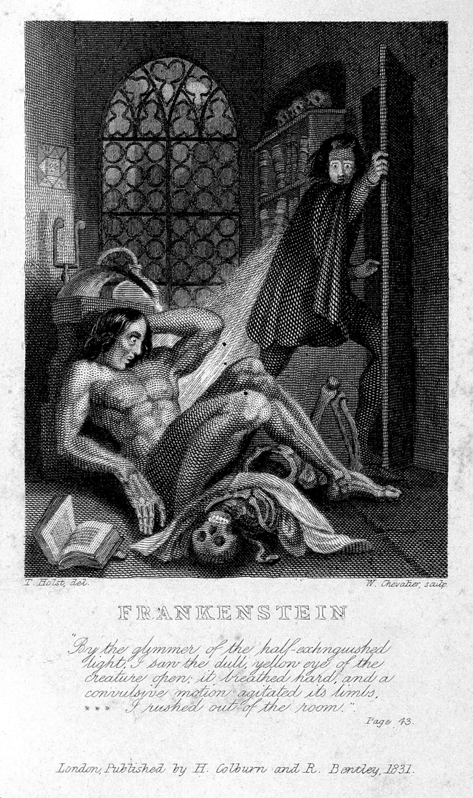
Knowledge Organiser – ‘Frankenstein’
Overview
Vocabulary
1 | The Romantic movement was a rebellion against the industrial revolution. The Romantics believed in the power of nature, art and the imagination. They felt that great art came from strong emotions and nature rather than machines.
9. | Gothic | A style of writing that has elements of fear, horror, death, and gloom, as well as romantic elements, such as nature and very high emotion.
10. | Era | A period of time, usually in history, that is different from other periods because of particular characteristics or events
11. | Romanticism | A style and movement in art, music and literature in the late 18th and early 19th century, in which strong feelings, imagination and a return to nature were more important than reason, order and science.
12. | Pathetic fallacy | Applying human qualities to nature and the weather.
13. | Embedded narration | In an embedded narrative, the main story is told within a framing narrative eg) a story within a story
14. | First person | Writing from the speakers perspective ‘I’, ‘we’, ‘my’
15. | Metaphor | A figure of speech that is used to make a comparison between two things that aren't alike but do have something in common eg) Her tears were a river flowing down her cheeks
16. | Personification | Representing objects and qualities as humans eg) The leaves waved in the wind
17. | Imagery | Language that produces pictures in the minds of people reading or listening
18. | Abandoned | Left and no longer wanted, used or needed
19. | Isolation | The act of separating somebody/something; the state of being separate
20. | Grotesque | Extremely ugly in a strange way that is often frightening or amusing
21. | Prejudice | An unreasonable dislike of or preference for a person, group, custom. Especially when it is based on race/religion/gender
2
Frankenstein tells the story of a scientist called Victor Frankenstein. He gives life to his own creation. However, the creation turns out to be a hideous monster. Frankenstein rejects the monster which is forced to live a lonely life without a companion.
3 | At the beginning of the novel, Walton’s ship is stuck in the ice. This cold atmosphere creates a chilling mood and is an example of pathetic fallacy. Walton is isolated from others just as the monster becomes isolated later in the novel.
4 | There are three separate narrators. We learn directly about Robert Walton's travels in his own words. He then meets Victor Frankenstein and his story is told to us through the letters which Robert Walton is writing to his sister. Finally, we hear the Monster's account of his development, but this is told to us by Victor, which is in turn told to Walton. The novel then returns to Victor's point of view and then finally to Walton’s.
Themes 5. Science and technology | Scientific discovery leads to tragedy, and misery for all of the characters. Therefore, many people think that Frankenstein shows us the dangers of scientific discovery. Christians believe that only God can create life, but in Frankenstein, Victor creates life. Because the monster turns out to be hideous, Shelley might be warning us that man should not play the role of God.
6. Ambition Hubris | Victor and Walton are both very ambitious but they bot have flaws. Both Victor and Walton dream of changing society and bringing glory to themselves through their scientific achievements. Yet their ambitions also make them imperfect.
7. Nature Vs Nurture | The most obvious example of the nature vs. nurture question is in the relationship between Victor Frankenstein and his monster. Some people argue that the monster’s cruelty is because Victor rejected him and did not act like a father figure (nurture). However, it might also be argued that his personality is innately evil (nature).
8. Responsibility | Frankenstein created the monster. Therefore, a major question is whether Frankenstein is responsible for the monster and his violence.
Characters | Victor Frankenstein – The doomed protagonist and narrator of the main portion of the story TheCreature– The eight-foot-tall, creation of Victor Frankenstein. Walton – The Arctic seafarer whose letters open and close Frankenstein. Alphonse Frankenstein – Victor’s father, very sympathetic toward his son. William - Victor’s youngest brother and the darling of the Frankenstein family. Elizabeth – An orphan, four to five years younger than Victor, whom the Frankensteins adopt. Justine - A young girl adopted into the Frankenstein household while Victor is growing up. Justine is blamed and executed for William’s murder. Henry Clerval - Victor’s boyhood friend, who nurses Victor back to health in Ingolstadt.

Slide 2
Pit stop Progress- Can you do the following?
Understanding- You can do the following State the beliefs held by the Romantics. State key events in Mary Shelley’s life. State the order of events in the novel. State the main characters in the novel. | Date achieved: _________________________________ _________________________________ _________________________________ _________________________________
Applying- You can do the following Describe the characters and their traits. Describe in detail the events of the novel. Describe key themes and how and where they are represented in the novel. Describe the structure of the novel. | Date achieved: _________________________________ _________________________________ _________________________________ _________________________________
Analysing- You can do the following Compare the arguments for nature and nurture. Analyse key extracts from the text. Explain key quotations. Explain which words work and why. | Date achieved: _________________________________ _________________________________ _________________________________ _________________________________
Evaluating- You can answer the following questions using a 2 sided argument Identify how the author creates effects / Answer HOW questions. To what extent do you think that Victor is responsible for the monster’s crimes? To what extent do you think Victor’s ambition was his own downfall? | Date achieved: _________________________________ _________________________________ _________________________________ _________________________________

