Slide 1
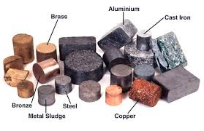
On a post-it note
List as many properties of metal that you can think of
A hint to start you off: conductors of heat

Slide 2
Lesson Outcomes
Describe the properties of the alkali metals
Describe the reactions of the alkali metals with water
3. Predict the reactions of other alkali metals from the reactivity order of Li, Na and K
Key words: reaction, sodium, potassium, lithium, observation, alkali, properties

Slide 3
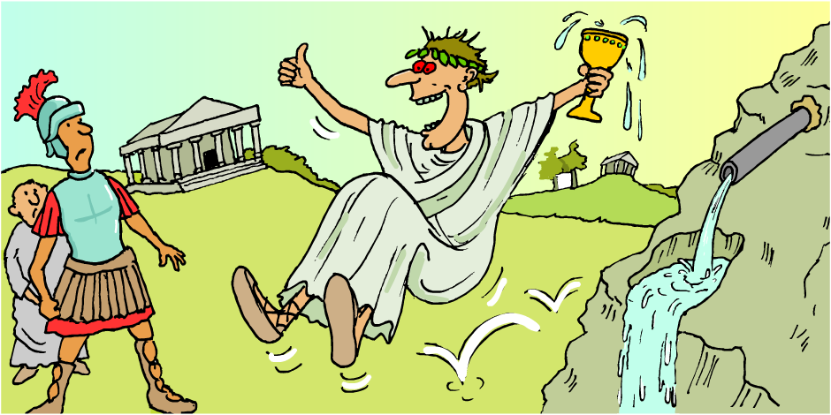
Metals and water
The Romans used lead to make water pipes but didn’t know that lead reacts slowly with water and makes it poisonous!
Some metals react vigorously with water, some metals react slowly and some do not react at all.
Which is the best type of metal to use for water pipes?

Slide 4
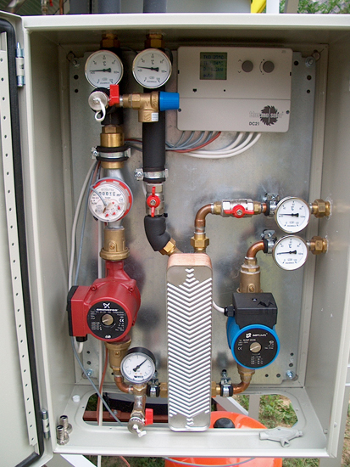
Using unreactive metals
The words ‘plumber’ and ‘plumbing’ come from plumbum (the Latin word for lead) because the ancient Romans used lead for their water pipes.
Why is lead no longer used in plumbing?
Copper is a much better metal for water pipes because it does not react at all with water – perhaps plumbers should be renamed coppers!
Notes:
Photo credit: Csongor Varga

Slide 5
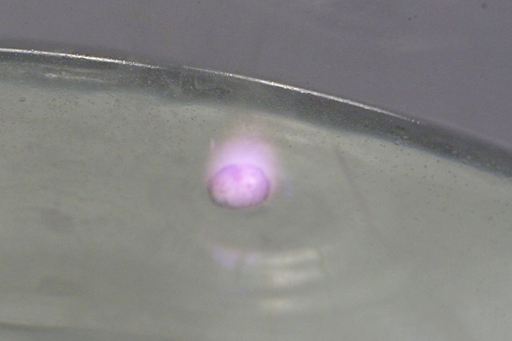
Reacting metals with water
When any metal reacts with water, the products are a metal hydroxide and hydrogen gas.
This is the general equation for the reaction of a metal with water:
metal
+
water
Metal
hydroxide
hydrogen
+
Notes:
Photo credit: Dr John Mileham

Slide 6
Example:
Calcium + Water Calcium Hydroxide + Hydrogen
Caesium + Water Caesium Hydroxide + Hydrogen

Slide 7
Unusual metals?
Using your periodic table, can you find:
Na
Li
K

Slide 8
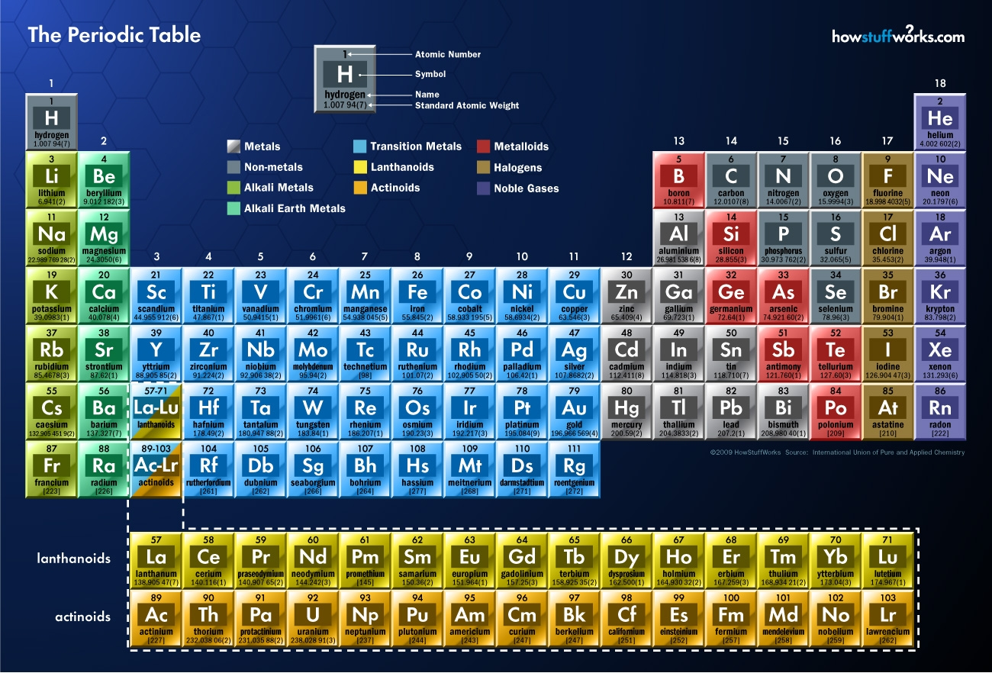

Slide 9
Learning Objective:
Observing the reaction between the alkali metals and water

Slide 10
Apply

Slide 11
Record your observations
Remember to record everything you see on your observation sheet!
Hint: Does the metal float?

Slide 12
Predict…
What do you think would happen if we put rubidium into the water?

Slide 13
What about Rubidium, Caesium and Francium?

Slide 14
Complete the following equations:
_________ + Water → Potassium hydroxide + Hydrogen
Lithium + Water → _______ _______ + Hydrogen
Sodium + Water → ______ ________ + ________
Rubidium + Water → ______ ________ + _________
Killer Challenge:
Can you write out the symbol equations for these reactions?

