Slide 1
Do now task
How much can you remember?
What is the Hindu Holy book called?
Ganesha is the God of?
Krishna is the God of?
What would a Hindu pray to Kakshmi for?
Notes:
The Vedas
of good luck and removing obstacles
Love and joy
Wealth

Slide 2
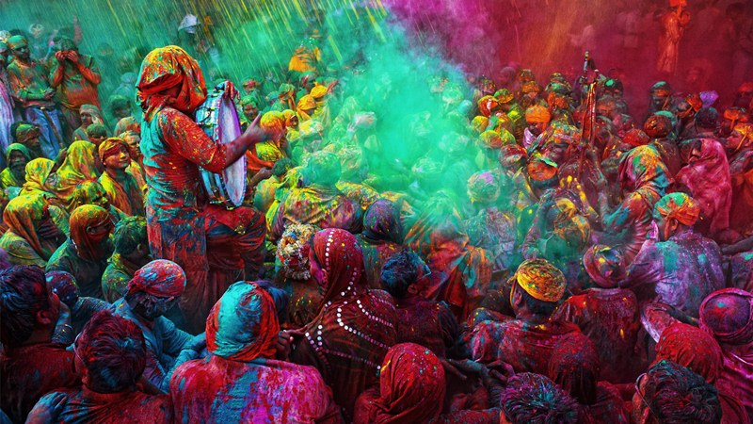
Holi
Quick starter:
Why are festivals important in religion?
What is the purpose of celebrating festivals?

Slide 3
Holi- The Festival of Colours
A spring festival, usually celebrated in March
The festival is officially celebrated on the day after the full moon in February-March
Holi celebrates Krishna, and the legend of Holika and Prahalad
Holi is particularly celebrated in North India
Distinctions of caste, class, age, and gender are suspended during Holi, it is a festival about equality.
There is a lot of music, dancing, street parties and mainly it is celebrated by throwing powdered paint.
Bonfires are lit during Holi as a symbol of purifying the air of evil spirits and food offerings are roasted.

Slide 4
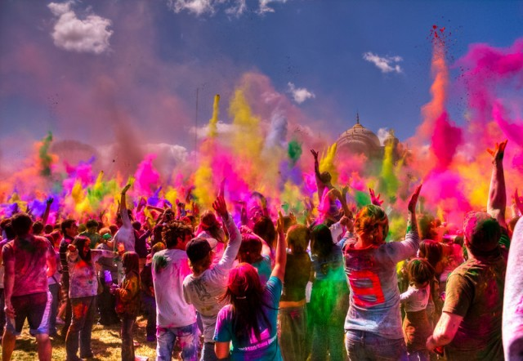
Read through the story of Holi and answer these questions…
1. What are the moral(s) of this story?
2. How do you think the story relates to how Hindu’s celebrate Holi?
3. Why do you think it is an important Hindu festival?
Key word- Gulal- the coloured powder thrown during Holi

Slide 5
Marked writing..
Using both Diwali and Holi as examples, answer the following question:
‘Festivals are an excellent way to celebrate faith’ Discuss
Make sure you include- information about both festivals (stories and how they are celebrated), morals of the stories, key words, analysis and your own opinion. (could there be a better way? Hint- Puja/Temple?). You will be given a 1-9 level for your answer
Festivals are an excellent way to celebrate faith because….
An example of this is Diwali……
Another example is Holi…
Festivals are not the only way to celebrate faith… Other ways include…. Puja is a good way to express faith because…

