Slide 1
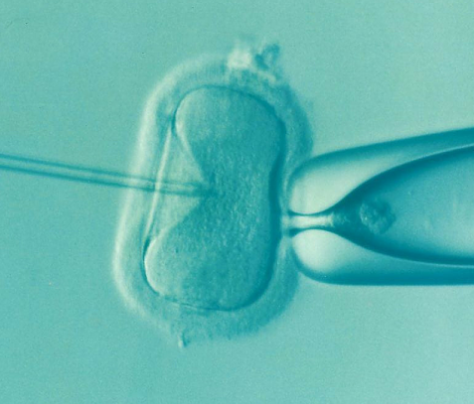
Infertility Treatments
Grade | Objective | Outcomes
1-3 | To be able to name and describe the use of hormones to treat fertility problems | Describe the use of fertility drugs in women with low FSH levels.
 |  | Use a model, e.g. a flow diagram to explain the process of In Vitro Fertilisation (IVF).
4-6
 |  | Evaluate the use of fertility treatments
7-9
Starter:
Name one example of a hormonal method of contraception and one non-hormonal method
Explain how each of these methods of contraception work
Can you think of any reasons why a woman or a man may be infertile?

Slide 2
In the UK as many a one in six couples have problems conceiving when they want to.
Think > Pair > Share: Why might a woman, man or the combination of the two have problems with conceiving?

Slide 3
How many did you identify?
Lack of important female hormones
Eating disorders, e.g. anorexia
Obesity
Think > Pair > Share: Why might a woman, man or the combination of the two have problems with conceiving?
Damaged oviducts
Lack of sperm in the semen
Age – late thirties and older it is more difficult to fall pregnant

Slide 4
The role of FSH & LH ~ Treating infertility
FSH and LH are important ____________ which are released from the ________ _______.
The job of FSH is to stimulate the eggs to ________ in the __________, it also stimulates the production of _________.
LH is needed for ________ to occur.
If a woman cannot get pregnant due to a lack of FSH, artificial FSH can be used as a _______ drug. This means her eggs will _____, artificial LH can be given to stimulate an _____ to be released from the ovary and she can get pregnant naturally.
Key Words: Pituitary gland, fertility, mature, egg, hormones, oestrogen, ovaries, ovulation

Slide 5
Self-assessment:
FSH and LH are important hormones which are released from the pituitary gland.
The job of FSH is to stimulate the eggs to mature in the ovaries, it also stimulates the production of oestrogen.
LH is needed for ovulation to occur.
If a woman cannot get pregnant due to a lack of FSH, artificial FSH can be used as a fertility drug. This means her eggs will mature, artificial LH can be given to stimulate an egg to be released from the ovary and she can get pregnant naturally.

Slide 6
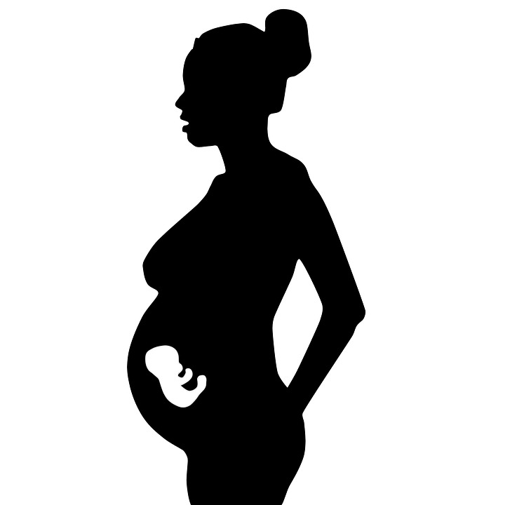
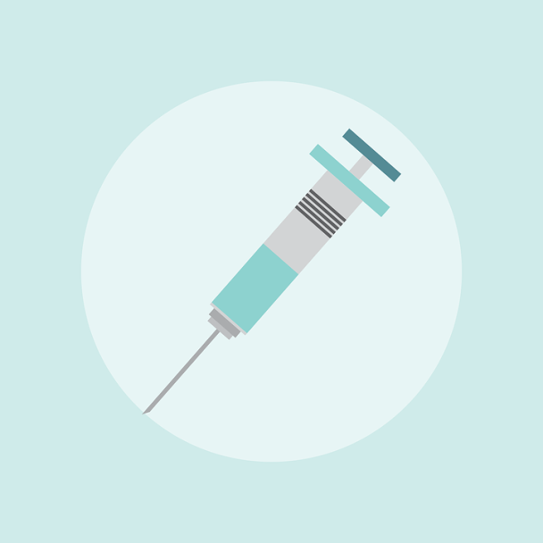
In vitro fertilisation
Fertility drugs are also used in IVF (in vitro fertilisation). IVF is a form of fertility treatment used if the oviducts have been damaged or blocked by infection, if a donor egg has to be used or if there is no obvious cause of long-term infertility.

Slide 7
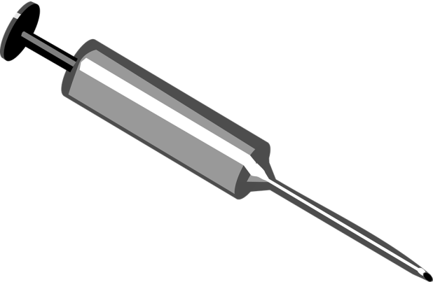
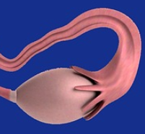
How IVF works….
1. Fertility drugs are used to make lots of eggs mature at the same time for collection
2. The eggs are collected and placed in a special solution in a Petri dish

Slide 8
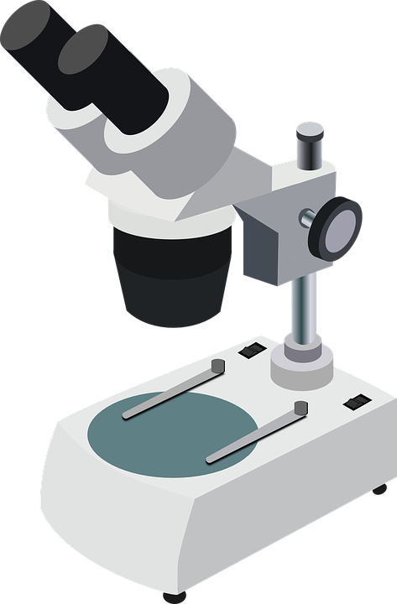
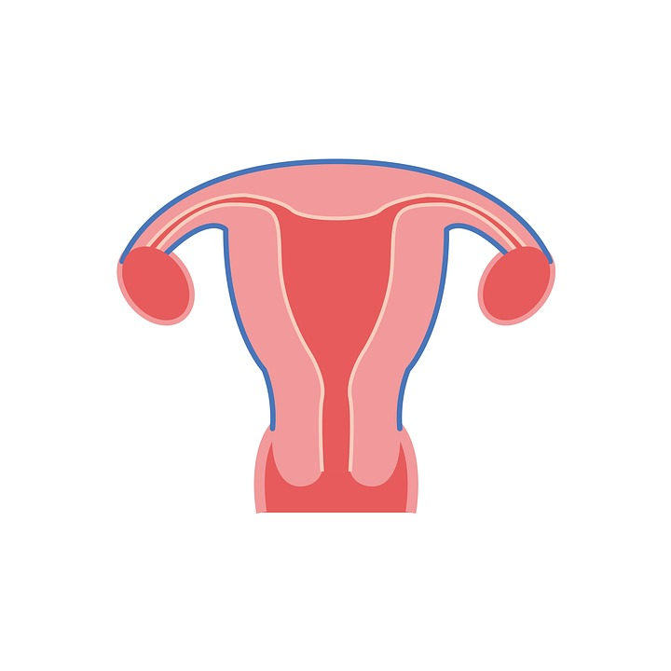
3. A sample of semen is collected and the sperm and eggs are mixed in the Petri dish
4. The eggs are checked to make sure they have been fertilised and the early embryos are developing properly
5. When the fertilised eggs have formed tiny balls of cells, 1 or 2 of the tiny embryos are placed in the uterus of the mother.

Slide 9
Task: Complete the worksheet to show the steps taken during IVT treatment
Extra Challenge: Answer the questions at the bottom of your worksheet in your books

Slide 10
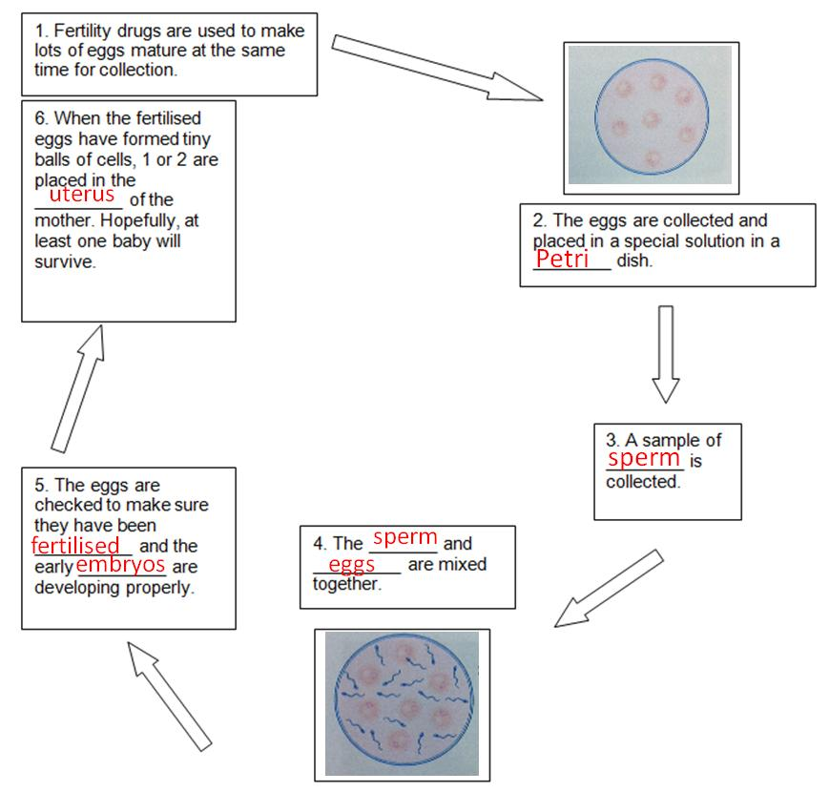
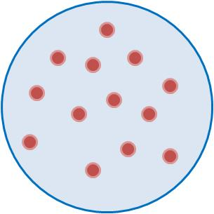
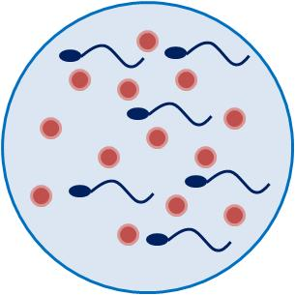
Self-assessment:

Slide 11
The advantages and disadvantages of IVT treatment
Task: Read the information on the use of fertility treatments and sum up the advantages and disadvantages in a table in your books:
Advantages
Disadvantages

Slide 12
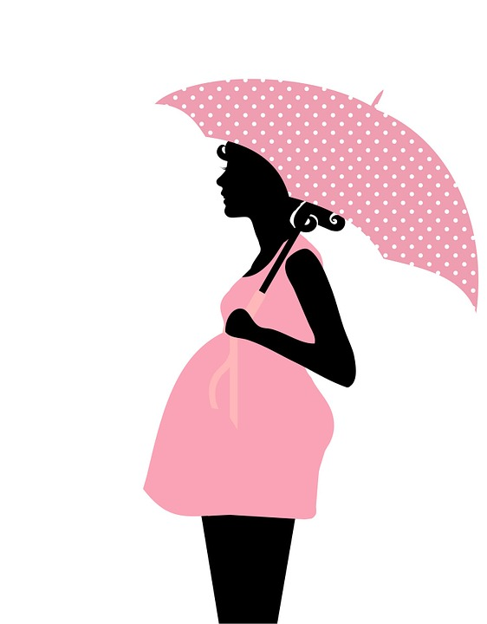
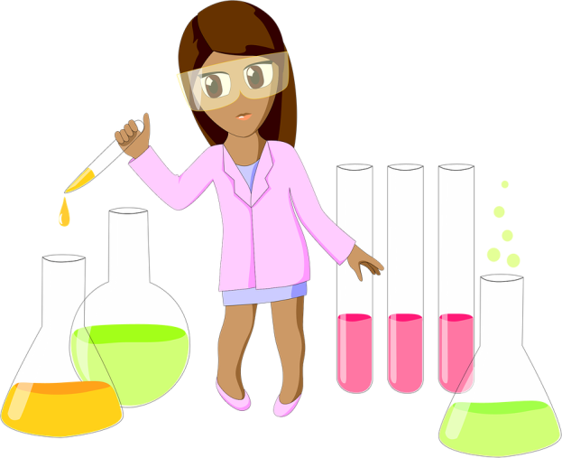
Opinions on IVF
Task: You are going to be given a card sort showing different people’s opinions on IVF treatment.
In groups discuss which opinions you agree with, write a conclusion about your own opinion on the matter in your books. Make sure you explain your answer.

Slide 13
Plenary ~ Write a twitter message summarising what you have learnt this lesson.
#keywords

Slide 14
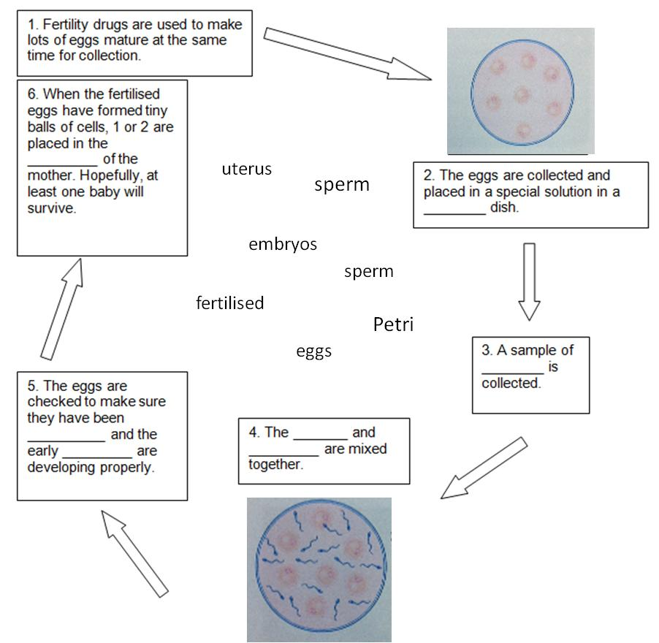
In vitro fertilisation
In vitro fertilisation
Extra Challenge Questions:
Babies produced by IVF are sometimes called ‘test tube’ babies – why is this not really true?
Why do you think it is common for women who have had IVT to have twins or triplets?
Extra Challenge Questions:
Babies produced by IVF are sometimes called ‘test tube’ babies – why is this not really true?
Why do you think it is common for women who have had IVT to have twins or triplets?

Slide 15
Advantages and disadvantages of fertility treatments
Fertility treatments have been a major medical breakthrough and a huge relief to men and women who are unable to have babies. But there are some implications that need to be considered.
IVF is a pricey procedure, it can cost society money if it is provided by the NHS and if it is paid by the individual, and that individual goes through more than one cycle of treatment, it can cost tens of thousands of pounds.
IVF is not always a success, this can be hugely emotional for the mother and father who have devoted time and money and have high hopes for the procedure to work. The IVF drugs used have some heath risks for the mother, the whole process can be very physically, as well as emotionally, stressful.
If IVF is successful, it can increase the chance of a multiple pregnancy. This can put both the mother and babies at risk of premature birth and/or other complications. It also can be costly to the hospital to keep premature babies alive and if they survive they may have life-long disabilities.
Mature eggs produced by a woman who is using fertility drugs can be collected and stored to be used at a later date. This raises ethical concerns though, what if the mother dies? Or the partner disagrees with keeping the eggs or embryos?
Advantages and disadvantages of fertility treatments
Fertility treatments have been a major medical breakthrough and a huge relief to men and women who are unable to have babies. But there are some implications that need to be considered.
IVF is a pricey procedure, it can cost society money if it is provided by the NHS and if it is paid by the individual, and that individual goes through more than one cycle of treatment, it can cost tens of thousands of pounds.
IVF is not always a success, this can be hugely emotional for the mother and father who have devoted time and money and have high hopes for the procedure to work. The IVF drugs used have some heath risks for the mother, the whole process can be very physically, as well as emotionally, stressful.
If IVF is successful, it can increase the chance of a multiple pregnancy. This can put both the mother and babies at risk of premature birth and/or other complications. It also can be costly to the hospital to keep premature babies alive and if they survive they may have life-long disabilities.
Mature eggs produced by a woman who is using fertility drugs can be collected and stored to be used at a later date. This raises ethical concerns though, what if the mother dies? Or the partner disagrees with keeping the eggs or embryos?

Slide 16
Roman Catholic priest: “I believe that life starts at fertilisation and that all life is sacred. These embryos have rights and these are just as important as a baby that has been born. I don’t think that IVF should be allowed at all.”
A pregnant mother: “IVF has given me the chance to have a child when it looked impossible. I’d like to keep those spare embryos in case I want another child in the future. If I don’t use them, I’m happy for them to be donated to other couples who would like a child.”
Scientist: “We have such an opportunity to use these embryos for work in human cloning and stem cell research. They’re not ‘human’ yet – they are just a ball of cells. We should use them to research the prevention of disease and human suffering.”
Politician: “I am thoroughly against the use of spare IVF embryos for scientific research. It’s a slippery slope to human cloning and selecting embryos for characteristics. Even though they can’t live on their own, they still have the potential to be a human life and that should be respected.”

