Slide 1
Introducing forces

Slide 2
WALT
Be able to define the word force and identify the different types

Slide 3
WILF
GW – Define the word force BI –Categorise the different forces into contact and non-contact forces EW – Speculate everyday examples where the different types of forces are used

Slide 4
Thinking
What is a force?
What do they do?

Slide 5
Forces
Forces are needed in everyday life.
Without them nothing would move, stop moving, change shape, change size, change direction or turn!

Slide 6
Basic forces
In simple terms all forces really do one of three things.
Pull
Push
Turn

Slide 7
Effect of forces
The push, pull or turn can have the following effects
Change an objects speed
Change the shape of an object
Change the direction of an object

Slide 8
Forces
Forces can be either a push, pull or a turn.
They can make an object change its speed, shape or direction.

Slide 9
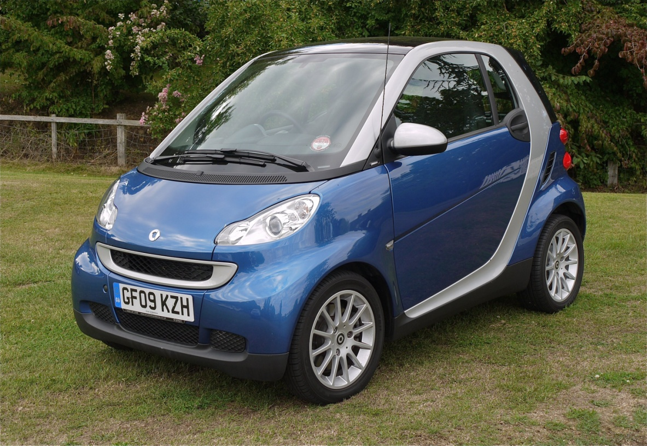
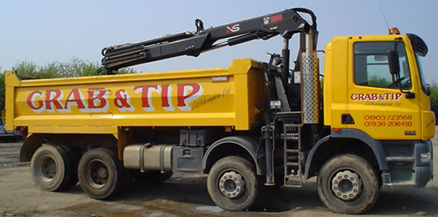
Size of forces
Forces can vary in size from the extremely small to the extremely large.
Which would need the larger force to start moving? Stop? Why?

Slide 10
Thinking
Write down the names of any forces that you can think of.

Slide 11
Lots of forces but 2 types
We have come up with a lot of forces, however, we can put these into only 2 categories.
Contact or non contact forces.
It is as easy as it sounds!

Slide 12
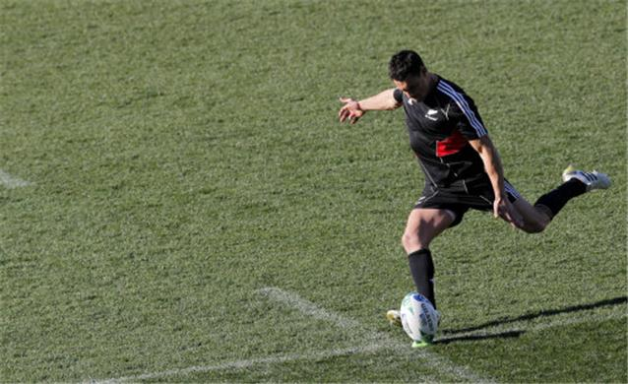
Contact forces
Contact forces need to actually touch the object
Applied force – like kicking a ball

Slide 13
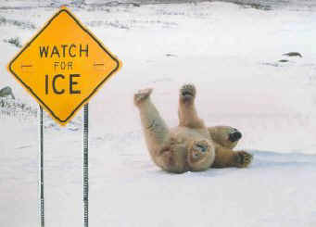
Contact forces
Contact forces need to actually touch the object
Friction – Not enough you fall over

Slide 14
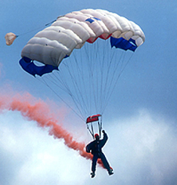
Contact forces
Contact forces need to actually touch the object
Air resistance (another type of friction)

Slide 15
Contact forces
Contact forces need to actually touch the object
Spring force – Compressed spring pushes back

Slide 16
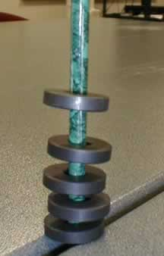
Non Contact forces
Non contact forces can act over a distance
Magnetism – can make other magnets float

Slide 17
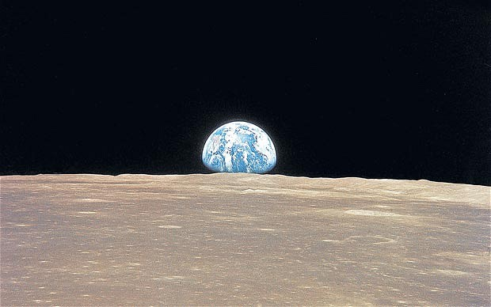
Non Contact forces
Non contact forces can act over a distance
Gravity – Keeps the Moon orbiting the Earth

Slide 18
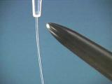
Non Contact forces
Non contact forces can act over a distance
Electrostatic force – making a stream of water bend

Slide 19
Task
Complete the practical following the instructions on the worksheet
Answer questions 1 – 8 on page 139 in full sentences

Slide 20
WILF
GW – Define the word force BI –Categorise the different forces into contact and non-contact forces EW – Speculate everyday examples where the different types of forces are used

