Slide 1
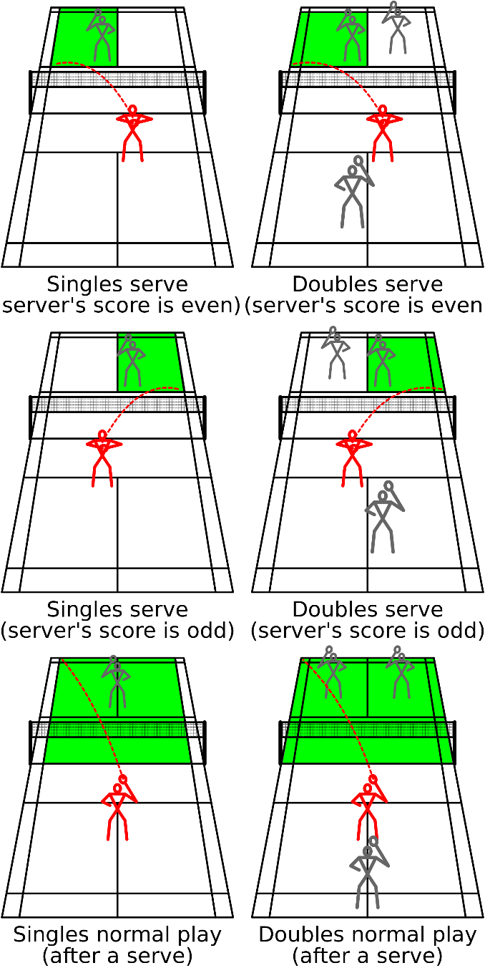
Knowledge Organiser – Badminton
Badminton Overview
Court Markings
1 | A match is played between either two individuals or two pairs. The individual or pair serve throughout the game. A badminton game is played up to 21 points, and a point can be scored from every rally. If the score reaches 20-20 then a two-point advantage is required for victory, however. If no player has managed to achieve this two-point advantage by the time the score reaches 29-29, then the first player to reach 30 is the winner. Matches are generally played over the best-of-three sets. A match consists of the best of 3
2 | The court must be rectangular and marked with lines. These lines are the boundaries in which the game must be played.
3 | In singles matches, the inside tram lines are “out” and in doubles the outside tramlines are “out”. The court is split into two halves by a net.
4 | The diagonally opposite boxes are called the service boxes.
Serving
5
Types of Shots / Techniques
6 | Short Serve | Racket is held across the body (backhand) and below waist height. Shuttle held out above racket and hit low over net diagonally.
7 | Overhead Clear | It is played to the opponent's back court and may be used defensively (high clear) or offensively as when played flatter (attacking clear).
8 | Drop Shot | A shot played with finesse to land the shuttle swiftly and close to the net on the opponent's side (tap shot)
9 | Smash Shot | It is the most attacking shot in badminton. It is an overhead shot which brings the shuttle down from a height at a steep angle.
10 | Net Shot | Shot hit from the fore court clearing the net and then falling rapidly
11 | Underarm clear/Long Serve | Shot played to back of opponent’s court (high). Stand sideways on and use whip action with the racket to create power on shot. When used as serve the player will need to serve diagonally to their opponent’s court.
12 | Tactics | Doubles Tactics- Positioning on court (Side by side/Front and back) Hitting into space- Moving opponent around the court Shot selection- Selecting the correct shot for correct situation Deception-Selecting shot to deceive/trick opponent Targeting opponents weakness

