Slide 1
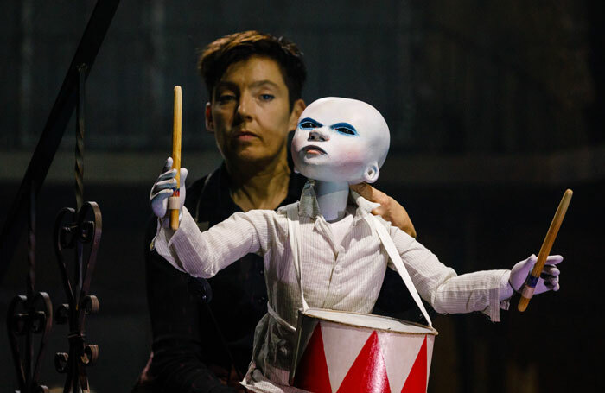
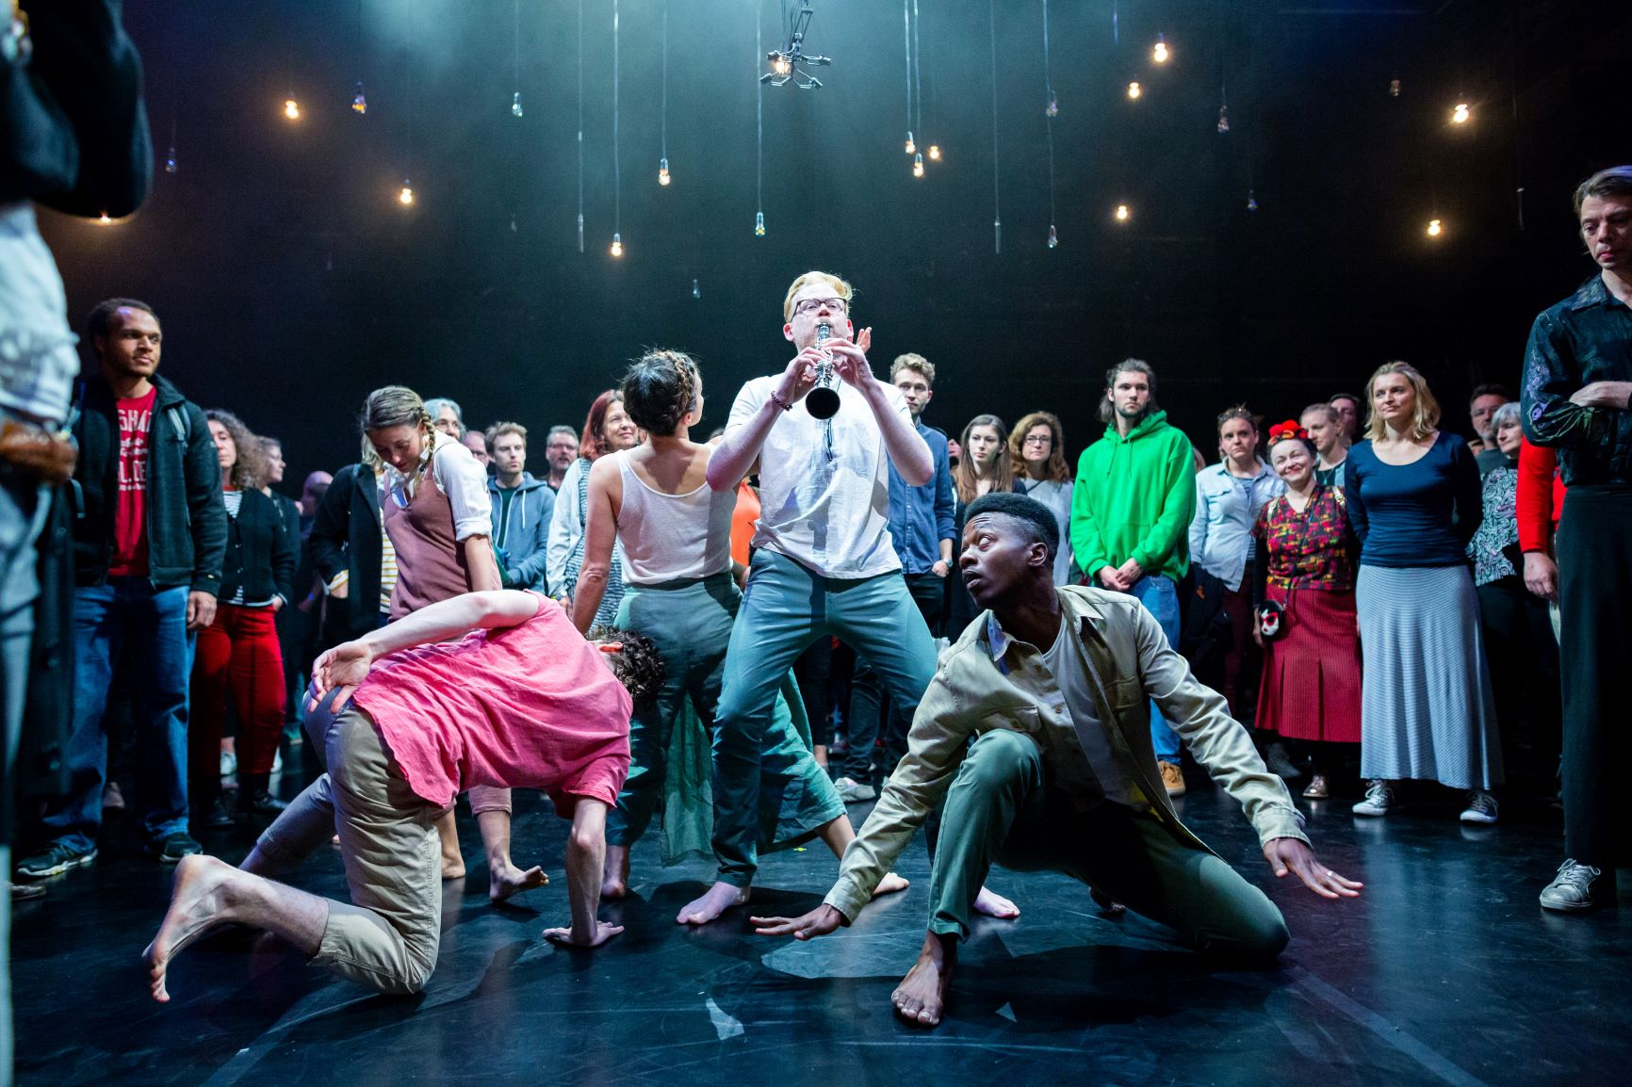
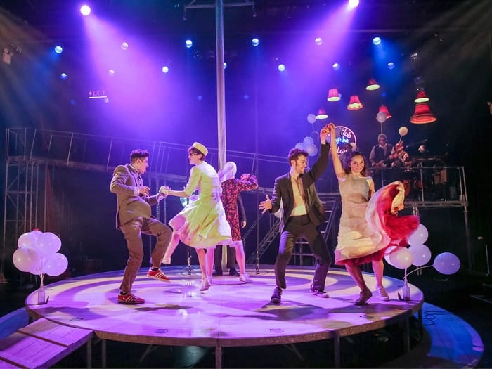
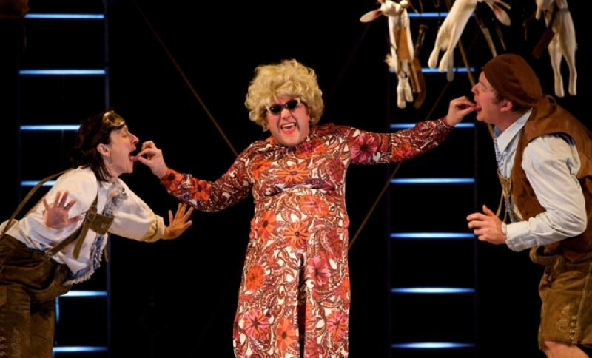
Devising Theatre

Slide 2
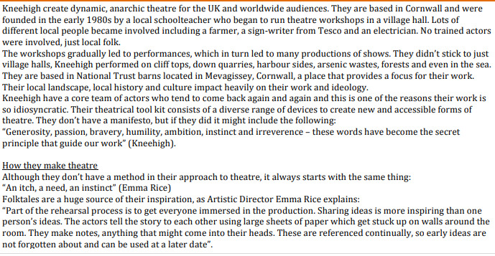
Devising Theatre

Slide 3
Devising Theatre

Slide 4
Devising Theatre

Slide 5
TASK 1
As we watch clips from Kneehigh’s Archive performances, use a whiteboard to write down key techniques or conventions that you see being used.
Devising Theatre

Slide 6
TASK 1
https://www.youtube.com/watch?v=D1KXcmFrJW4
Devising Theatre

Slide 7
TASK 1
https://www.youtube.com/watch?v=DP7EVLyzhuI
Devising Theatre

Slide 8
TASK 1
Devising Theatre

Slide 9
TASK 1
Devising Theatre

Slide 10
TASK 1
Devising Theatre

Slide 11
DO NOW: LIST ANYTHING YOU WOULD SEE IN A KNEEHIGH SHOW
Puppetry
Multi Role
Song & Dance
Devising Theatre

