Slide 1
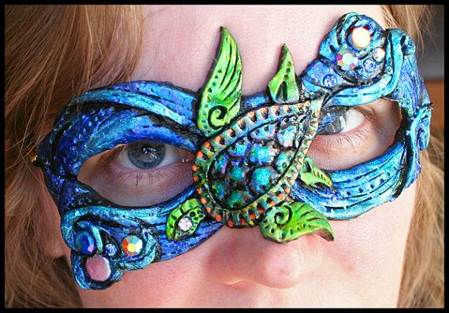
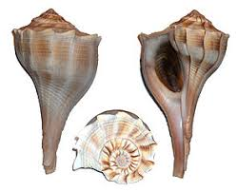
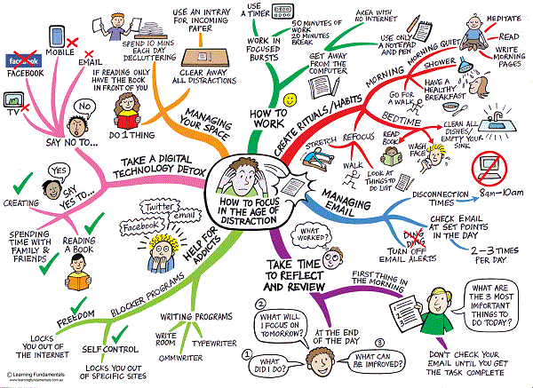
Knowledge Organiser – Ladders
Main tasks and assessment points
1 | Year 10 Unit 1. This unit is all about using mixed media and materials. This will be taught using Carnival Masks as the theme/inspiration.
Title page : Carnival Masks Create a page with lettering and imagery. APP1
Research page 1: Carnival Research All research pages need:
Title, background, relevant information, pictures, sketches and a personal comment. A.O.1
Research page 2 : Sea Life 8+sea life images, mind map on Seven Seas. A.O.2
Research page 3 : Watercolour techniques Samples of techniques with descriptions, sea life study, carnival study. A.O.2/3 S.A Sea Life sketch
Research page 4 : Experimentation with materials such as inks, pastels, printing. A.O.2
Key drawing terms/ information
2 | Line drawing - a sketch using lines and outlines, but no shading or tone. Lines can be different thicknesses. Look carefully a the basic shape.
3 | Tone/Shading - by pressing hard or lightly with our pencils, we can achieve a range of tones or shades. Using this on our drawings can help it look 3D and more realistic. There are many shading techniques.
4 | Texture - how the surface of something looks or feels, e.g. rough, smooth. We will create this using different techniques.
Other key terms for this unit
5 | Backgrounds – Use a range of materials and techniques to create interesting. Appropriate back grounds for your research pages. Try paints, torn paper, sponge textures etc.
6 | Carnivals - is a Western Christian and Greek Orthodox festive season that occurs before the season of Lent. Celebrations include street festivals, costumes, music and dancing. Look at Brazil, Notting Hill, Brazilica , Lpool.
7 | Sea Life- Your research can be about any creature or plant that has lived in the sea.
8 | Mind map – About Masks and Carnivals. You can make Two separate maps.
9 | Mixed Media- Use a variety of materials together on one piece of work. Experiment and explore different qualities of each material. E.g ink and wax.
10 | Personal comment –Write a brief comment that tells of your own opinions about work you have created or images you have looked at. Give reasons and justify your comments. They can be positive or negative.
Careers include: Fashion Design, Set Design, T.V, movies, Special Effects for films, Costume Designer, Sculptor, Ceramicist, 3D artist,

