Slide 1
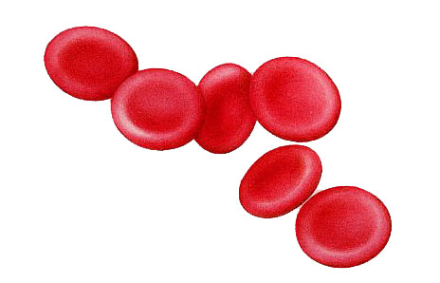
LP1 Knowledge Organiser – Science Year 7
Key Learning Points:
Topic: B1 Cells
Key Questions:
1 | Cell | Cells are the basic building blocks of all animals and plants. They are so small you need a microscope to see them.
2 | Nucleus | Contains genetic information that controls the functions of the cell. Found in both animal and plant cells.
3 | Cell Membrane | Controls what enter and leaves the cell. Found in both animal and plant cells.
4 | Cytoplasm | Where many cell activities and chemical reactions within the cell occur. Found in both animal and plant cells.
5 | Mitochondria | Provides energy from aerobic respiration. Found in both animal and plant cells.
6 | Chloroplast | Where photosynthesis occurs. Found only in plant cells.
7 | Vacuole | Used to store water and other chemicals as cell sap. Found only in plant cells.
8 | Cell Wall | Strengthens and supports the cell. Found only in plant cells.
9 | Eukaryotic Cells | These are cells that contain a nucleus and organelles.
10 | Magnification | The degree by which an object is enlarged. Magnification = (size of image) ÷ (size of real object)
11 | Microscope | An instrument used to magnify objects.
12 | Diffusion | The movement of particles from an area of high concentration to an area of low concentration.
13 | Concentration | A measure of the number of particles of a substance in a fixed volume.
14 | MRS GREN | A phrase to remember living organisms life processes. Movement, Respiration, Sensitivity, Growth, Reproduction, Excretion, Nutrition.
15 | Multicellular | A living thing that is made up of lots of cells.
16 | Unicellular | A living thing that is just one cell, e.g. Bacteria
17 | Organ | A group of different tissues that work together to carry out a particular function e.g. heart
18 | Organ System | A group of organs that work together to complete a specific function.
19 | Tissue | A group of similar cells that carry out the same function e.g. muscle tissue.
20 | Specialised | A cell that has become differentiated to carry out a particular function e.g. red blood cell.
Key Diagrams:
21
22
26 | Which cell parts are only found inside a plant cell?
27 | What is the role of a nucleus?
28 | Name the following cell and features it has to do its job.
29 | Name the following cell and features it has to do its job.
30 | What is the equation for working out the magnification on a microscope?
31 | What does the “N” in MRS GREN stand for?
32 | What are the lungs an example of?
33 | What type of cell is this?
34 | What is the job of the cell wall?
23
24
25

