Slide 1
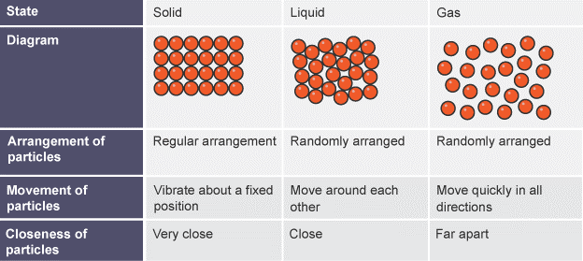
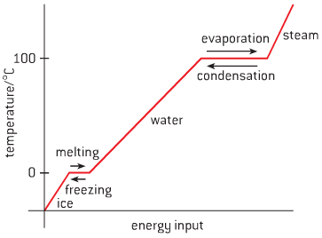
LP1 Knowledge Organiser – Science Year 7
Topic: C1 Particle Theory
Key Questions:
Key Learning Points:
Key Diagrams:
21 | How are the particles arranged in a solid?
22 | How are the particles arranged in a liquid?
23 | How are the particles arranged in a gas?
24 | What is the process called when a gas turns into a solid?
25 | What has to be done for a liquid to turn into solid?
26 | What is the process called when a liquid turns into a gas?
27 | What has to be done for a solid to turn into a liquid?
28 | Draw the particle diagram for a solid.
29 | What is the process of diffusion?
17
1 | Material | The different types of things that other things are made from.
2 | Particle | The very small things that materials are made up of.
3 | Mixture | A material made up of two or more other materials, each of which do not have the same properties.
4 | Substance | A material that is not a mixture. It has the same properties all the way through.
5 | Property | A quality of a substance or material that describes its appearance or how it behaves.
6 | Solid | Particles are arranged very close in a regular arrangement, they vibrate around a fixed position.
7 | Liquid | Particles are arrange close and in a random arrangement, they move around each other.
8 | Gas | Particles are arranged far apart in a random arrangement, they move quickly in all directions.
9 | Melting | When a substance turns from a solid to a liquid.
10 | Freezing | When a substance turns from a liquid to a solid.
11 | Evaporation | The process where a substance turns from a liquid to a gas.
12 | Condensation | The process where a substance turns from a gas to a liquid.
13 | Boiling | When substances change from the liquid state to the gas state.
14 | Density | 1 kg of a gas has a larger volume than 1 kg of a solid. There is empty space between particles in a gas, but in a solid, they are tightly packed together, so the density of the gas is much smaller than the density of the solid.
15 | Diffusion | Particles in a liquid or a gas spread out from an area of high concentration to an area of low concentration until the concentrations are equal.
16 | Pressure | The force over a given area.
18
19
20

