Slide 1
Do now task
How much can you remember?
How are tropical storms measured?
How would tourism in the UK change due to climate change?
What does interdependence mean?
What is the brain drain?
Pencil cases out
Conduct cards in pencil cases
Coats and bags off

Slide 2
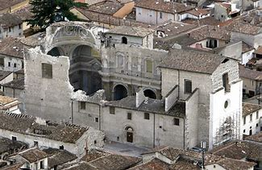
L’Aquila, HIC, 2009
Success Criteria
Bronze: Describe the reasons for and the general impacts of a HIC earthquake.
Silver: Compare the impacts of an earthquake between a HIC and an LIC
Gold: Identify and evaluate the factors which influenced the effects and responses to the earthquake.

Slide 3
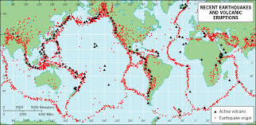
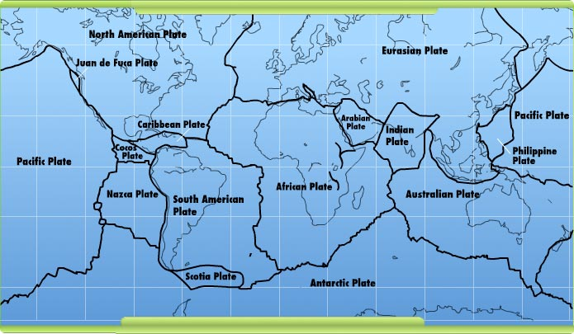
Pattern of earthquakes & volcanoes
Activate
Thinking hard: Trends and Patterns
Describe the global distribution of earthquakes & volcanoes (3)
T – Describe the overall trend. (Earthquakes & volcanoes tend to occur…)
E – Give specific examples. (For example, there are lots of…)
A – Point out any anomalies. (There are some hazards that do not fit this pattern. For example..)
Plate boundaries
Notes:
optional

Slide 4
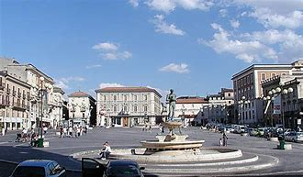
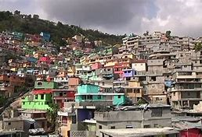
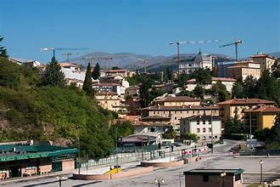
Activate
How does L’Aquila look different to Haiti?
L’Aquila
Haiti

Slide 5
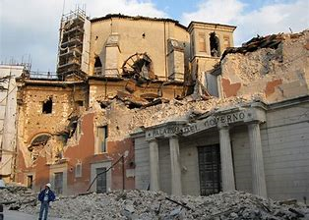
https://www.bing.com/videos/search?q=l%27aquila+earthquake+news&&view=detail&mid=E43E468C25CC85E32E46E43E468C25CC85E32E46&&FORM=VRDGAR

Slide 6
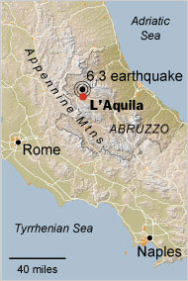
Demonstrate: Thinking Hard – use the card sort
1) Categorise the statements into impacts and responses.
2) Categorise the impacts into primary and secondary.
3) Categorise the responses into immediate and long term.
4) Colour co-ordinate the impacts into economic, environmental and social.
5) Compare: List the difference in death toll, homelessness and cost of Haiti. Explain some reasons for these differences.

Slide 7
Other factors which may affect severity
Depth of focus
Population density
Plate margin
Magnitude
Time of day
Time of year
Corruption

Slide 8
Consolidate Thinking hard: Practice
“Primary effects are more significant than secondary effects.” To what extent do you agree? [9]
On the one hand, primary effects are more significant. For example… This means that…
On the other hand, some would argue that secondary effects are more significant. For example… This means that…
In conclusion, I think that… This is because…

Slide 9
Homework – due next lesson
Research
1 – How buildings can be made more earthquake proof. Bring in no more than 200 words as a summary. In your own words.

