Slide 1
Primary Colours
WALT: Explain the difference between the primary and secondary colours.

Slide 2
WILF
GW - State that the secondary colours are a combination of 2 primary colours.
BI – Predict what colour will be reflected when coloured light is shone on coloured objects.
EW – Explain how the different wavelengths of colour are absorbed/reflected when we see objects.

Slide 3
Starter
Can you draw the colour mixing circles?

Slide 4
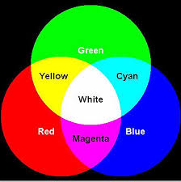
The colour mixing circles

Slide 5
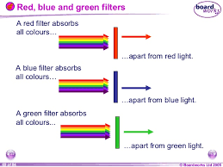
How do filters work?

Slide 6
What happens when white light and coloured light is shone on the secondary colour filters?

Slide 7
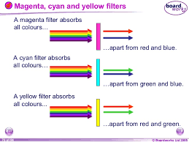

Slide 8
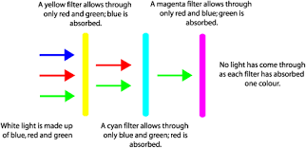

Slide 9
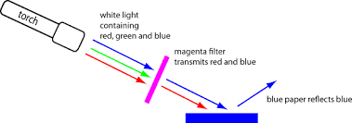

Slide 10
Task
Complete worksheet colour 3.

