Slide 1
Do now task
How much can you remember?
1. After the Anglo-Saxons who ruled England?
2. What does the word ‘crisis’ mean?
3. What century was the year 1066 is?
4. Who lost the Battle of Hastings?
Notes:
1. The Normans 2. A time of intense difficult or danger. 3. 11th century. 4. Harold Godwinson

Slide 2
The Feudal System and The Domesday Book
Learning Objective
I will be able to describe the Feudal System and the Domesday book
I will be able to explain how they both allowed William to ruler England
Keywords
System
Survey
Feudal

Slide 3
Read it:
Significance
Define it:
The quality of being worthy of attention; importance.
Deconstruct it:
From Latin significare ‘indicate, portend’.
Example:
The students were studying the significance of the Church Medieval England.
Digging Deeper:
It can mean the meaning to be found in words or events- “The significance of what was happening was very clear to me.”
Link it:
Importance, seriousness, noteworthiness, magnitude.

Slide 4
Feudalism – a system where different groups of people have different roles and responsibilities. The higher up the system, the fever people there are but the more responsibility they have.
Peasants – poor farmers
Knights – professional soldiers
Barons – noble and wealthy men

Slide 5
William was king but he could not run the country on his own.
He needed other people to help him run the country, in return for giving them land and power.
This was

Slide 6
The Feudal System

Slide 7
The Feudal System
King – ruled and protected the country
Barons & Nobles – given land by the King. Had land and power
Knights – fought for the King and country
Peasants – did all the work, like farming
How could this help King William?
Notes:
Students to draw it in the shape of a triangle to show the difference in the number of people at each part – Where the power was and who had it.

Slide 8
The King owned all the land.
The King gave some land to the Barons, if they promised to give him money and men for the army.
The Barons gave some of their land to the Knights, if they promised to fight when needed.
The Knights gave small strips of land to the peasants.
The Peasants had to farm the land.
Notes:
Explain this to students – discuss.

Slide 9
The feudal system gave the King an army – the ‘feudal host’.
It was the basis of the medieval class system – it defined who the ‘haves’ and who the ‘have-nots’ were.
However, the feudal system did not stop the Barons from rebelling against the King, or from torturing and killing their peasants.

Slide 10
Who do you think these people are in the Feudal system?

Slide 11
Who do you think these people are in the Feudal system?

Slide 12
Who do you think these people are in the Feudal system?

Slide 13
Who do you think these people are in the Feudal system?

Slide 14
Activity
You must complete the survey by going around the class and recording the information on to your worksheet.

Slide 15
In 1085 William the Conqueror ordered a survey to find out:
Who owned what
How much it was worth
How much was owed to him as King in tax, rents and military service
He sent officials (representatives) all over England to find out the wealth of the land and who owned it.
The results created what is known as the Domesday Book.
Why would King William want to know all of this information?

Slide 16
How did the Domesday book help William control England?
The Domesday book allowed William to collect taxes from everyone in the country more accurately.
Domesday means ‘judgement day’ and William used it to understand more about the land he had conquered and learn where to build more castles to keep the population under control.
The problem in collecting the information was that William’s men spoke Norman-French whilst the English spoke ‘Old English’.
The English did not have anyone ask them questions like this before and they were fearful of having to pay more taxes on what little they had.

Slide 18
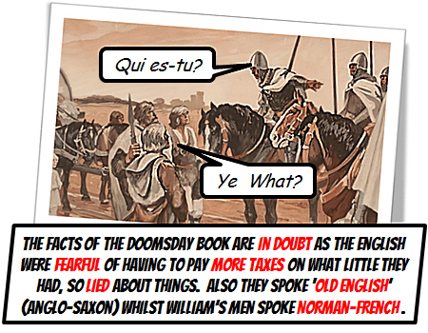

Slide 19
Describe the different parts of the Feudal system worked? (6 Marks)
The Feudal system had four different parts to it. At the top was the King. The King had to ………………………………………………
Secondly, there was the …………… They had to ……………….…………
Thirdly, there was the ………………. They had to …………………………
Finally, there was the …………………….. They had to ……………………
COPS Complete

Slide 20
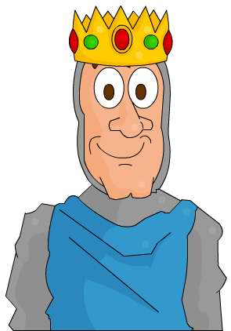
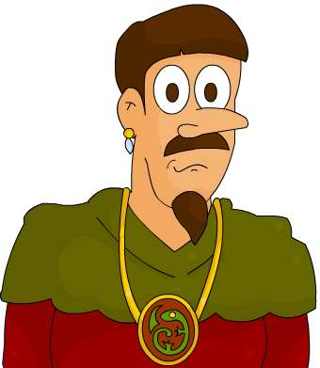
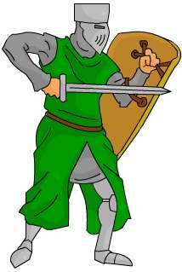
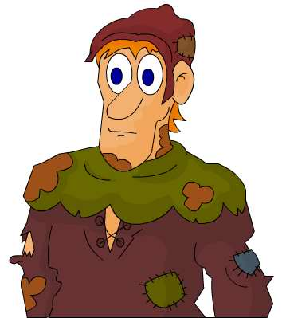
What would happen if the Barons were not loyal to the King?
How did the Feudal System work?
King
Provides money and knights
Grants land to
Barons
Provide protection and military service
Grants land to
Knights
Provide food and services when demanded
Grants land to
Peasants
Notes:
Est 10 mins Explain and get students to add annotation to the previously drawn feudal system.

Slide 21
The Feudal system and the Domesday Book
https://www.youtube.com/watch?v=dSSNDE6HH3c
The Feudal system and the Domesday Book
https://www.youtube.com/watch?v=p5UUTxEZZY8
https://www.youtube.com/watch?v=om_BIzXaVwU

