Slide 1
LP1 Week 5A 5th October Monday

Slide 2
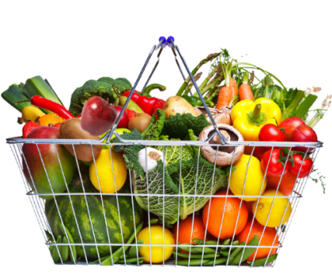
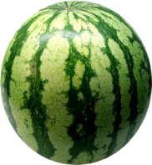
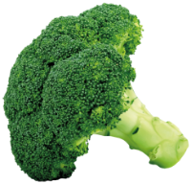
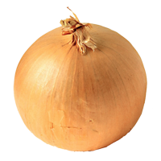
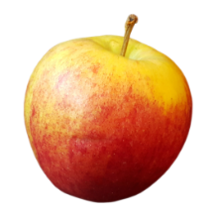
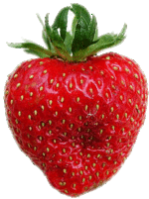
Year 7 LP1
English 5-a-day
Please answer on your paper sheet.
1
What was last week’s word of the week?
2
Write a sentence about the last chapter we read of CDF using alliteration.
3
How does chapter 3 build up a sense of wrongdoing and dishonesty?
4
Write an example of a concrete noun
5
Write an example of an abstract noun

Slide 3
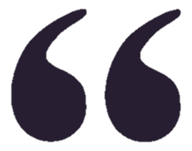
Read it:
Evidence
Define it:
(noun) Facts or information to prove or disprove an idea, theory or statement.
Deconstruct it:
From Latin evidentia, from evident- ‘obvious to the eye or mind’
Example:
Always find evidence in texts to help explain your ideas!
Digging Deeper:
In writing, evidence can mean quotes, either individual words, whole sentences or carefully chosen sections.
Link it:
Proof, confirmation, validation

Slide 4
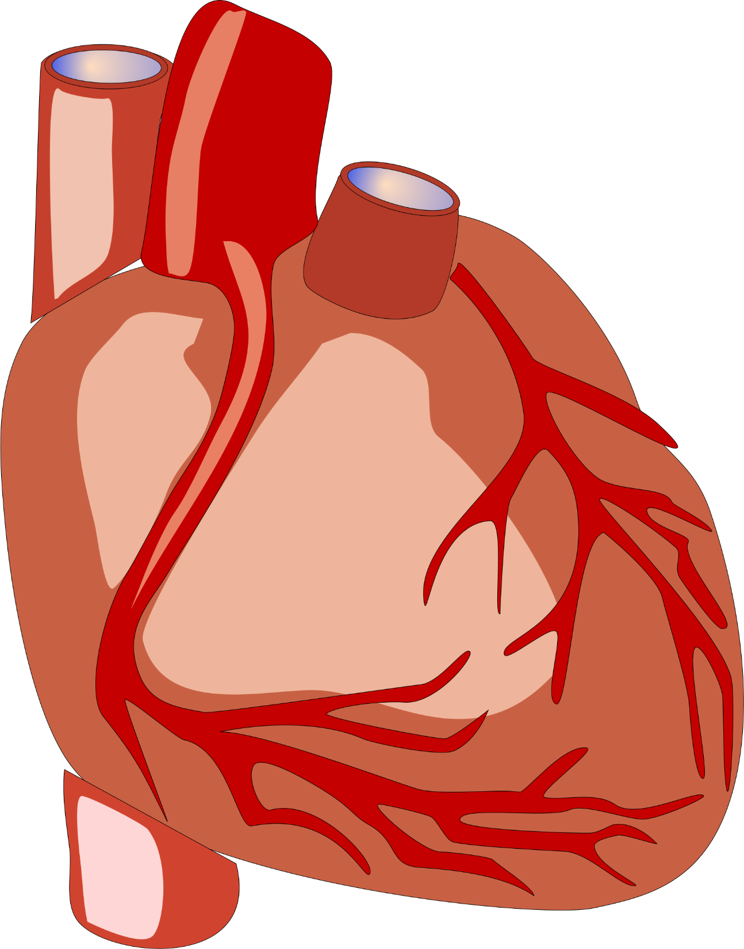
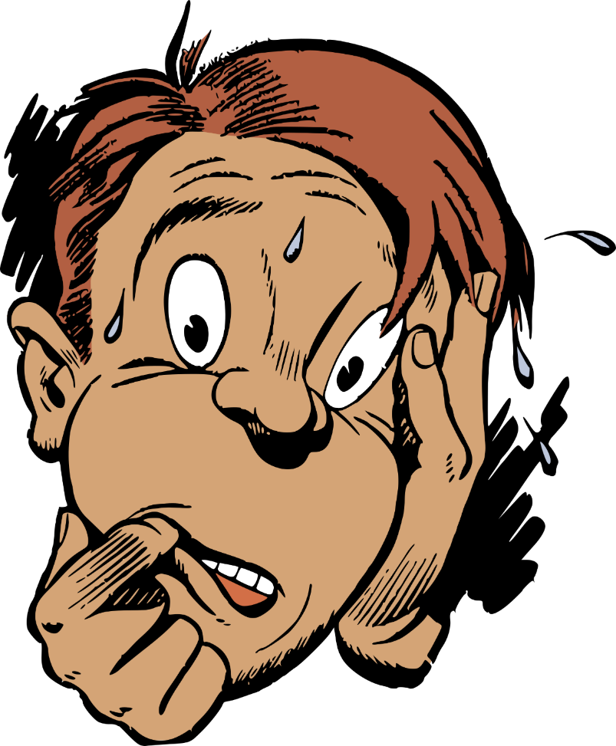
Chapter Nine and Tension
Do Now!!!
Starter…
What do writers do to make their writing tense, exciting and engaging?
We know tension is where a reader feels worried and scared for the characters in a narrative (story), but how can a writer create tension?
How can you use short sentences to make a story tense?
If you were writing a tense part of a narrative, how would you do it?
What are the best techniques for creating tension in a narrative? Why?

Slide 5
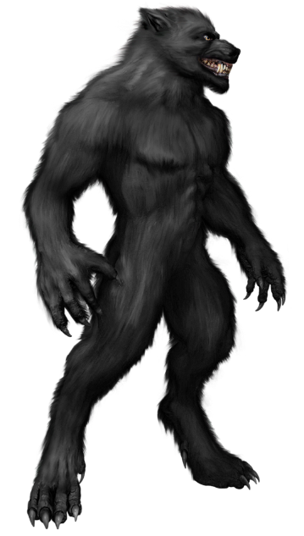
Learning objectives
Which
Words
Work?
To describe different ways of creating tension in your writing
To explain how Darren Shan creates tension for his readers in Chapter Nine
To use a quote and the words… The effect

Slide 6
How does the writer use language to create a threatening and terrifying atmosphere in this extract?
Task:
Read the passage- Underline/highlight all the words and images that are threatening
Name the Language used: adjective? Simile? Personification?
Explain the effect – read the following slides…

Slide 7
Which
Words
Work?
The Wolf Man and ladies were about halfway down the rows of seats when there was a big BANG! I know what made the noise, but suddenly the Wolf Man began roaring and he shoved the ladies away from him.
People screamed and those nearest him leapt from their seats and ran. One woman wasn’t quick enough, and the Wold Man leapt on her and dragged her to the ground. She was screaming fit to burst, but nobody tried to help. He rolled her over on to her back and bared his teeth. She stuck a hand up to push him away, but he got his teeth on it and bit it off!
A couple of people fainted when they saw that and loads more began yelling and running. Then, out of nowhere, Mr Tall appeared behind the Wolf Man and wrapped his arms around him. The Wolf Man struggled for a few seconds, but Mr Tall whispered something in his ear and he relaxed. While Mr Tall led him back to the stage, the women in the suits calmed down the crowd and told them to return to their seats.
While the crowd hesitated, the woman with the bitten-off hand went on screaming. Blood was pumping out of the end of her wrist, covering the ground and other people. Steve and me were staring at her, our mouths wide open, wondering if she was going to die.
Firstly
Furthermore
Finally
How does the writer use language to create a threatening and terrifying atmosphere in this extract?

Slide 8
LP1 Week 5A 5th October Tuesday

Slide 9
Year 7 LP1
English 5-a-day
Please answer on your paper sheet.
1
What word class is ‘evidence’?
2
Name three of the acts listed on the CDF flyer.
3
What does ‘Not for the feint-hearted’ tell the reader about the CDF?
4
Write an example of a collective noun
5
Adding a comma here will change the meaning. Where should it be?
“Let’s eat grandma!”

Slide 10
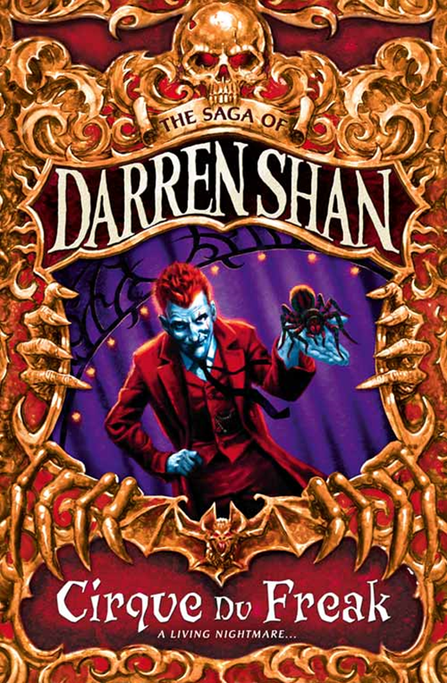
Fill the shapes with connotations of threat and fear…
Which
Words
Work?
Firstly
Furthermore
Finally

Slide 11
Fill the shapes with connotations of threat and fear…
Which
Words
Work?
Terrifying
Frightening
Disturbing
Daunting
intimidating
Sinister
Firstly
Furthermore
Finally

Slide 12
Which
Words
Work?
The Wolf Man and ladies were about halfway down the rows of seats when there was a big BANG! I know what made the noise, but suddenly the Wolf Man began roaring and he shoved the ladies away from him.
People screamed and those nearest him leapt from their seats and ran. One woman wasn’t quick enough, and the Wold Man leapt on her and dragged her to the ground. She was screaming fit to burst, but nobody tried to help. He rolled her over on to her back and bared his teeth. She stuck a hand up to push him away, but he got his teeth on it and bit it off!
A couple of people fainted when they saw that and loads more began yelling and running. Then, out of nowhere, Mr Tall appeared behind the Wolf Man and wrapped his arms around him. The Wolf Man struggled for a few seconds, but Mr Tall whispered something in his ear and he relaxed. While Mr Tall led him back to the stage, the women in the suits calmed down the crowd and told them to return to their seats.
While the crowd hesitated, the woman with the bitten-off hand went on screaming. Blood was pumping out of the end of her wrist, covering the ground and other people. Steve and me were staring at her, our mouths wide open, wondering if she was going to die.
Firstly
Furthermore
Finally
How does the writer use language to create a threatening and terrifying atmosphere in this extract?

Slide 13
Let’s work on an answer together… use the caterpillar connotations for threat and fear.
I (My turn):
We (Give me an idea):
You (Now it’s your turn to write an idea)

Slide 14
Let’s work on an answer together…
Fear – ‘a big bang’
I (My turn):
Firstly, the writer uses the adjective ‘big’, to describe the ‘bang’. The effect of this is that it creates a sense of fear, as a loud noise in the dark theatre would be scary.
Firstly
Furthermore
Finally

Slide 15
(WE) Let’s work on an answer together…
I (My turn):
We (Give me an idea):
Collect your ideas…
You (Now it’s your turn to write an idea)

Slide 16
How does the writer use language to create a threatening and terrifying atmosphere in this extract?
Which
Words
Work?
Purple Problem (Extension task)
Find another example of where SHAN creates a terrifying atmosphere… WWW? Explain
Firstly
Furthermore
Finally

Slide 17
LP1 Week 5A 5th October Wednesday

Slide 18
Year 7 LP1
English 5-a-day
Please answer on your paper sheet.
1
What is a synonym for ‘evidence’?
2
What is meant by the ‘atmosphere’ of a piece of writing?
3
Name one persuasive language feature used in the CDF flyer.
4
Select the right homophone: “There/their/they’re kit was bright red.”
5
Change these adjectives to comparatives: cheap, new, helpful

Slide 19
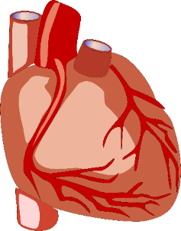
Here are many techniques you can use to create tension in your writing:
Which
Words
Work?
Short, snappy simple sentences that mean the reader has to keep pausing
Ellipses (…)
Keeping the action away from the reader as long as possible.
Powerful verbs (Thrashing, hitting, pummeling)
Including the 5 senses (See, hear, touch, taste, smell)
Emotive language
A change in the behaviour of characters
Creating an anxious mood and atmosphere to begin with
Changing to a chaotic mood and atmosphere
Speeding up or slowing down time
Repetition
Onomatopoeia (Crash! Bang! Wallop!)
Foreshadowing and foreboding (Hinting at what will happen)
Italics for emphasis
We’re going to read Chapter Nine now – this is a particularly tense chapter.
Find three different tension techniques in the chapter and write down quotes to back up your analysis.
Explain how each of these examples creates tension for the reader.
Evaluate which techniques the writer uses the most in order to build a sense of tension in his writing. Include specific examples and techniques in your evaluation.
Be a master tension maker!

Slide 20
LP1 Week 5A 5th October Thursday

Slide 21
Year 7 LP1
English 5-a-day
Please answer on your paper sheet.
1
Describe the meaning of ‘evidence’
2
Why did Darren stop lending Tommy his comics?
3
In Chapter 4, why does Darren shout at his Mum?
4
Change these adjectives to superlatives: happy, sad, important
5
Write a sentence beginning with an adverb

Slide 22
Analysing tension in chapter nine
Which
Words
Work?
Technique: Keeping the action away from the reader
Example: “There was no need for the screaming.”
How does it create tension in Chapter Nine? The writer begins by trying to make us feel relaxed and calm by saying the freak was not scary, but this means we will feel even more tense later on in the chapter.
Short, snappy simple sentences that mean the reader has to keep pausing
Ellipses (…)
Keeping the action away from the reader as long as possible.
Powerful verbs (Thrashing, hitting, pummeling)
Including the 5 senses (See, hear, touch, taste, smell)
Emotive language
A change in the behaviour of characters
Creating an anxious mood and atmosphere to begin with
Changing to a chaotic mood and atmosphere
Speeding up or slowing down time
Repetition
Onomatopoeia (Crash! Bang! Wallop!)
Foreshadowing and foreboding (Hinting at what will happen)
Italics for emphasis
We’re going to read Chapter Nine now – this is a particularly tense chapter.
Find three different tension techniques in the chapter and write down quotes to back up your analysis.
Explain how each of these examples creates tension for the reader.
Evaluate which techniques the writer uses the most in order to build a sense of tension in his writing. Include specific examples and techniques in your evaluation. Complete this in your exercise book.
Technique One: ____________
Example: “______________________”
How does it create tension in Chapter Nine? _________________________________________________________________________________________________________________________________
Technique Two: ____________
Example: “______________________”
How does it create tension in Chapter Nine? _________________________________________________________________________________________________________________________________
Technique Three: ____________
Example: “______________________”
How does it create tension in Chapter Nine? _________________________________________________________________________________________________________________________________

Slide 23
LP1 Week 5A 5th October Friday

Slide 24
Year 7 LP1
English 5-a-day
Please answer on your paper sheet.
1
What was last week’s word of the week?
2
What is ‘first person’?
3
What is ‘third person’?
4
Change these adjectives to superlatives: happy, fast, important
5
There, their or they’re? “The boys were running to ______ school.”

Slide 25
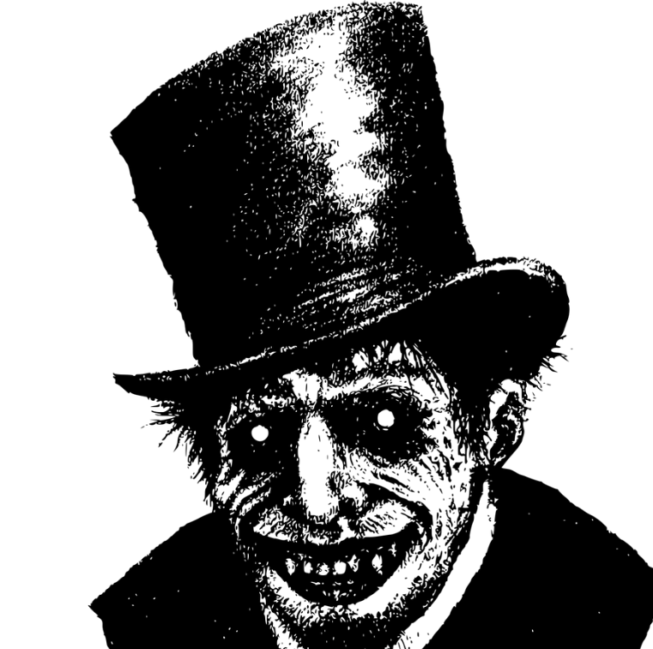
Mr Tall has decided he wants to test your analytical skills…
Discussion: What will you need to include in your response to this question in order to make it really successful? You’ve got to prove yourself to Mr Tall!
Here’s my question: “How does Shan create tension for the reader in Chapter Nine?”
Are you up for the challenge or do you need a babysitter to help?
Firstly
Furthermore
Finally
What a horrible man he is!

Slide 26
We’re now going to work on responding to Mr Tall’s challenge!
What should be our success criteria for judging the success of our analytical paragraphs:
1)
2)
3)
4)
5)
Here’s my question: “How does Shan create tension for the reader in Chapter Nine?”
Firstly
Furthermore
Finally

Slide 27
Using our success criteria, we’re going to answer Mr Tall’s question now
In Chapter Nine Shan is able to create tension for the reader by using… When we are told “…” this helps the reader to understand that… In particular, when it says “…” This effect on the reader is…
Here’s my question: “How does Shan create tension for the reader in Chapter Nine?”
Firstly
Furthermore
Finally
Really want to challenge yourself? Write an analytical paragraph about which tension techniques Shan uses the most and why.
Fill in the gaps!

Slide 28
Plenary: Tall Tales
Working in a pair, one person needs to pretend they are Mr Tall and the other explains what they have learnt from today’s lesson.
To describe different ways of creating tension in your writing
To explain how Darren Shan creates tension for his readers in Chapter Nine
To evaluate the effectiveness of our analytical paragraphs
Firstly
Furthermore
Finally

