Slide 1
Do now task
How much can you remember?
1. How was Hungary connected to the Soviet Union?
2. What year was the Hungarian uprising?
3. During WW2 who took over Vietnam?
4. Who did the Vietminh defeat at the battle of Diem Bien Phu?
Notes:
1. Hungary was a satellite state of the SU. 2. 1956. 3. Japan. 4. The French (France).

Slide 2
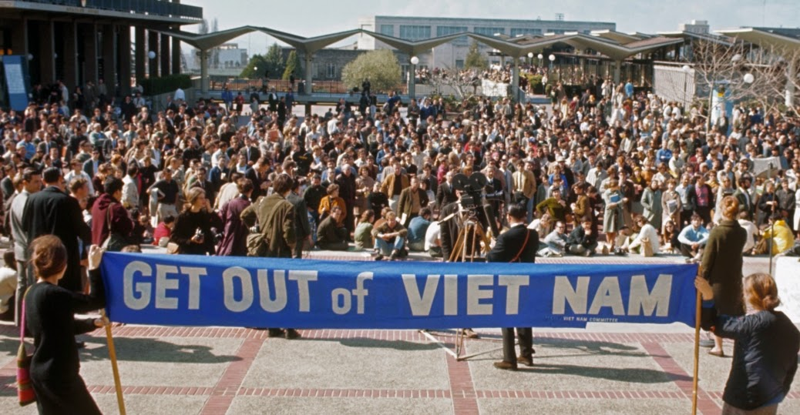
Opposition to the war
What can you infer from this source?
Learning Objective
I will understand why there was opposition to the war.
I will be able to explain the different reasons for people opposing the war.

Slide 3
Initial reaction to the war
- Before 1965, there was broad support for US involvement.
- Some anti-war groups spoke out from the start.
- Once LBJ escalated the war, the media and the public grew concerned.
- Opposition came from people of every race, class, age and religion.
Why was there support for the war before 1965?
Why would an escalation of the war create more opposition?

Slide 4
https://www.bbc.com/bitesize/guides/z89hg82/revision/6
Watch the video clip and answer the questions below.
1. Who decided to not run for election again?
2. Who became President in 1969?
3. What was Vietnamisation?
4. What year did the USA leave Vietnam?
5. Who opposed (against) the war?

Slide 5
How could a living room war lead to opposition?
First war to be widely watched on TV!
Ordinary Americans watched news reports
on the war and anti-war protests.
Saw the violence, death and bombings!
Lost faith in the government! Clear that they were lying and keeping information!
Living Room War
Why would seeing war on TV lead to opposition?

Slide 6
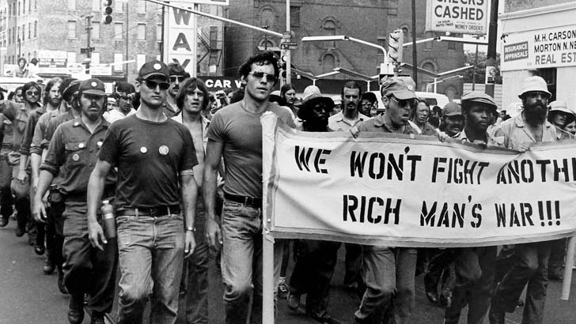
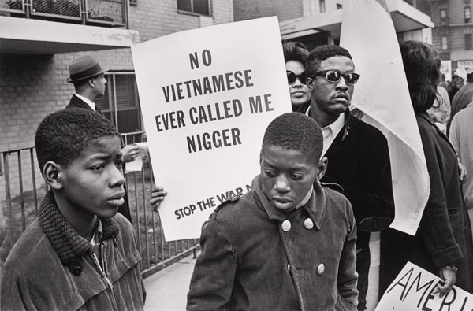
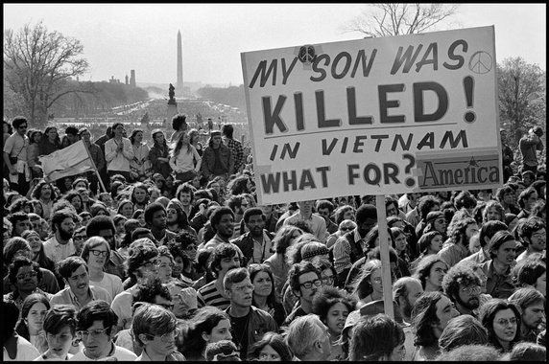
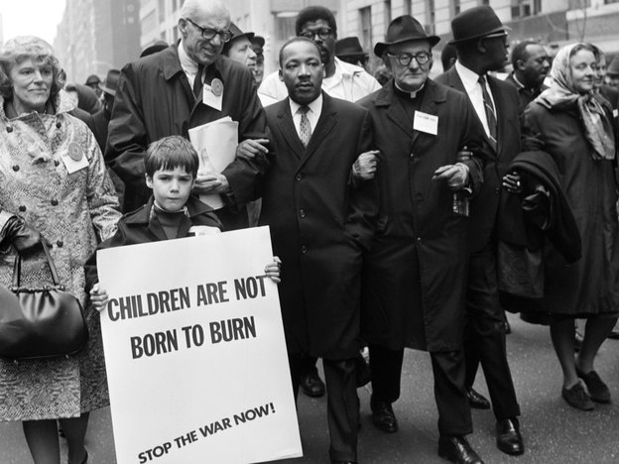
Notes:
Examine each image and decide what type of people are opposing the war and why they would oppose it? (Whiteboards)

Slide 7
Short term factors
Events like the TET Offensive and invading Cambodia triggered opposition.
The cost of the war paid for by taxes. Money could be spent elsewhere.
Some black Americans opposed fighting for a country where they faced racism daily.
What reason would make you oppose the war?
Religious beliefs
Believed all war is wrong.
Long term factors
-Rising death toll
-Loss or serious injury of loved ones
-Length of the war.
Opposition to the war
The student movement – rejected the values of their parents (counter culture) and wanted social change.
Mostly white and middle class.
Students for a Democratic Society (SDS) supported communists. “Hey, hey, LBJ How many kids did you kill today?”
Can you think of a reason that would make you support the war?

Slide 8
https://www.youtube.com/watch?v=-7Y0ekr-3So Country Joe McDonald
https://www.youtube.com/watch?v=Kt5MDaTapEw Burning draft cards
https://www.youtube.com/watch?v=HeFMyrWlZ68 Muhammad Ali
https://www.youtube.com/watch?v=QAT1KA3Xjbs media

Slide 9
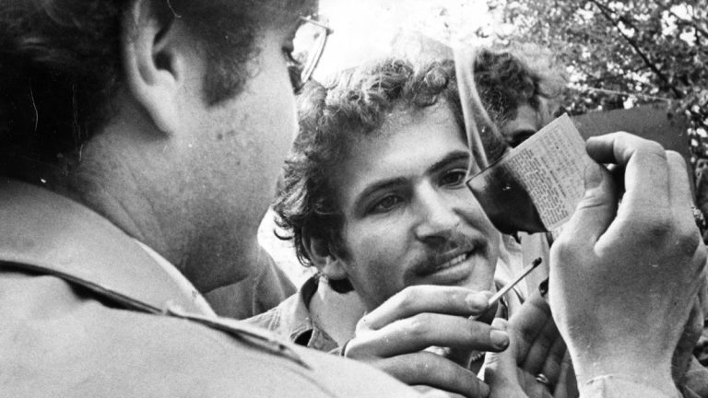
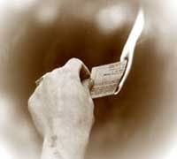
The draft
- Compulsory service in the military. Drafted from the age of 18 and given basic training.
- Many thought it was unfair as they were too young and not well enough trained.
- Poor families, black and white were less able to avoid it.
- Later changed to a lottery system.
Why would the draft lead to opposition?
Why could the rich avoid it?

Slide 10
Explain why there was opposition to the war (8 marks)
There was opposition to the war for a number of reasons. One reason there was opposition was ….
This meant that …. This led to …
Another reason there was opposition to the war was because ….
This meant that ….. This led to …
Third reason there was opposition was ….. This meant that …… This led to …
Finally, there was opposition to the war because …. This meant that ….. This led to …

Slide 13
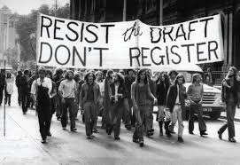
Whiteboard Recap
Example Answer
What I can infer: From source A I can infer large numbers of people mobilised to campaign against the war in Vietnam.
Details in the source that tell me this: The details in the source that tell me this are that the demonstration was arranged by the National Mobilisation Committee to End the War. By refusing to accept the draft their aim was to make the war impossible to continue.
What I can infer: From source A I can also infer that the demonstrators took their national campaign to the political centre of the country. They clearly sought to speak directly to the politicians who made policies about the war.
Details in the source that tell me this: The details in the source that tell me this is the fact that the demonstration took place in Washington DC.
Give two things you can infer from this source about the anti-war movement in the USA from 1969 onwards. (4 marks)
What I can infer:
………………………………………………………………………………………………………………………………………………………………………………………………………………
……………………………………………………………………
Details in the source that tell me this:
………………………………………………………………………………………………………………………………………………………………………………………………………………
……………………………………………………………………
Source A, Draft resisters at a demonstration in Washington DC arranged by the National Mobilisation Committee to End the War in Vietnam, 1969.

Slide 14
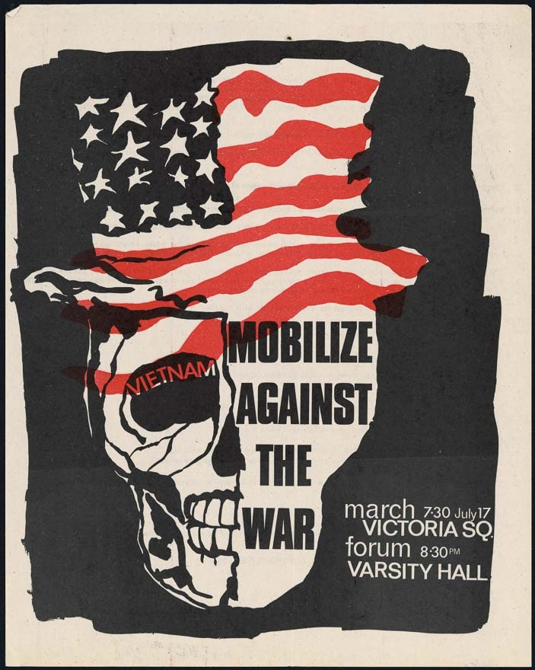
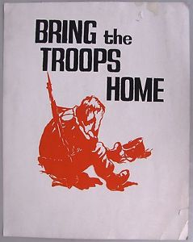
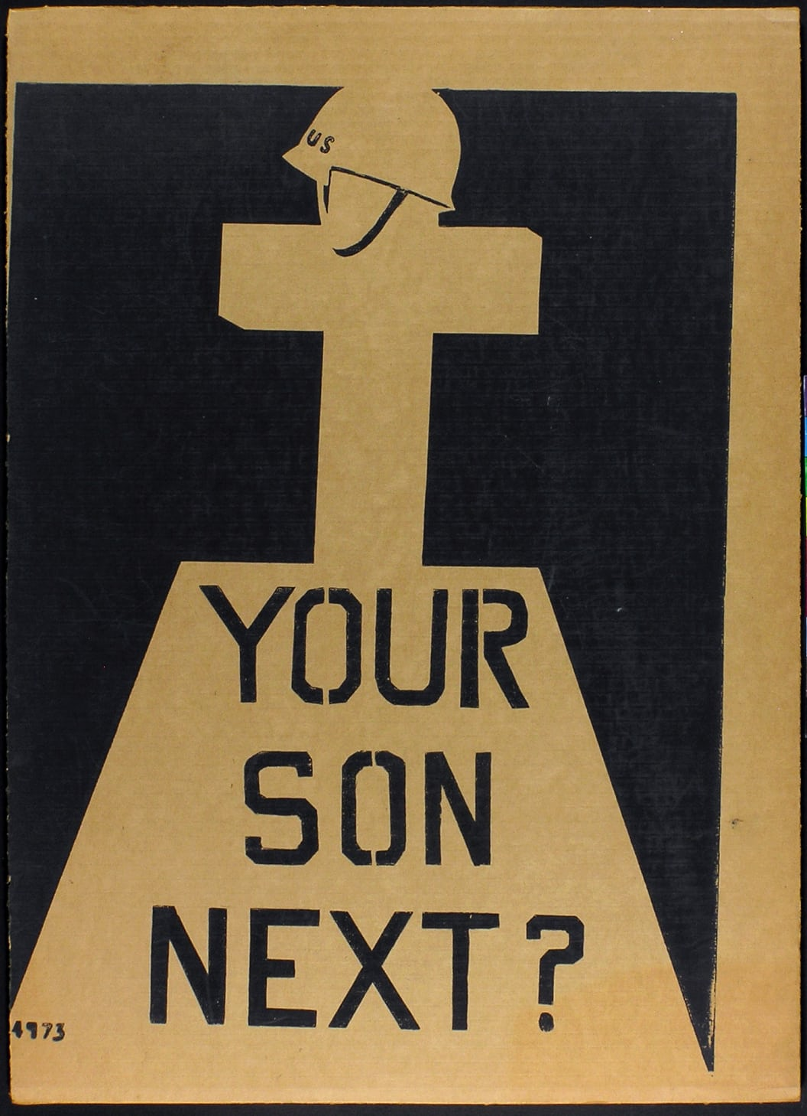
Plenary – Design an anti-war poster
Chose a certain type of opposition
-Student movement
-Young people
-Black person
-Poor people
-Religious beliefs
*Include as much information you have learnt as possible*

Slide 15
Exit Ticket
Identify the correct statement
A – Before 1975, there was broad support for US involvement in Vietnam. Some anti-war groups spoke out from the start. Once LBJ escalated the war, the media and the public grew concerned. Opposition came from people of every race, class, age and religion.
B – Before 1965, there was broad support for US involvement in Vietnam. Some anti-war groups spoke out from the start. Once LBJ escalated the war, the media and the public grew concerned. Opposition came from people of every race, class, age and religion.
C – Before 1965, there was broad support for US involvement in Vietnam. Some anti-war groups spoke out from the start. Once JFK escalated the war, the media and the public grew concerned. Opposition came from people of every race, class, age and religion.
Notes:
ANSWER - B

