Slide 1
Do now task
How much can you remember?
How many black students tried to enrol at Little Rock?
What year was the Civil Rights Act passed?
What year was the Voting Rights Act passed?
Which US President passed both of the above Acts?
Notes:
1. Nine. 2.1964. 3. 1965. 4. President Johnson.

Slide 2
Wolsey’s rise to power
Recap – True or False
1. Henry was the eldest son of Henry VII.
False – Second son.
2. Henry’s reign began in 1609?
False - 1509.
3. Henry wanted to be a renaissance king.
True.
4. Henry did not believe in the Divine Right of kings.
False – he did believe in it.
5. One of Henry’s aims was to win back lands from France.
True.
Learning Objective
I will understand who Wolsey was.
I will be able to explain how Wolsey rose to power.

Slide 3
Read it:
Describe
Define it:
Give a detailed account in words of an event.
Deconstruct it:
late Middle English: from Latin describere, from de- ‘down’ + scribere ‘write’.
Example:
Describe the leadership of Martin Luther King.
Link it:
Mark out, outline, recount.

Slide 4
‘In 1509, England’s new King had everything going for him.’ How far do you agree? (16) You may use the following in your answer: - English government - The alliance with Spain
Plan this answer
Structure
-Intro – Agree/partly agree/disagree
-On one hand, I agree with the statement (At least 2 different points explained)
-On the other hand, I disagree with the statement (At least 2 different points explained)
-Conclusion
To answer this successfully you need to talk about Henry’s strengths and weaknesses when he became king.
List them first
Strengths Weaknesses
Notes:
DON’T DO THIS JUST PLAN IT BUM the question – on one hand – youth, wealth, stable government and country left to him, alliance with Spain (very powerful), very popular, smart and intelligent, on the other hand – he was not interesting in the daily running of a country, no male heir at this point, was not trained to be king as his older brother was, stubborn, did not listen to advice very often, not a major power in Europe– conclusion

Slide 5
Who was Wolsey?
Wolsey
Notes:
Spider diagram facts about Wolsey on the following slides.

Slide 6
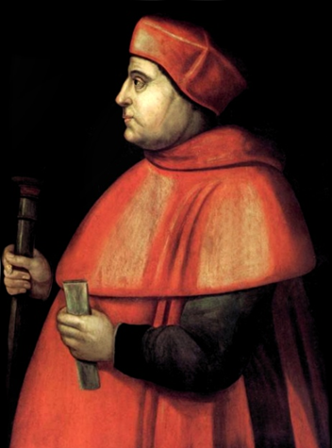
Who was Wolsey?
Born in 1472 Thomas Wolsey was the son of an Ipswich butcher. He graduated from College in Oxford, and was ordained into the priesthood in 1498. He became a Royal Chaplain (private priest) in 1507 to King Henry VII.
The accession of Henry VIII to the throne in 1509 helped Wolsey’s further rise to power. It was he who provided the King with an army and a strategy to beat the French at the Battle of the Spurs in 1513.
In 1514 he became Archbishop of York, which was the second most powerful position in the Church throughout England. He also became Papal legate in 1518. The real peak of his power was reached when he was appointed Cardinal and Lord Chancellor in 1515. He was thereafter Henry’s chief minister until his fall from grace in 1529.

Slide 7
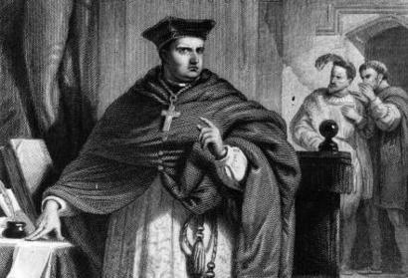
Who was Wolsey?
He was charming and gifted, and he dominated the country’s legal, financial and administrative system following his appointment as Lord Chancellor in 1515. As Lord Chancellor, Wolsey was the king’s chief minister and main advisor on all things.
Wolsey was one of England’s most important churchmen (as Archbishop of York and then a cardinal). He was also skilled in building relationships with other powerful countries.
Known as Alter Rex (second king).

Slide 8
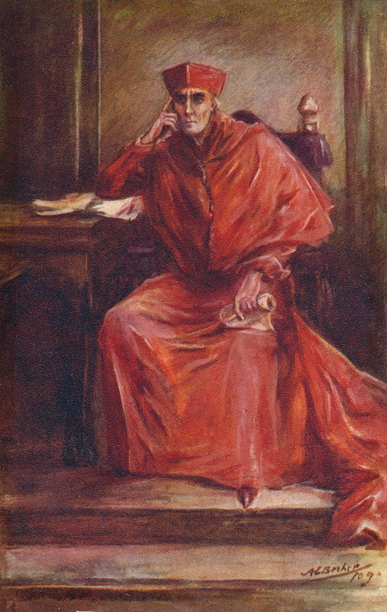
Who was Wolsey?
Wolsey built palaces and gained a fortune second only to the king himself, which showed how great his status was in Tudor England. He was able to live like a king. This is unusual considering he was the son of an Ipswich butcher.
His father, a relatively wealthy butcher and cattle dealer, provided his son with an excellent education, allowing him to enter Oxford University to study to become a priest. This was one of the few ways ambitious young men without a noble background could advance in the world.

Slide 9
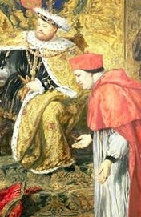
Who was Wolsey?
Wolsey was very intelligent and made the most of this opportunity – gaining his degree when he was only 15 years old. When he came to power, Wolsey engaged with a huge rebuilding programme at Oxford University.
When Henry VIII became King, Wolsey was appointed onto the Royal Council. This gave him access to the new King and the opportunity to build a personal relationship with the new King, using his charm, flattery and wit.

Slide 10
Reasons for Wolsey’s rise to power 1
Henry did not involve himself with the day to day running of government. This increased Wolsey’s power as he was left to carry out the important tasks that bored Henry.

Slide 11
Reasons for Wolsey’s rise to power 2
Wolsey’s appointment as Royal Almoner in 1509 (in charge of donations to the poor) made him a member of the Royal Council. This gave him regular access to the king. This allowed him to influence Henry and other members.

Slide 12
Reasons for Wolsey’s rise to power 3
Henry disliked many of his father’s advisers who he saw as too cautious and unpopular. This removed potential rivals and made Wolsey’s rise to power easier.
Wolsey was ambitious and driven to get power and influence.

Slide 13
Reasons for Wolsey’s rise to power 4
Wolsey’s persuasive skills and his use of flattery enabled him to have influence over the king and made him an effective negotiator on Henry’s behalf.
His ruthlessness and willingness to financially ruin his rivals stopped many from challenging him or his position. This allowed him to gain even more power.

Slide 14
Reasons for Wolsey’s rise to power 5
The war with France in 1512 allowed Wolsey to impress Henry. He organised a well-equipped and a well-supplied army. He showed skills that Henry would need and this increased his power and influence at court.

Slide 15
Explain why Wolsey had become Henry’s chief minister by 1515. (12 marks) You may use the following in your answer: -Wolsey’s appointment as Royal Almoner -Henry’s dislike of his father’s advisers You must also use information of your now.
……………………………………………………………………………………………………………………………….
……………………………………………………………………………………………………………………………….
……………………………………………………………………………………………………………………………….
……………………………………………………………………………………………………………………………….
……………………………………………………………………………………………………………………………….
……………………………………………………………………………………………………………………………….
……………………………………………………………………………………………………………………………….
……………………………………………………………………………………………………………………………….
Notes:
Try to include 3 to 4 separate points.

Slide 16
Exit Ticket
Identify the correct statement
A – The war with France in 1502 enabled Wolsey to prove his worth to Henry by organising a well-equipped and well-supplied army. Wolsey demonstrated skills that Henry later relied on, increasing his power and influence.
B – The war with France in 1512 enabled Wolsey to prove his worth to Henry by organising a well-equipped and well-supplied army. Wolsey demonstrated skills that Henry later relied on, increasing his power and influence.
C – The war with Spain in 1512 enabled Wolsey to prove his worth to Henry by organising a well-equipped and well-supplied army. Wolsey demonstrated skills that Henry later relied on, increasing his power and influence.
Notes:
ANSWER - B

