Slide 1
Do now task
How much can you remember?
Why does the distribution of China's population differ across the country?
How does inequality link to Mumbai?
3. Is a tsunami a primary or secondary effect? Why?
4. Name 5 countries in Asia
Pencil cases out
Conduct cards in pencil cases
Coats and bags off
Notes:
East by the coast good for trade/ west id hot and dry mainly desert or mountain regions unsuitable for development
Rich and poor in one city/ conflict/ housing/ healthcare and opportunities
secondary…. Was a knock on from the earthquake
Russia: China: India: Kazakhstan: Saudi Arabia: Indonesia: Iran: Mongolia: Pakistan: Turkey: Myanmar (Burma): Afghanistan: Yemen:
Thailand: Turkmenistan: Uzbekistan: Iraq: Japan: Vietnam: Malaysia: Oman: Philippines: Laos: Kyrgyzstan: Syria: Cambodia: )
Bangladesh: Nepal: Tajikistan: North Korea South Korea: Jordan: Azerbaijan: United Arab Emirates:
Georgia: Sri Lanka: Bhutan: Taiwan: Armenia: Israel: Kuwait: Qatar: Lebanon: Brunei: Hong Kong: Bahrain: Singapore: Maldives

Slide 2
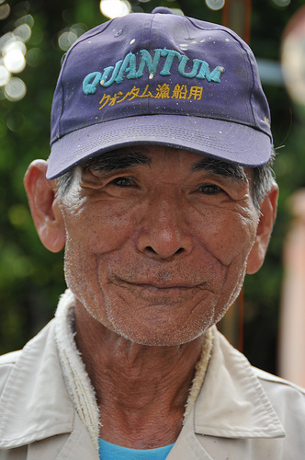
Gangster Grannies (and Grandads)
Starter: Why did this 77 year old Japanese man, who had never broken a law before in his life, end up in prison?
Write down your reason in your book!
https://www.youtube.com/watch?v=BClrkMopItM

Slide 3
Japan struggles with elderly crime wave
Japan has low levels of crime, except among elderly!
Y8.3 billion (£39 million) is spent on constructing three new prison wards that are specifically designed to cater to the rising number of elderly inmates.
Think: Why are elderly people committing crimes?

Slide 4
Class reading
Read through the BBC news article ‘Why some Japanese elderly want to go to jail’.
https://www.bbc.co.uk/news/stories-47033704

Slide 5
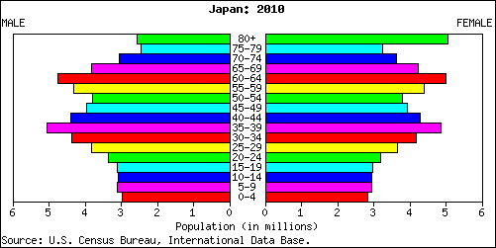
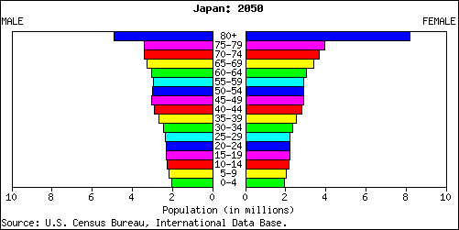
Population Pyramids
Population pyramids are graphs that show population structures (ie. how many males and females of different age groups are in the population in each place).
https://www.youtube.com/watch?v=EKTJQZ9fhBo

Slide 6
Task: Complete the questions as a class
What can we tell about the life expectancy and birth rates?
In which year will more tax be paid?
Who is dependent?

Slide 7
1.
2.
3.
4.
5.
Task: Think of 5 things that old people need to survive.
Which of these can a prison provide?

Slide 8
Shoplifting is considered a minor crime in Japan.
Look at the statistics for Shoplifting offences committed by 65+ year olds in Japan.
Describe the distribution of shoplifting offences by 65+ in Japan between 2005 and 2016.

Slide 9
Many elderly are repeat offenders who commit another minor crime shortly after their release simply to get back into a community where they are comfortable, warm, fed and have friends of their own age.
https://www.youtube.com/watch?v=rmkFl60w0ZA

Slide 10
How to support the elderly in Japan
The elderly are offending so they are in a community where they are comfortable, warm, fed and have friends of their own age.
Task: In your books write an argument about how the Japanese government could better support the elderly.
Include written ideas of how you can Japan can help the elderly and drawings too!
Use the pictures to help you!

