Slide 1
DO NOW TASK (RP)
What colour is the roaring flame?
Which flame has the hottest temperature and why?
What are forces measured in?
What scientific instrument is used to measure forces?
Name the two categorisations of forces
Blue
Roaring flame because there's more oxygen supply (because of air hole)
Newtons (N)
Newton-Metre
Contact forces and non contact forces

Slide 2
Measuring forces

Slide 3
WALT
Be able to measure forces and know the unit of force

Slide 4
WILF
GW – Draw arrows to represent the forces acting on an object BI – Investigate the weight of objects using force meters EW – Draw diagrams including forces drawn to scale

Slide 5
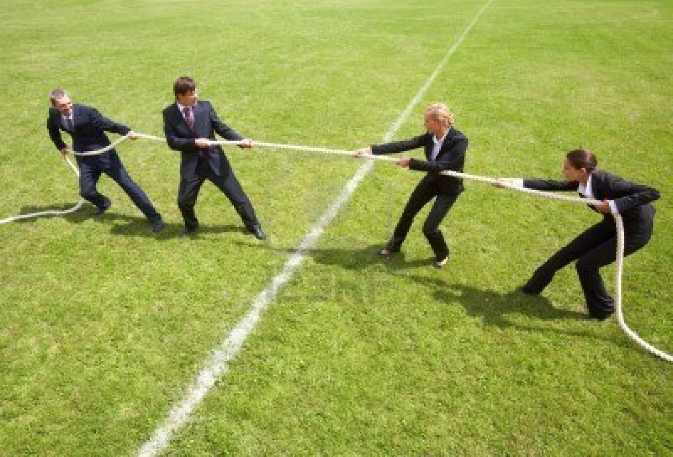
Representing forces
We represent forces on diagrams with arrows

Slide 6
Task
Draw a diagram/picture of a tug of war showing the forces involved.

Slide 7
Task
Measure the weight of different objects in the room. Try measuring the force of your pencil case, coat, shoe, etc. and record in the table below.
Make sure you choose your force meter carefully to avoid damaging it.
Object | Weight (N)

Slide 8
Mass and weight

Slide 9
Working scientifically
In science you have to follow certain rules when you are drawing a graph
Axis labelled
Units on axis
Uniform (even) scales
Title
At least ½ page in size
This means anyone else can understand what your graph is telling them.

Slide 10
Task
Plot a graph of your results, take care to follow the rules of graphs in science
Axis labelled
Units on axis
Uniform (even) scales
Title
At least ½ page in size

Slide 11
Force (N)
Mass (kg)

