Slide 1

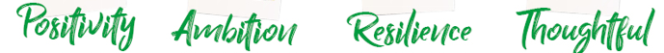
Do now task
How much can you remember?
What is another word for cosmological (argument)?
What is another word for design argument)?
Who developed the design argument?
How many days did it take God to create the world?
Notes:
Causation
Teleological
William paley
7

Slide 2
Read it:
Moral
Define it:
Right and wrong behavior
Deconstruct it:
from Latin moralis "proper behavior of a person in society,"
Example:
I am a moral person
WOW
Link it:
Right, ethics, conscience, consequence

Slide 3
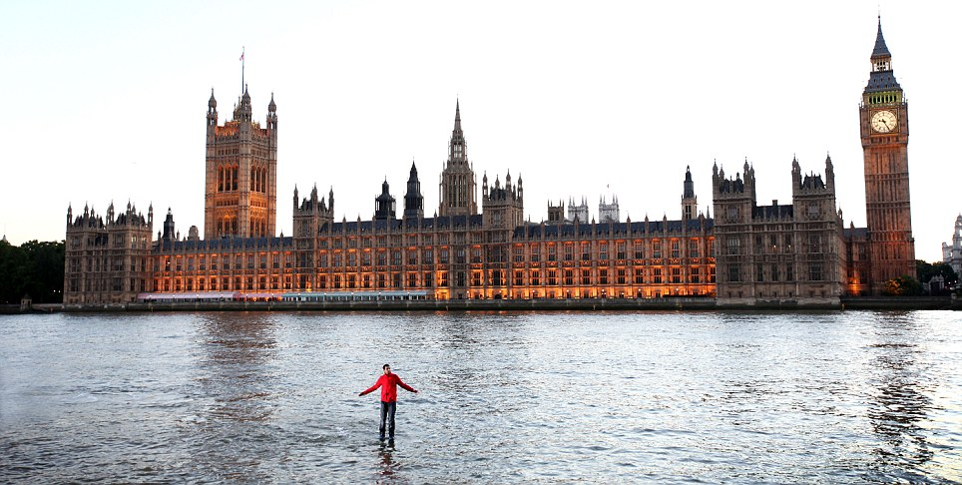
Title: Miracles
What is happening in this picture?

Slide 4
Lesson Objectives
By the end of the lesson everyone will know what a miracle is.

Slide 5
Key Words
Miracle
Mystery
Coincidence
What do these words mean?

Slide 6
Match up the words with the definitions.
Miracle
Mystery
Coincidence
something that cannot be explained.
If I wanted an ice cream and then an ice cream van appeared.
an event that defies the law of nature, that can be linked to a God or the supernatural.

Slide 7
Key Words
Mystery – something that cannot be explained.
Coincidence- A remarkable concurrence of events or circumstances without apparent casual
connection.
Miracle – an event that defies the law of nature, that can be linked to a God or the supernatural.

Slide 8
Think, pair, share
With the person next to you can you think of any miracles?
Write them down in your books.

Slide 9
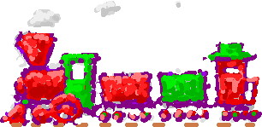
A child is stuck on a railway line. A train is coming, but the driver fails to see the child. However just in the nick of time the driver faints, his hand is taken off the lever and the train breaks automatically. The train then stops in front of the child.

Slide 10
What is a…
Miracle
Coincidence
Mystery

Slide 11
Team work
In groups you will all learn about a different event.
You will need to fill in your sheets.
Is it a miracle, mystery or coincidence?

Slide 12
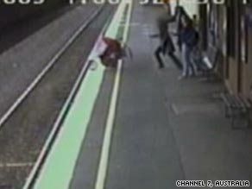
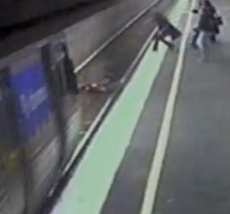
Mother who saw baby's pram fall under train thought baby had died.
Notes:
http://www.telegraph.co.uk/news/uknews/6437098/Mother-who-saw-babys-pram-fall-under-train-thought-baby-had-died.html

Slide 13
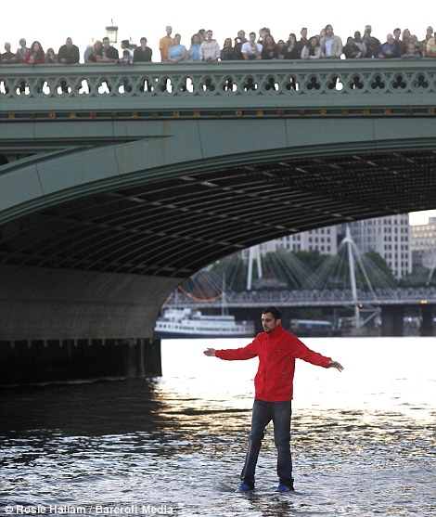
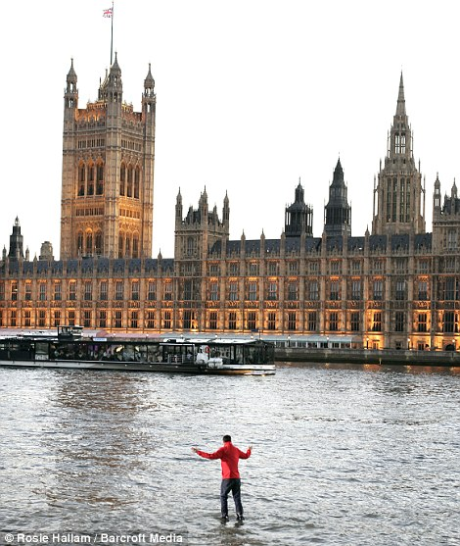
Dynamo crosses the River Thames on foot - without using a bridge.
Notes:
http://www.dailymail.co.uk/news/article-2008399/Illusionist-Dynamo-walks-Thames-Magician-crosses-river-foot.html

Slide 14
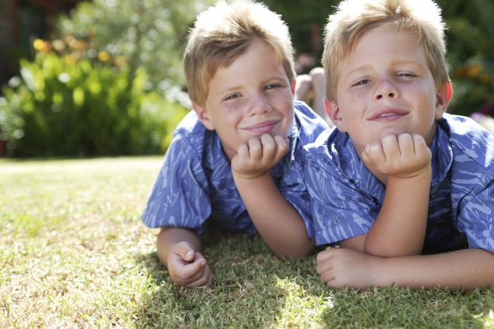
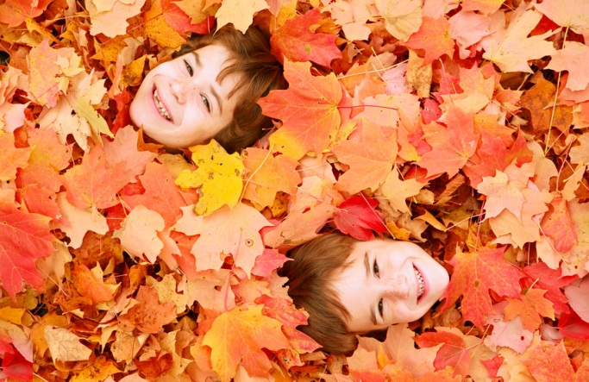
Conjoined twins separated in groundbreaking surgery.
Notes:
http://www.telegraph.co.uk/news/worldnews/southamerica/peru/10070497/Conjoined-twins-separated-in-groundbreaking-surgery.html

Slide 15
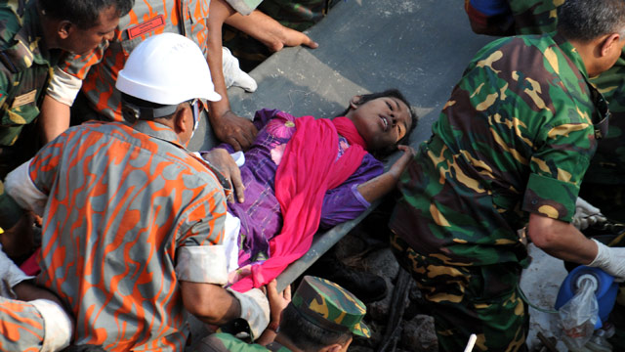
Bangladesh factory: woman found alive in rubble 17 days after collapse
Notes:
http://www.theguardian.com/world/2013/may/10/bangladesh-factory-collapse-survivor-rescue-dhaka

Slide 16
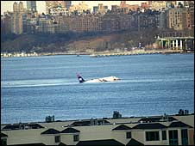
Airbus crashes in New York river

Slide 17
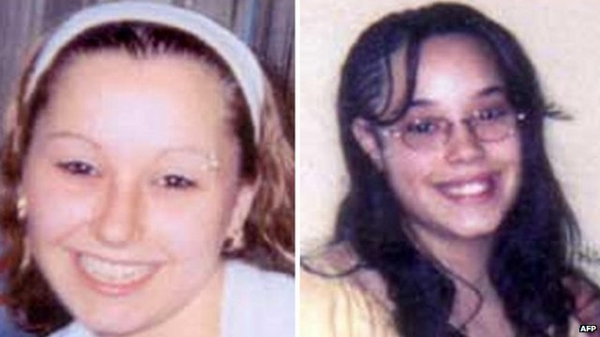
Three girls found after being captured for 10 years

Slide 18
Bermuda Triangle
Notes:
http://digitaljournal.com/article/351316

Slide 19
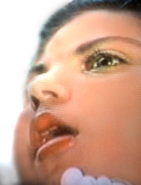
Audrey Santo
Notes:
http://en.wikipedia.org/wiki/Audrey_Santo

Slide 20
Feedback
You now have three minutes to prepare a speech about which ever event you have just looked at.
You will need to present it to the group.
You will need to tell us what you have done in the gaps on the sheet.

Slide 21
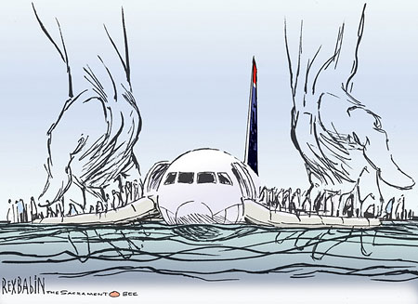
A modern miracle?
Notes:
http://www.youtube.com/watch?v=imDFSnklB0k

Slide 22
