Slide 1
Respectful online communication
Collaborating online respectfully

Slide 2
Do Now
Explain the difference between Volatile and Non Volatile RAM.

Slide 3
Alternative
One or more things available as another possibility.
Read it
Define it
From Medieval Latin alternativus
Audiobooks are an interesting alternative to reading.
Deconstruct it
Example
From Old French alterer
Other, Another, Substitute and Different
Dig Deeper
Link it

Slide 4
Scenario
Mia logs on to the school network. Her password is 123456. She then emails her teacher about his lesson. You can read the email below. What advice would you give Mia in this scenario?
Message
From: Mia
Subject: Hi
I wasn’t listening in history yesterday and didn’t write down the homework. What was it again?

Slide 5
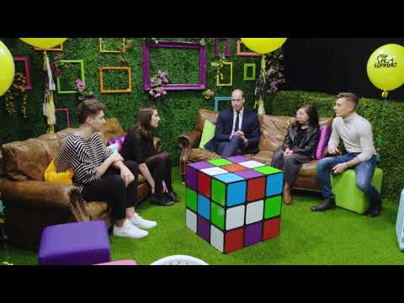
Stop, speak, support
Watch this video to hear about situations in which people have been hurt by online comments.

Slide 6
Think before you send
On social media, it is quite easy to make comments from behind a screen and not think about the impact that it has on the person receiving the comments.
We need to think about our actions before we make comments.

Slide 7
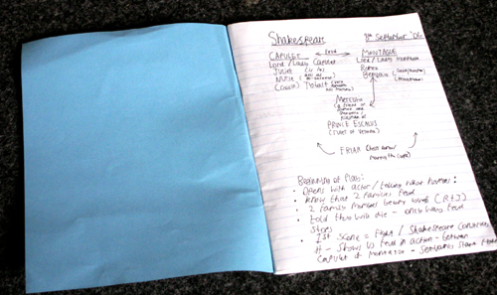
In school, we can share, collaborate, and comment on other people’s work.
Comments from the non-digital world
Comments using online application tools

Slide 8
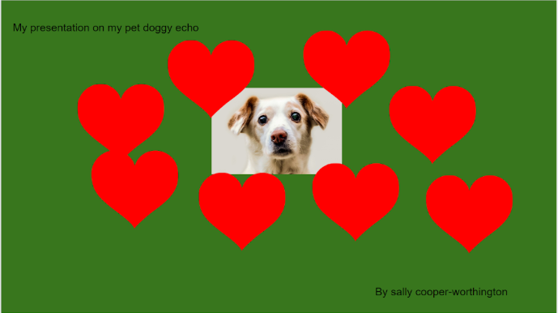
Activity 3
I like the hearts but maybe have less of them?

Slide 9
Activity 3
I hate green it's a horrible colour

Slide 10
Activity 3
Use capital letters for your name
Notes:
Image source: https://pixabay.com/photos/dog-animal-friend-loyalty-316459/
Image source: https://en.wikipedia.org/wiki/File:Love_Heart_SVG.svg
The obviously negative ones are “I think your dog is ugly” and “I hate green it's a horrible colour”. They are nasty comments and not helpful for the learner to make improvements to her work.
The other comments are acceptable, but it is important to remind the learners about balance. If a learner has already had a lot of comments telling her how to improve, could she maybe have one to compliment her work as well? The learners should remember that they are learning to be supportive participants.

Slide 11
Activity 3
I think your dog is ugly

Slide 12
Activity 3
Try to keep it simple. Perhaps have the dog as a larger image?

Slide 13
Activity 3
I would make the title of the presentation larger so that it stands out.

Slide 14
Advice for writing comments online
Keep it friendly.
Be specific.
Try to stick to the facts.
Remember that your tone can sound different to the reader.
Avoid sarcasm as it is difficult to interpret online.
Try to use the ‘sandwich technique’. This means to say something positive, then something critical, and end with something positive.
Ask a question to start a discussion.

Slide 15
How to receive feedback: always assume good intentions
Plenary
READ — Read the comment carefully.
STOP — Before you react negatively, assume that the comment comes from a positive place.
APPRECIATE — Say ‘thank you’.
DECIDE — Make a decision: do you agree with it? Could you ask a question about the feedback for clarity? Could you come to a compromise?
REMEMBER — Remember that feedback is there to help you improve, not to make you feel bad.

Slide 16
Task
Complete the low stakes quiz on words of the week.

