Slide 1
‘Do Now’ Retrieval Practice
Which of these is ‘the wave equation?
v = f x λ B) f = v ÷ λ C) f = v x λ
2. Which of these are all transverse?
light/sound/radio
microwaves/light/sound
gamma/radio/light
3. Which of these is Hooke’s Law?
F = k ÷ e B) F = k x e C) F = ½ k x e²
4. Which radioactive particle is a helium nucleus?
A) Alpha B) Beta C) Gamma

Slide 2
‘Do Now’ Retrieval Practice
Which of these is ‘the wave equation?
v = f x λ B) f = v ÷ λ C) f = v x λ
2. Which of these are all transverse?
light/sound/radio
microwaves/light/sound
gamma/radio/light
3. Which of these is Hooke’s Law?
F = k ÷ e B) F = k x e C) F = ½ k x e²
4. Which radioactive particle is a helium nucleus?
A) Alpha B) Beta C) Gamma

Slide 3
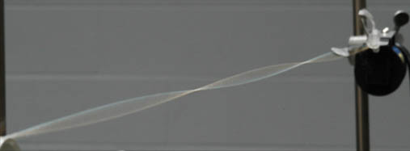
THINK!
How can we find out the speed (velocity) of a wave in a piece of string?

Slide 4
Wave Speed Experiments
Learning Objective
Know: How to find the speed of water waves, sound waves and waves in strings.
Learning Outcomes
Be able to: Describe three experiments and explain the calculations involved.
Key words: Frequency Wavelength Velocity

Slide 5
Key Ideas
The frequency is found using a ‘signal generator.’
The wavelength is measured with a ruler.
The speed is found using
v = f x λ

Slide 7
Ripple Tank
Light shines through the transparent base and waves make shadow ‘wave fronts’ (because deeper water absorbs more light). A flashing ‘strobe light’ connected to a frequency generator can be used to make the waves seem to ‘freeze’, so that their wavelength can be measured.
By multiplying the wavelength by the frequency (from the frequency generator) the speed can be calculated using
V = f x λ

Slide 8
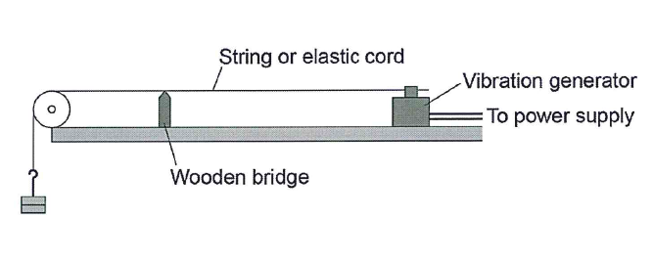
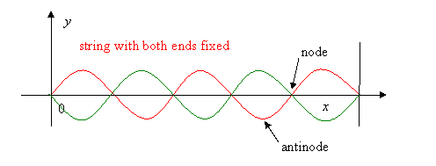
Measuring Wavelength on Stretched Cord
Set up the equipment as shown
Measure the distance between 3 nodes

Slide 9
Microphone Experiment
Use a signal generator and speaker to produce a sound of a known frequency (f), put 2 microphones nearby so 2 identical wave ‘traces’ are seen on the screen.
Move the microphones apart until the 2 traces match again, this distance is the wavelength (λ).
Use V = f x λ to find the speed of the wave (V).

