Slide 1
Reversible Reactions

Slide 2
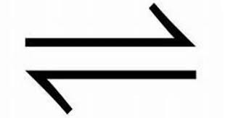
What does this symbol mean?
Reversible Reaction

Slide 3
A + B C + D
This shows a reversible reaction.
The products (C + D) react to form the reactants (A + B) again.
The reaction of A + B is called the FORWARD reaction. The reaction of C + D is called the BACKWARD reaction.

Slide 4
Equilibrium in reversible reactions
When the reactants react, their concentrations fall (because they are being used up to make the products) – this means the forward reaction will SLOW DOWN
As more products start to be made the backward reaction will SPEED UP
After a while the forward and backward reaction will go at the same rate, this means the reaction has reached EQUILIBRIUM
Equilibrium doesn’t mean the same amount of products and reactants are formed, just that the amounts aren’t changing anymore
Can only happen in a CLOSED system (where none of the reactants or products can escape)

Slide 5
Once the reaction is at equilibrium, there could be more of either the products than reactants or vice versa
If there are more products than reactants the reaction is going in the FORWARD direction
If there are more reactants than products the reaction is going in the BACKWARD direction
You can change direction by changing conditions
HEAT
Ammonium Chloride Ammonia + Hydrogen Chloride
COOL
If you heat this reaction it will go in the FORWARD direction, you will get more ammonia and hydrogen chloride (products). If you cool the reaction it will go in the BACKWARD direction, you will get more ammonium chloride (reactant).

Slide 6
Mini Plenary
In some reactions the can react to re-form the reactants again. We call this a reaction. At in a closed system, the of the reaction is the same as the rate of the reaction. If we change the reaction , this can affect the of the and products in the equilibrium mixture.
products
reversible
equilibrium
rate
forward
reverse
conditions
amount
reactants
Amount conditions equilibrium forward products rate reactants reverse reversible

Slide 7
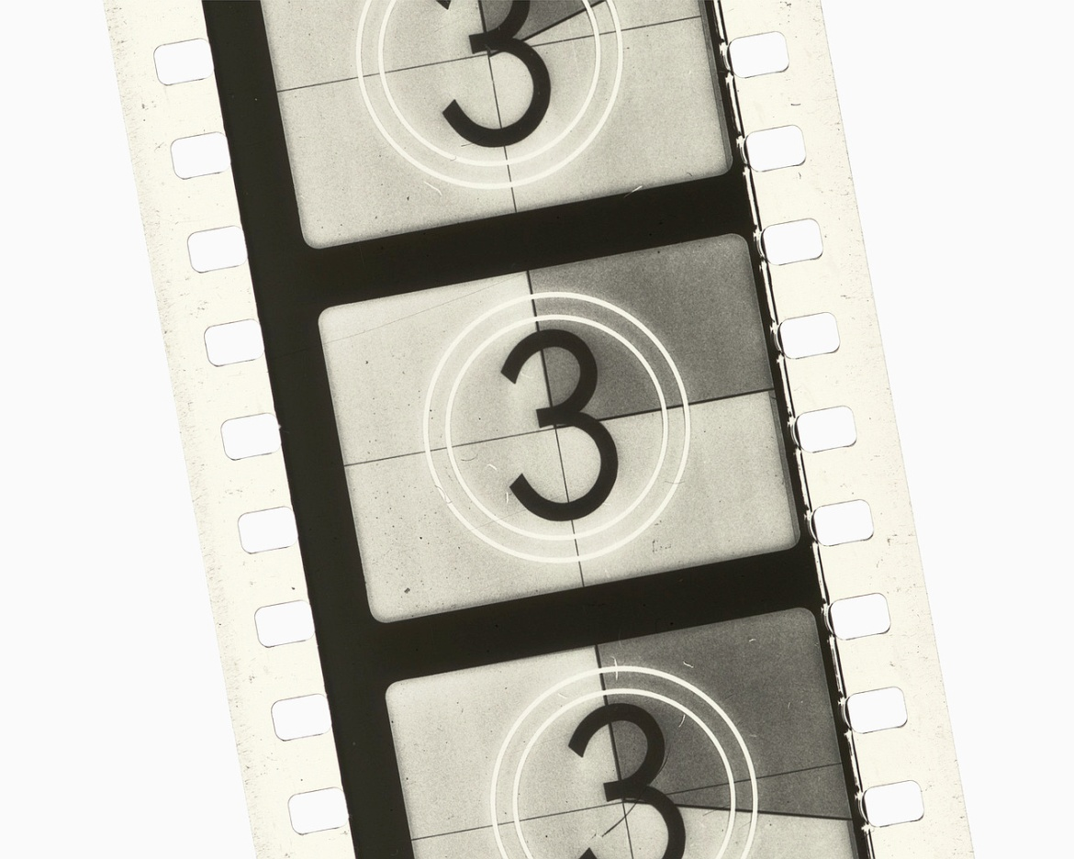
Video
http://www.youtube.com/watch?v=wlD_ImYQAgQ
Watch the video and answer the questions
Fuse School- Global Education
Great revision videos

