Slide 1
STARTER - Use the periodic table to name the elements or their find out their chemical symbol.
Ca
Helium
Argon
Mg
Ne
N
Oxygen
S
K
Aluminium
Hydrogen
Extension: List any elements in the periodic table that you did not know the chemical symbol for.

Slide 2
Reaction Profiles

Slide 3
REVIEW: Exothermic and endothermic reactions
exothermic reactions release energy – they get hot
ex = out (as in ‘exit’)
thermic = relating to heat
endothermic reactions absorb energy – they get cold
en = in (as in ‘entrance’)
Most chemical reactions are exothermic.

Slide 4
Learning outcomes:
Expected: draw reaction profiles for exothermic and endothermic reactions. Grade 4
Challenge: understand the definition of activation energy. Grade 6

Slide 5
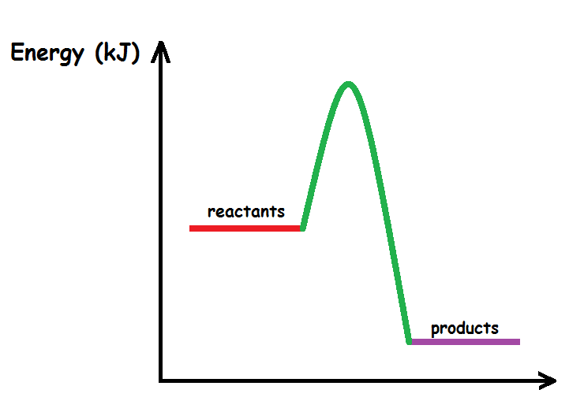
What is meant by reaction profiles?
You can find out more information about what is happening in a particular reaction by looking at its reaction profile.
The diagram gives information about the energy contained in the reactant and products measured in kilojoules per mole (kj/mol).

Slide 6
Exothermic reactions reaction profile
First things to notice is products have less energy then the reactants.
That is because energy is being transferred from the reaction to the surroundings
The difference between the energy of the reactants and the energy of the products tells us the energy that is being released to the surroundings.
Write the subtitle and draw the diagram with a ruler and pencil. Do the labels in PEN!

Slide 7
Complete the reaction profile for an exothermic reaction
C₅H₁₂ + O₂ H₂O + CO₂
Reactants
Energy (joules)
ΔH = negative
Products
Progress of reaction

Slide 8
Endothermic reactions reaction profile
First things to notice is products have more energy then the reactants.
That is because energy is being taken in from the surroundings.
Write the subtitle and draw the diagram with a ruler and pencil. Do the labels in PEN!

Slide 9
Complete the reaction profile for an endothermic reaction
H₂ + I₂ 2HI
Energy (joule)
Products
Reactants
Progress of reaction

Slide 10
Activation energy is the MINIMUM amount of ENERGY NEEDED for a chemical reaction to take place.
Reactants must collide with sufficient energy before they can be converted into products.

Slide 11
How to draw the activation energy for exothermic reactions
The activation energy is drawn from the reactants to the peak of the curve.
The arrow in pink represents the activation energy.

Slide 12
How to draw the activation energy for endothermic reactions
The activation energy is drawn from the reactants to the peak of the curve.
The arrow in pink represents the activation energy.

Slide 13
Past paper question in exam conditions 7 minutes

