Slide 1
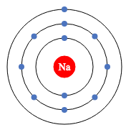
“Do Now”
SA
5 minutes
How many electrons does Sodium (Na) have?
Draw the atomic structure for Sodium:
True or False.
To separate a soluble solid from a liquid I would use evaporation.
What separation technique do we use to separate an insoluble solid from a solution?
Choose one answer. A mixture is:
A substance containing two different substances that are not bonding together
A substance containing two or more different elements or compounds when the separate parts are not bonded together
A substance containing only one type or element or compound
11 electrons
False
Filtration

Slide 2
Practical: Making Copper Sulfate Crystals

Slide 3
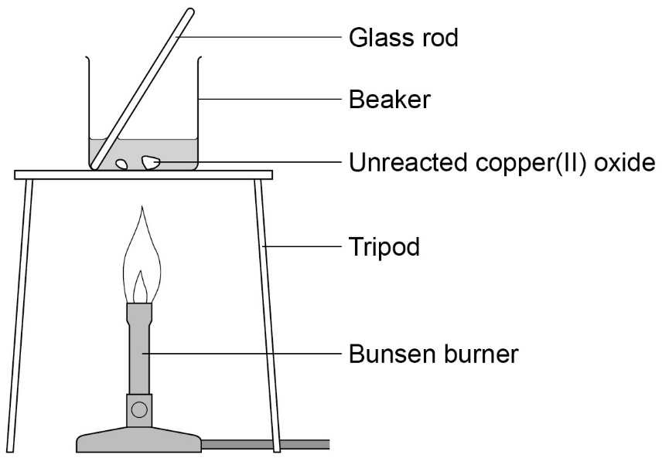

Slide 4
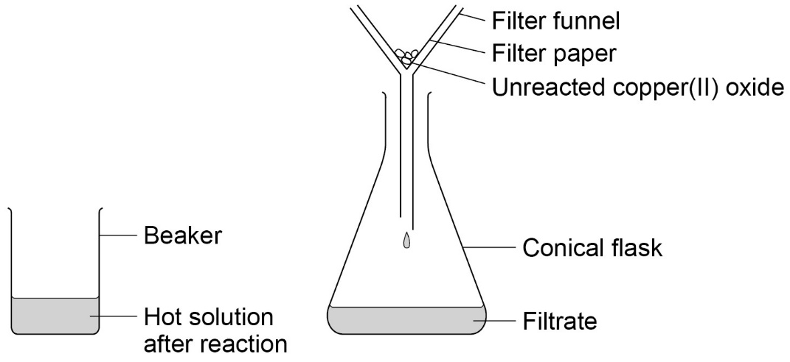

Slide 5
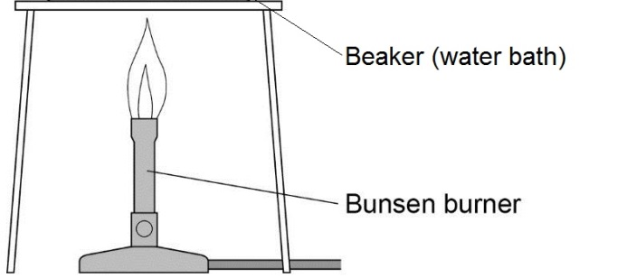

Slide 6
Make sure sheet is glued in and questions are completed.

