Slide 1
“Do Now”: 3 minutes, back of book
1. Why do we need products from crude oil?
For energy
2. List 3 uses of crude oil?
Cars, Planes, Trains, Detergent, Plastics, Solvents
3. Explain how the products in crude oil are different.
They all have different carbon chain lengths

Slide 2
Fractional Distillation

Slide 3
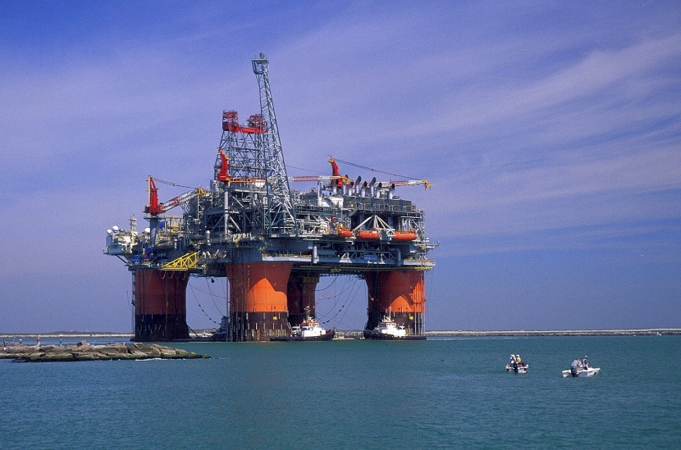
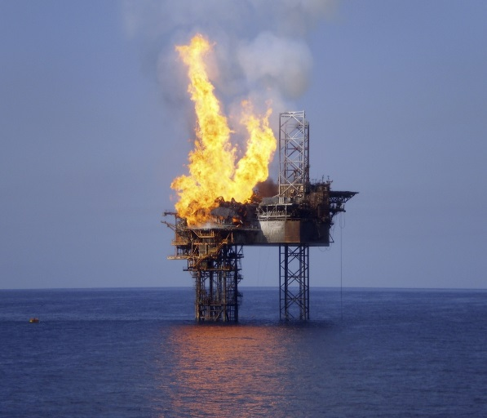
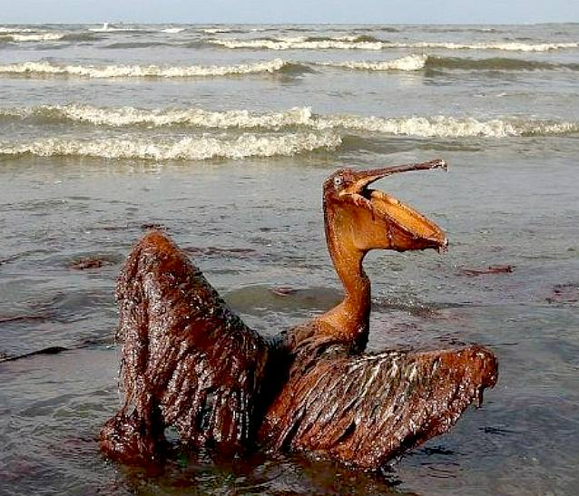
The Journey of Crude Oil….
Crude oil is formed underground over millions of years. It is very often found under the rocks of the sea bed. Extracting the oil is a very difficult and hazardous process.
Oil rigs or drilling platforms are built in the ocean. These are used to drill through the sea bed to obtain the oil.
Once the oil has been pumped out from the sea bed, it is sent down long pipelines to an oil tanker or an oil refinery on the land.
Oil spills have caused huge disasters in the ocean while fires in the oil rigs have claimed many lives.

Slide 4
Can crude oil just be used for the different uses?
Can you take crude oil and pump it straight into a car?
Can you take crude oil and pump it straight into a train?
Can you take crude oil and pump it straight into a plane?
No!

Slide 5
Crude oil is a mixture of lots of different HYDROCARBONS
Each set of hydrocarbons have a different use, these are called FRACTIONS
They are separated from each other using FRACTIONAL DISTILLATION
The crude oil is heated
It evaporates (turns into a gas)
The gas enters the fractioning column
In the column it is hot at the bottom and gets cooler as you go up
The short chain hydrocarbons have low boiling points so they come off at the TOP of the column where it is cooler
The long chain hydrocarbons have high boiling points so come off at the BOTTOM of the column where it is hotter
The crude oil mixture separates into different fractions (parts) e.g. petrol

Slide 6
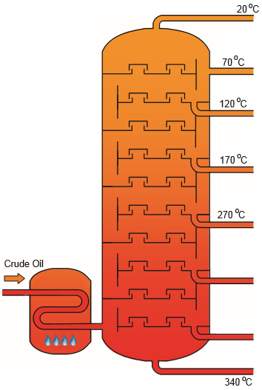
Fractional Distillation
Small Molecule properties:
Large Molecule properties:

Slide 7
Fractional Distillation
Refinery gas
Bottled gases
Small Molecule properties:
Low boiling point
Flammable
Volatile
Less viscous
Petrol
Fuel for vehicles
Kerosene
Jet fuel and lighting
Diesel
Heavy vehicle fuel
Heavy Fuel Oil
Large Molecule properties:
High boiling point
Not flammable
Not volatile
Viscous
Ships and factories
Bitumen
Road surfaces

Slide 8
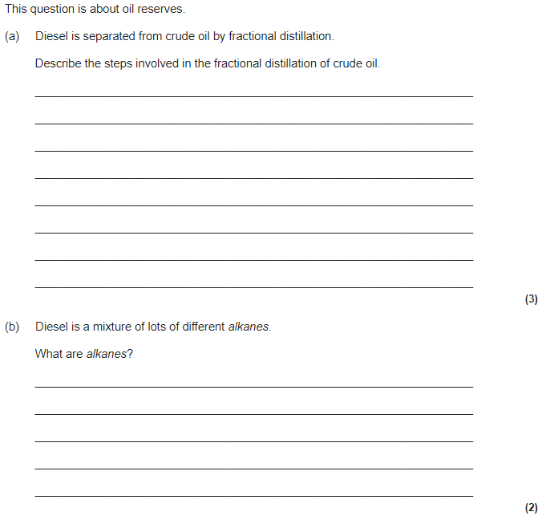
Exam practice

Slide 9
Exam practice
heat the crude oil until it vaporises (turns into a gas) (1)
vapours (gases) condense (turn into a liquid) (1)
at different temperatures (1)
(alkanes) are hydrocarbons or are compounds of hydrogen and carbon only (1)
Alkanes have only (carbon-carbon) single bonds (1)

