Slide 1
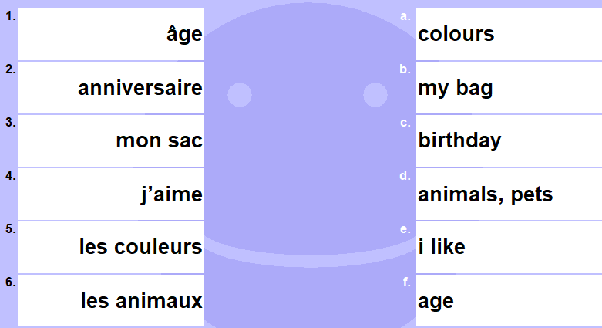
DO NOW
1)
2)
What do these questions mean?
Comment tu t’appelles?
Quel âge as-tu?
C’est quand ton anniversaire?
3)
Can you answer each one in French?

Slide 2
DO NOW
1)
1 | F
2 | C
3 | B
4 | E
5 | A
6 | D
2)
What do these questions mean?
Comment tu t’appelles?
Quel âge as-tu?
C’est quand ton anniversaire?
3)
Je m’appelle …
J’ai onze ans
Mon anniversaire c’est le (huit avril).

Slide 3
Classwork
J’ai un chien.
L.O. | TO SAY WHAT PET YOU HAVE
Homework – devoirs
Learn your new vocabulary off by heart.
You can make a poster and label all the animals.

Slide 4
Read it:
Les animaux
[noun]
Pronounced [lez ah-nee-mo]
Define it:
It means ANIMALS or PETS
Deconstruct it:
From LATIN – ANIMALES (having life)
Example:
Tu as un animal?
Digging Deeper:
animalier – to do with animals
un documentaire animalier
Link it:
un chat, un chien

Slide 5
Les animaux
[noun]
Definition
ANIMALS, PETS
Examples
un chien, un chat
Draw it
Example
Tu as un animal?
Non- examples
animé = animated

Slide 6
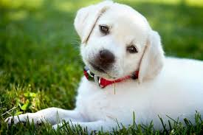
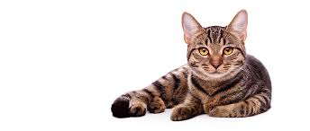
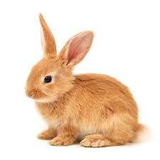
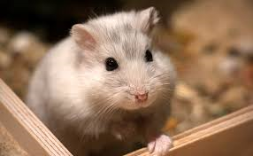
un chat
un chien
un hamster
un lapin

Slide 7
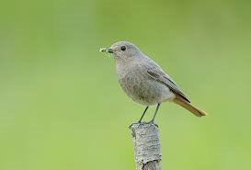
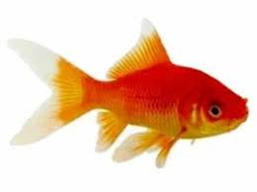
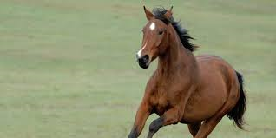
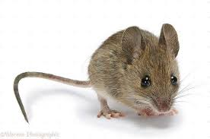
un oiseau
un poisson rouge
un cheval
une souris

Slide 8
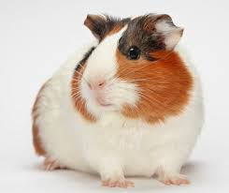
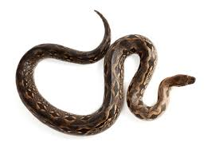
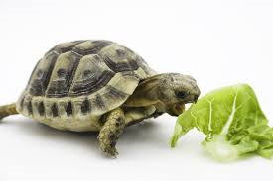
un cochon d’Inde
un serpent
une tortue

Slide 9
I don’t have a pet.
Je n’ai pas d’animal.

Slide 10
As-tu un animal? J’ai… un chien un chat un hamster un lapin un oiseau un poisson rouge une souris un cheval un cochon d’inde un serpent une tortue Je n’ai pas d’animal | Do you have a pet? I have… a dog a cat a hamster a rabbit a bird a goldfish a mouse a horse a guinea pig a snake a tortoise I don’t have a pet

Slide 12
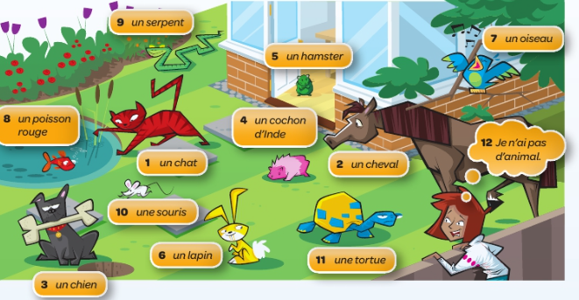

Slide 14
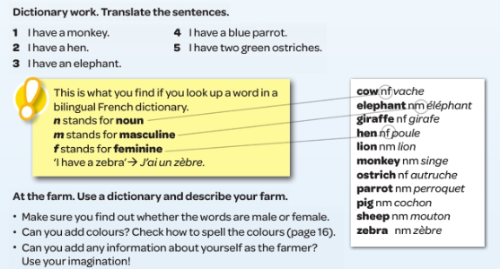

Slide 15
I
I have
a cat
but
I prefer
dogs.
J’ai
un chat
mais
je préfère
les chiens.

Slide 16
WE
I have
a horse
but
I prefer
hamsters.
I have a dog but I like tortoises.
I have a bird but I hate birds.

Slide 17
YOU
I have
a fish
but
I prefer
dogs.
I have a mouse but I like snakes.
I have a tortoise but I hate tortoises.

Slide 18
Homework - devoirs
Learn your vocabulary off by heart. Practise saying and writing them.
You can search for some videos on youtube which can teach you how to pronounce names of pets in French!

