Slide 1
DO NOW
1)
un crayon
un stylo
une trousse
un cahier
une règle
un livre
2)
My name is
I’m 11 years old
In my school bag there is
I like
3)
Nouns which start with LA or UNE are called __________________.
Nouns which start with LE or UN are called ____________________.

Slide 2
DO NOW
1)
un crayon | a pencil
un stylo | a pen
une trousse | a pencil case
un cahier | an exercise book
une règle | a ruler
un livre | a book
2)
My name is | Je m’appelle
I’m 11 years old | J’ai onze ans
In my school bag there is | Dans mon cartable il y a
I like | J’aime
3)
Nouns which start with LA or UNE are called ____FEMININE______________.
Nouns which start with LE or UN are called _____MASCULINE_______________.

Slide 3
Travail de classe
Dans ma famille il y a mes parents.
L.O.: to say who is in your family to give your opinion.
DEVOIRS - homework
Learn members of the family by heart in French!

Slide 4
Copy out and learn the following words.

Slide 5
This is how you describe your family in French.
Dans ma famille, il y a mon frère, ma soeur, mon père et ma mère.
In my family there are my brother, my sister, my dad and my mum.
Can you write a short description of your family? If you would prefer you can make it up or pretend you’re someone famous and describe a famous family?

Slide 6
Let’s say why we like members of our family.

Slide 7
I
I like my brother because he is cool.
J’aime mon frère car il est cool.
I like my sister because she is cool.
J’aime ma soeur car elle est cool.

Slide 8
WE
I like my dad because he is cool.
I like my mum because she is cool.

Slide 9
WE
I like my uncle because he is super.
I like my aunty because she is super.

Slide 10
YOU
I like my step-dad because he is cool.
I like my step-mum because she is cool.

Slide 11
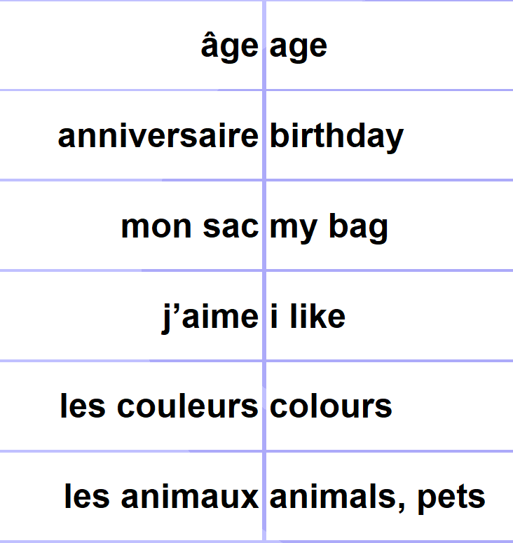
DO NOW
1
2
3
4
5
6

Slide 12
DO NOW
1
2
3
4
5
6

Slide 13
Travail de classe | Mercredi quatorze novembre
J’ai un frère qui s’appelle Marc.
Quizlet
taskmagic

Slide 14
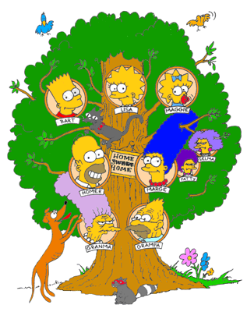
Je m’appelle Lisa Simpson.
Voici mon ___________, il s'appelle Bart.
Voici ma ___________, elle s’appelle Maggie.
Voici mon __________, il s’appelle Homer.
Voici ma ___________, elle s’appelle Marge.
Voici mon __________________, il s’appelle Grampa.
Voici ma __________________, elle s’appelle Granma.

Slide 15
dans ma famille | in my family
j’ai … | I have
il y a | there is / there are
qui s’appelle | who is called
qui s’appellent | who are called
mon père s’appelle | my dad is called
mes soeurs s’appellent | my sisters are called

Slide 16
Translate these sentences into English.

Slide 17
Translate these sentences into French.
1) In my family there is my mum, my dad and my brother.
2) I have my brother who is called Louis.
3) My mum is called Anne.
4) My sisters are called Valerie and Margot.
5) I have two brothers who are called Samuel and Erwan.

Slide 20
DEVOIRS
YOU CAN USE YOUR BOOK AND YOUR KNOWLEDGE ORGANISER!
Write a paragraph about yourself. Say:
what your name is
how old you are
when your birthday is
what colour you like
who there is in your family
what the members of your family are called.
Here’s an example below.
Je m’appelle Anne.
J’ai douze ans.
Mon anniversaire c’est le huit mai.
J’aime le rouge.
Dans ma famille il y a mon père et ma soeur.
Mon père s’appelle Stephane et ma soeur s’appelle Veronique.

Slide 21
Nom | Âge | Mère | Père
Mathis
Anton
Suzanne
Lucas

