Slide 1
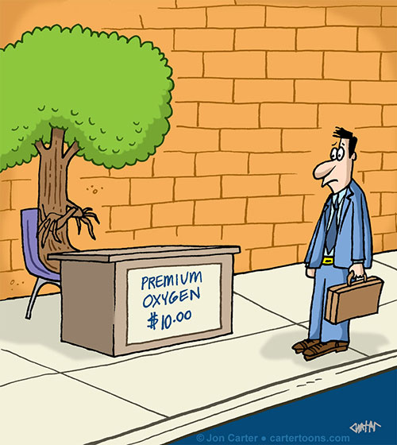
WALT: Explain how gases get in and out of leaves
WILF:
GW: You can recall the gases that are exchanged in the leaves of plants and can name the structures where this happens.
BI: You can make observations about which surface of a leaf allows most gas exchange and you can explain why.
EW: You can identify and explain some of the adaptations that plants have to reduce excessive water loss.

Slide 2
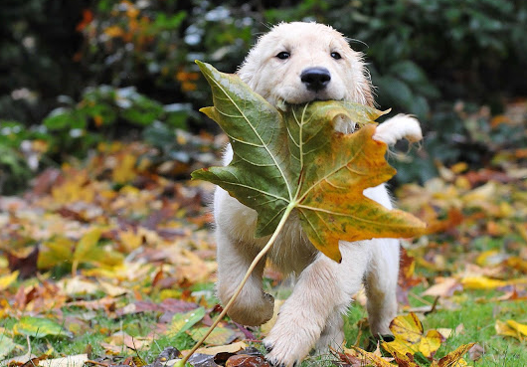
Who am I?
I am the layer at the top of the leaf that stops it from drying out.
I am like a skin at the bottom of the leaf.

Slide 3
Who am I?
3)I am the layer of rounded cells that catches any missed light.
4) I let gases in and out of the bottom of the leaf – there are many of me.
5) I am the main layer where photosynthesis happens – I have lots of cells packed tight.

Slide 4
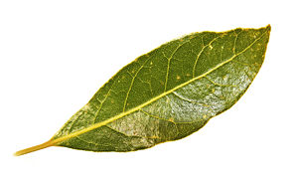
Starter:
Recall which gases go into and move out of a leaf during photosynthesis.
How do these gases get in and out of the leaf?

Slide 5
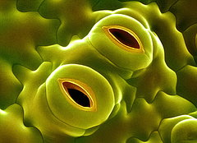
There are tiny air holes within the structure of the leaf called stomata
Either side of the air hole there are sausage shaped cells called guard cells

Slide 6
However, the stomata also allow water vapour ( gas) to escape ‘by accident’

Slide 7
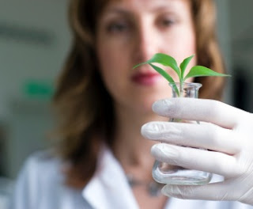
What do you think? Can you write a prediction to help me out? Can you explain your prediction to me?
Hint: Think about what needs to happen to water to get it to turn into a GAS.
Nancy wants to investigate which surface of a leaf – the top or bottom, has the most stomata on it.

Slide 8
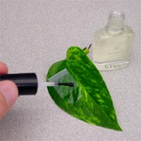
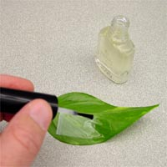
What to do:
The top and bottom surface of a leaf are painted with clear nail varnish. When it dries it creates an imprint of the leaf.

Slide 9
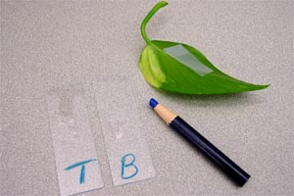
You need to carefully peel off each piece, putting it onto a microscope slide – you can write T and B on the slides for ‘Top’ and ‘Bottom’

Slide 10
Surface of the leaf observed | Number of stomata counted in microscope field of view
 | Your results | Another group’s result | Average
Top (upper) surface
Bottom (underside) surface

Slide 11
To answer:
What did you find out about the number of stomata on the surfaces of a leaf? (Include data to back up your conclusion)
Can you come up with a scientific explanation for your results.
Were your results reproducible – If someone copied the practical, would they get the same results?
Were there any issues that you came across when trying to collect your results that may affect their accuracy – can you think of any improvements?

Slide 12
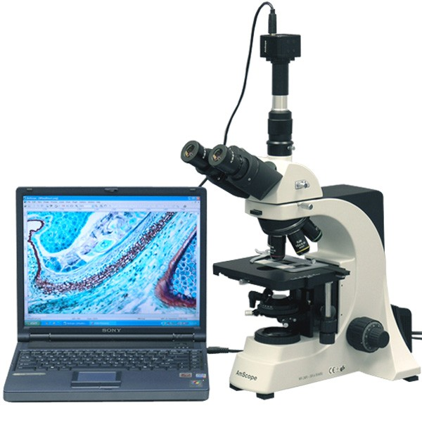
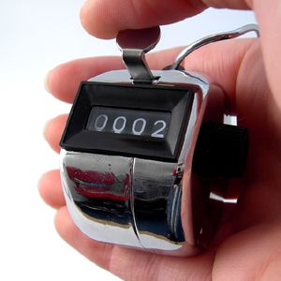
How might using a clicker counter help?
How might using a microscope camera attached to a computer help?

Slide 13
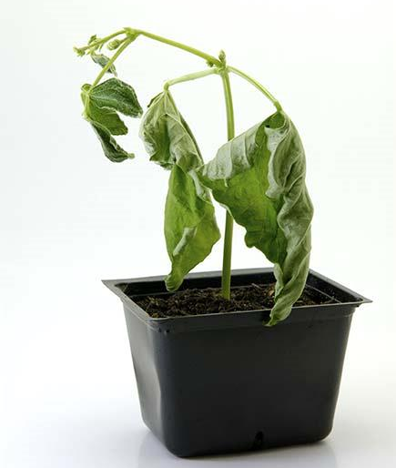
Higher level thinking
We now know that stomata allow gases in and out of a leaf, but we also know that they accidentally let out water vapour.
But....letting out too much water vapour can be a disaster:
Using your knowledge , can you suggest what plants could do to try to reduce excessive water loss? Especially in habitats like the desert.

Slide 14
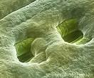
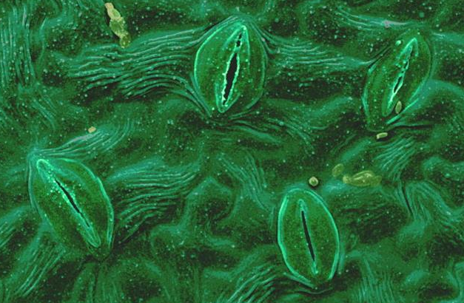
Notes:
The top image shows sunken stomata which creates a slightly cooler ‘microclimate’ and reduces further water loss.
The bottom image shows closed stomata.

Slide 15
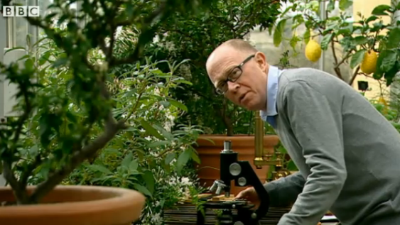
Clip for a clip

