Slide 1
What are the polar bears discussing?
Watch me!
Climate change!!! What does this have to do with tropical storms?

Slide 2
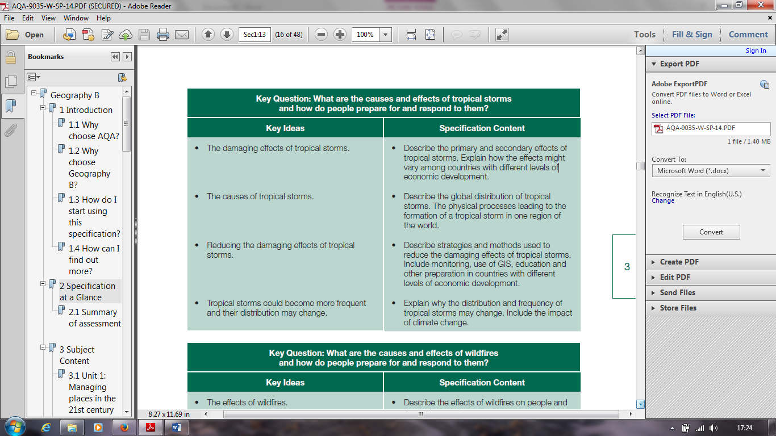
Big Picture

Slide 3
More tropical storms to come
LO: To make an informed judgement as to whether the number and severity of tropical storms is changing.
: To describe different opinions that people have about climate change.
Be able to explain how these differ and link it to variations in tropical storms globally.
Evaluate and give my own opinion on whether tropical storms are becoming more destructive.

Slide 4
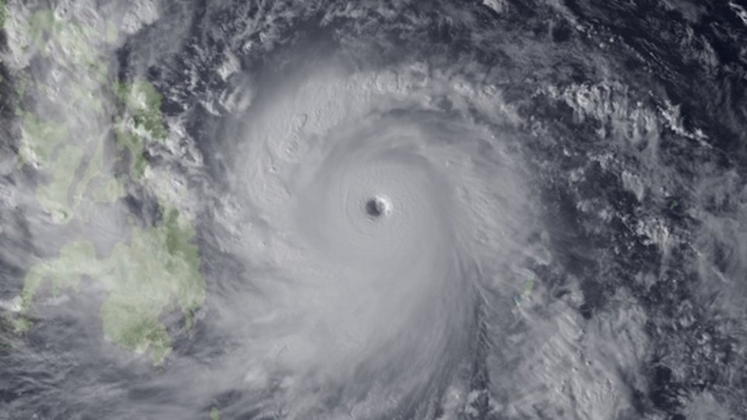
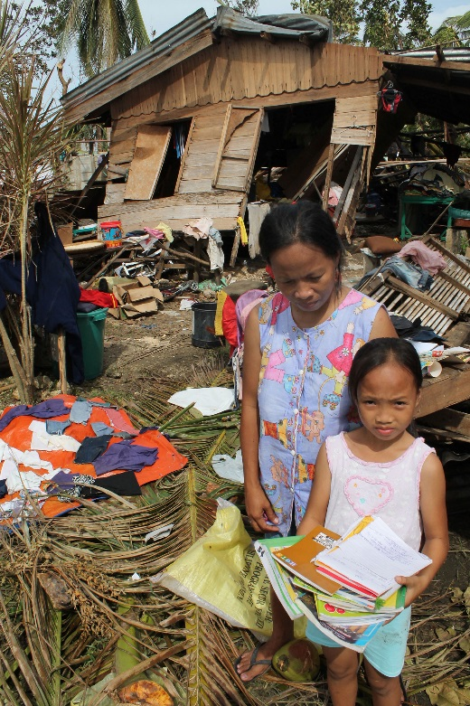
What is the future of tropical storms in the Philippines?
Typhoon Haiyan was one of the strongest tropical storms or cyclones ever recorded, devastating portions of Southeast Asia, particularly the Philippines, in November 2013. Yanna lives in Tacloban, in the Philippines. She has many questions about her future following the recent tropical storms.
Will the tropical storms come more frequently?
Will the tropical storms have a greater effect in the future?
Is it just my country, the Philippines, which will see changes happening?

Slide 5
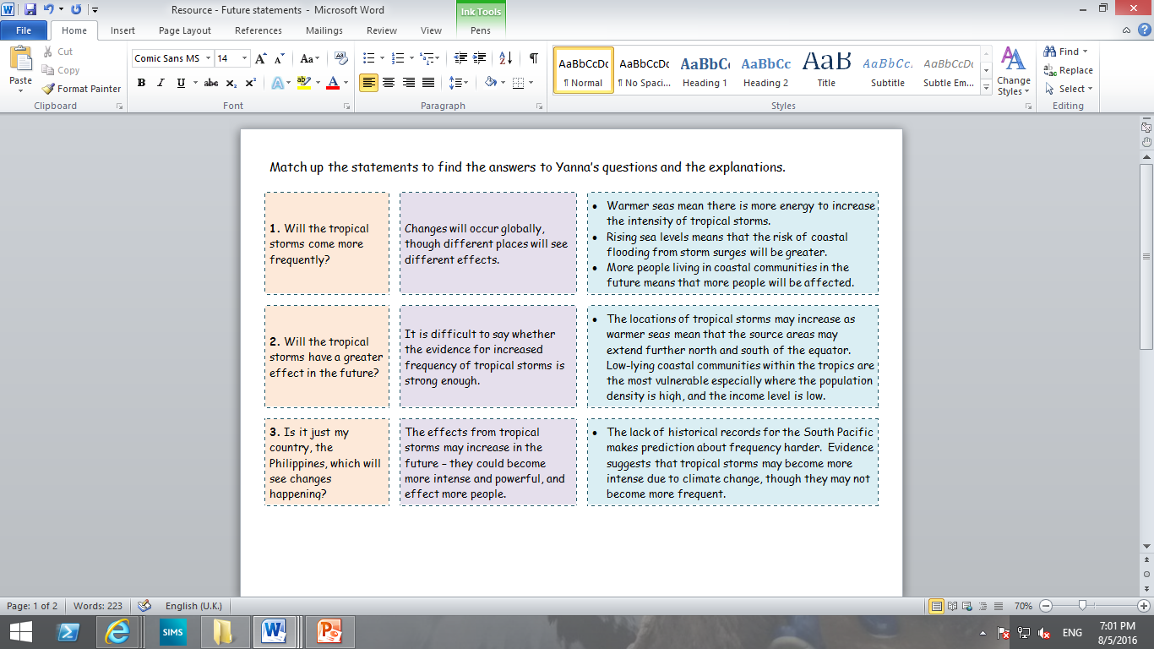
What is the future of tropical storms in the Philippines?
Match up the statements to find the answers to Yanna’s questions and the explanations.
Will the tropical storms come more frequently?
Will the tropical storms have a greater effect in the future?
Is it just my country, the Philippines, which will see changes happening?

Slide 6
1. Will tropical storms come more frequently? | It is difficult to say whether the evidence for increased frequency of tropical storms is strong enough. | The lack of historical records for the South Pacific makes prediction about frequency harder. Evidence suggests that tropical storms may become more intense due to climate change, though they may not become more frequent. Warmer oceans might increase the length of the tropical storm seasons.
2. Will tropical storms have a greater effect in the future? | The effects from tropical storms may increase in the future – they could become more intense and powerful, and effect more people. | Warmer seas mean there is more energy to increase the intensity of tropical storms. Rising sea levels means that the risk of coastal flooding from storm surges will be greater. More people living in coastal communities in the future means that more people will be affected.
3. Which areas of the world will see changes happening? | Changes will occur globally, though different places will see different effects. | The locations of tropical storms may increase as warmer seas mean that the source areas may extend further north and south of the equator. Low-lying coastal communities within the tropics are the most vulnerable especially where the population density is high, and the income level is low.
ANSWERS

Slide 7
What is the future of tropical storms in the Philippines?
Use the word bank to complete the following sentences to explain to Yanna the possible effects of climate change on tropical storms.
Climate change does affect everyone. Climate change can cause an increase in sea ________________ and an increase in the ________________ of the sea.
Frequency: The evidence says that tropical storms may become more intense but not necessarily more __________________________.
Distribution: Warmer seas mean that the source areas for tropical storms become further ________________ and south of the equator. Higher sea levels mean that more _____________ lying coastal communities will be affected.
Intensity: _______________ seas mean more energy to _______________ the intensity of tropical storms.
low | less frequent | west | north
temperature | warmer | frequent | increase
level | darker | size | decrease

Slide 8
What is the future of tropical storms in the Philippines?
Check your answers for your explanation to Yanna about the possible effects of climate change on tropical storms.
Climate change does affect everyone. Climate change can cause an increase in sea ________________ and an increase in the ________________ of the sea.
Frequency: The evidence says that tropical storms may become more intense but not necessarily more __________________________.
Distribution: Warmer seas mean that the source areas for tropical storms become further ________________ and south of the equator. Higher sea levels mean that more _____________ lying coastal communities will be affected.
Intensity: _______________ seas mean more energy to _______________ the intensity of tropical storms.
temperature
level
frequent
north
low
warmer
increase
low | less frequent | west | north
temperature | warmer | frequent | increase
level | darker | size | decrease

Slide 9
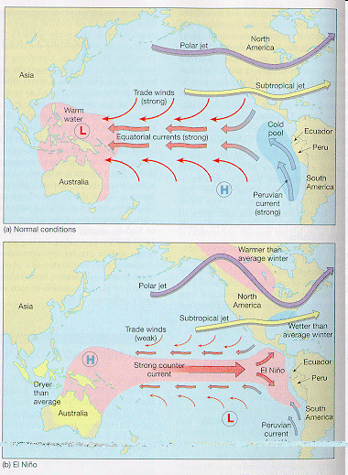
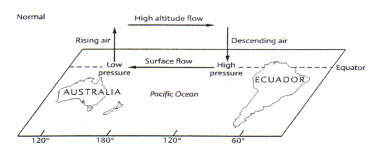
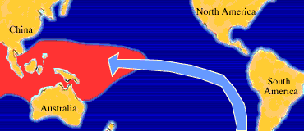

El Nino & La Nina
El Niño and La Niña are complex phenomena in the Pacific that disrupt normal weather patterns, bringing heavy rains and drought to different parts of the world.
Scientists know that El Niño contributes to an increase in global temperatures. But do rising global and ocean temperatures intensify El Niño?
http://video.nationalgeographic.com/video/news/101-videos/el-nino
Notes:
G&T

Slide 10
The number of tropical storms has doubled in the last 100 years.
Since 1995 hurricanes have become more frequent and intense.
Over the last 30 years there have been more tropical storms recorded with winds over 200km/h.
Changes to the number of tropical storms are part of a natural cycle.
Technology predicts that the number of tropical storms will fall after 2080.
We don’t have enough evidence to link global warming to the number of tropical storms.
Short term changes to the numbers of tropical storms may not be due to the actions of people.
Due to global warming, the surfaces of tropical oceans have warmed up by 0.5ºC in the last few decades.

Slide 11
Look at the statements you have ticked – which of these opinions do you agree with?
Many people believe that climate change has caused an increase in the number of tropical storms.
Others say they have stayed the same but they are becoming more severe.

Slide 12
Why are opinions divided?
Some people believe that climate change is affecting tropical storms.
Satellite technology has only been used to monitor storm activity since the late 1960’s.
Before then accounts from ships, pilots and simple weather monitoring devices were used.
This means that the storm power may have been stronger than originally measured, we’re just more accurate now a days.
There is a natural cycle of variations in the number of hurricanes…

Slide 13
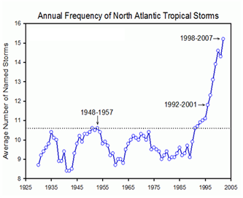
Variations in the number of Atlantic hurricanes.
What do you notice about the frequency of recorded storms since 1925 to 2005?
Write a short paragraph in the box to explain what you can see.

Slide 14
Global warming Vs Natural variations
There are more tropical storms reaching categories 4 & 5 now a days than in the past – a mixture of both GLOBAL WARMING AND NATURAL VARIATIONS?
Does an increase in frequency mean an increase in destructiveness?

Slide 15
Are tropical storms becoming more destructive?
In the USA, 6 out of the 10 most expensive hurricanes have occurred since 1990.
In the past, coastlines have been sparsely populated = less to damage = less money.
Today the number and value of property has increased with the increase in population. This means there is greater potential for damage.
In 2005 Hurricane Katrina caused damage at over $80 billion.
Does an increase in frequency mean an increase in destructiveness?

Slide 16
Question time
Suggest two reasons why the cost of the damage from tropical storms could increase in the future (4)

Slide 17
The population is increasing in many coastal areas and therefore there is more infrastructure put in place which can be damaged in tropical storms (2).
People are wealthier and take more holidays along the coast – this leads to more expensive hotels which cost more to repair after a storm event (2).
People are more affluent and so can afford holiday homes (e.g. Florida) which can lead to increased insurance costs after claims are made (2).
The number of tropical storms and their strength is increasing which can result in higher category storms which can damage property and the environment more easily (2).

Slide 18
Plenary – self assess
Give yourself a mark out of 4.
What could you have included to achieve full marks?

