Slide 1
Do it now!
Name the star in our solar system.
How many planets in our solar system?
What do we call the natural satellites in the solar system?
Name the galaxy our solar system is part of.
Which force keeps the planets orbiting the sun?

Slide 2
Name the star in our solar system.
The Sun.
How many planets in our solar system?
8
What do we call the natural satellites in the solar system?
Moons.
Name the galaxy our solar system is part of.
The Milky Way.
Which force keeps the planets orbiting the sun?
Gravity.

Slide 3
Title: Describe Thermal Conductivity
Date: Monday, 14 September 2020
Planners and equipment out
Date and Title in your books, underlined!
WILF:
GW: Identify some factors that affect the rate of heat transfer.
BI: Describe how to improve heat transfer.
EW: Apply your understanding of air as a conductor to explain why this was the best insulator.
Keywords: Thermal conductivity, Insulator.

Slide 4
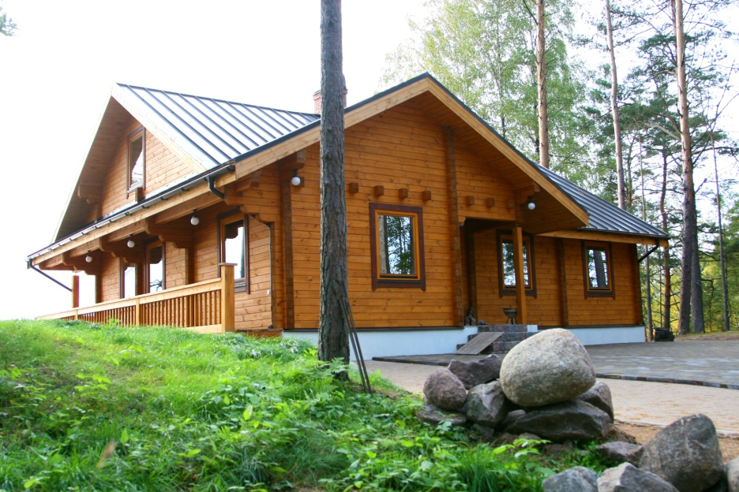
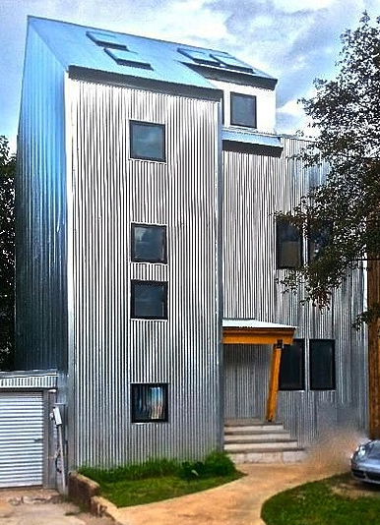
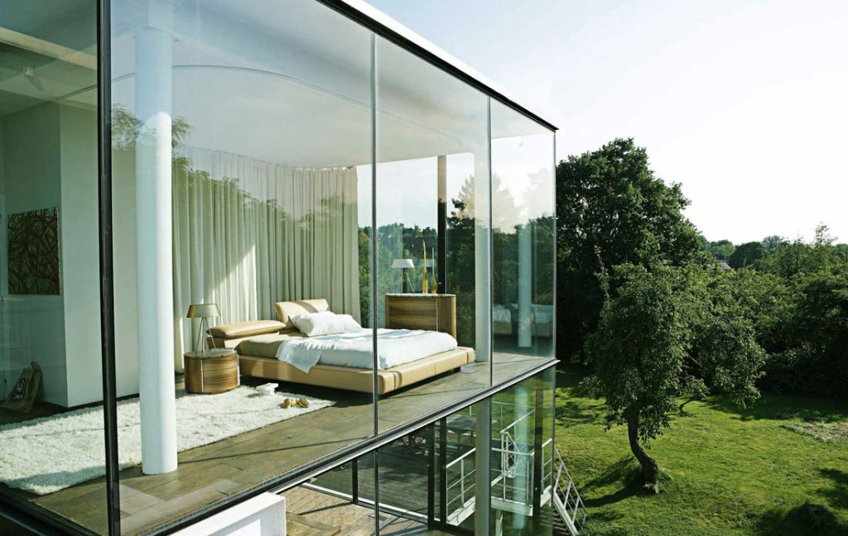
GW: Identify some factors that affect the rate of heat transfer.
Which house would keep the heat in best?
Notes:
Get the students to think about which house would warm up the quickest, and which may become cold the quickest.

Slide 5
GW: Identify some factors that affect the rate of heat transfer.
What makes this house so special?
Blocked from wind
Wood is a great insulator
Lots of sunlight
Double glazing windows
Slate for roof insulation

Slide 6
GW: Identify some factors that affect the rate of heat transfer.
There are a number of factors that affect how quickly heat can be lost…
Does the material conduct heat well (high thermal conductivity)?
Is there a large temperature difference?
Is there a draught?

Slide 7
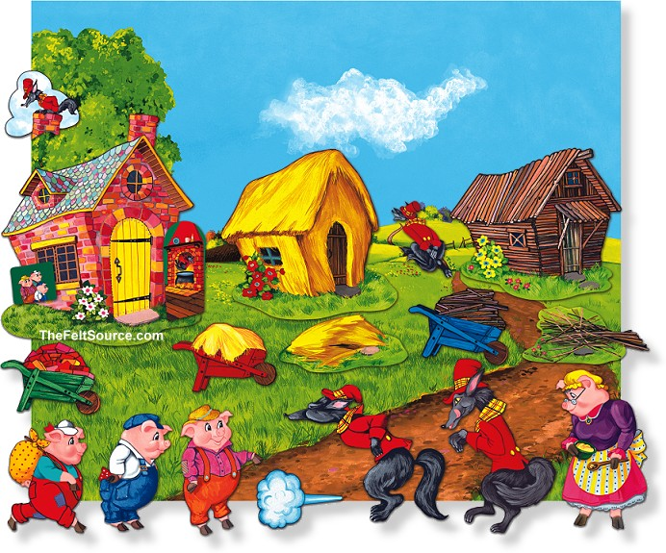
GW: Identify some factors that affect the rate of heat transfer.
Think of the factors that affect how quickly heat can be lost.
Which of the 3 little pigs houses would be the best insulated.
Bullet point 2 reasons to explain your choice.
Notes:
Wood is an insulator, so some people may think that the house will cool down over a longer period of time.

Slide 8
BI: Describe how to improve heat transfer.
Heat will flow through the walls of a house by conduction.
Thermal conductivity is defined as the ability of a material to allow the flow of heat from its warmer surface through the material to its colder surface.
If a material is better at conducting heat (energy) out of the house per second- It has a greater thermal conductivity.

Slide 9
Practical
Hypothesis:
“A thicker wall will transfer thermal energy at a slower rate than a thin wall”
How would we test this?
What are the independent, dependent and control variables?

Slide 10
BI: Describe how to improve heat transfer.
Take 3 containers. Wrap one in 1 layer of bubble wrap and one in 3
Pour 100 cm³ of boiling water into each different container.
Put a lid on the containers and a thermometer into the water.
Wait until the temperature reading stops going up and record the start temperature.
Start the watch
Record the temperature every minute for 10 minutes
Thermal Conductivity Experiment
SAFETY: CARRY THE KETTLE TO YOUR DESK
Insulating lid
10,20 or30 layers of newspaper
Can you draw your own table?

Slide 11
BI: Describe how to improve heat transfer.
Time (min) | Temperature (ºC)
 | 1 layers | 3 layers
0
1
2
….
10

Slide 12
BI: Describe how to improve heat transfer.
Time (min) | Temperature (ºC)
 | 1 layer | 3 layers
0 | 70 | 70
1 | 66 | 69
2 | 62 | 67
3 | 60 | 67
4 | 59 | 66
5 | 55 | 64
6 | 53 | 62
7 | 48 | 61
8 | 45 | 59
9 | 43 | 57
10 | 41 | 55

Slide 13
BI: Describe how to improve heat transfer.
Analysis
Identify the variables in this experiment
The independent variable was …….
The dependent variable was ……
The control variable was …..
Write a conclusion for the experiment
As the number of layers of bubble wrap increased…………
The bubble wrap could represent …………………… in a house.
You could increase the rate of energy transfer by…
Notes:
NOTE: remember to tell them where the 420 has come from

Slide 14
BI: Explain, using results, which insulator was best at its job.
Higher Analysis
Calculate (we will cover this in further detail later in the year)
temperature drop with 1 layer in 10 minutes was ____ºC
energy lost through 1 layer = temp drop x 420 = _____ J
average energy lost per second = ________ J
Repeat this calculation for the 2 and 3 layers
How does the number of layers of bubble wrap affect the rate of flow of thermal energy?
Did the water cool down at a constant rate?
What happened to the rate of cooling during the experiment?
Why did this happen?

Slide 15
BI: Explain, using results, which insulator was best at its job.
Heat energy passes through walls by conduction
The rate heat passes through the wall depends on
The thermal conductivity of the material
The thickness of the material
The temperature difference across the wall
The lower the thermal conductivity of the wall the less heat energy will pass through it.

Slide 16
BI: Describe how to improve heat transfer.
Heat energy passes through walls by conduction
Conduction
Convection
Radiation
The rate heat passes through the wall depends on
The thermal conductivity of the material
The thickness of the material
The temperature difference across the wall
Thickness
Thermal conductivity
Temperature
The lower the thermal conductivity of the wall the less/more heat energy will pass through it.
Notes:
Get the students to use the keywords for the lesson, focussing on how to change the rate of heat transfer.

Slide 17
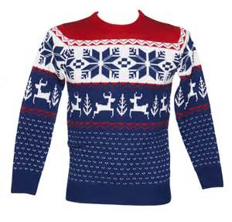
Why did the heat transfer fall as we increase the number of sheets of bubble wrap?
EW: Apply your understanding of air as a conductor to explain why this was the best insulator.
Adding layers of bubble wrap traps more air.
Air is great as an insulating material.
There are large gaps between particles in the air, making it difficult for energy to be passed on.
This reduces the amount of heat that manages to ‘escape’ through the bubble wrap !
Think of wearing a jumper to keep warm!

Slide 18
Challenging questions
1. Explain why the thermal conductivity value of a material is an important consideration when building properties.
2. Explain why insulators have a low thermal conductivity value.
3. Why would a pizza oven need to be made from a material with a low thermal conductivity value?

Slide 19
Challenging answers!-Green pen
1. Explain why the thermal conductivity value of a material is an important consideration when building properties.
If the thermal conductivity is too high, too much heat can be lost through the walls or can enter if very hot outside.

Slide 20
Challenging answers!-Green pen
2. Explain why insulators have a low thermal conductivity value.
Insulators/non-metals/plastics etc. have low thermal conductivities since the rate at which thermal energy is transferred through them is low and they are poor conductors this is because they do not have free electrons.
3. Why would a pizza oven need to be made from a material with a low thermal conductivity value?
The material needs to have a low thermal conductivity so that heat cannot escape from the oven and can be used to cook the pizza.

Slide 21
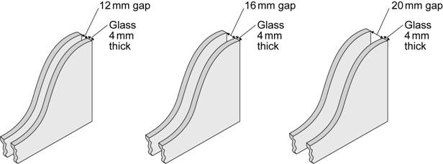
EW: Link your results to explain how we make sure that double glazed windows are energy efficient.
Type of window | 12 mm gap | 16 mm gap | 20 mm gap
1. Glass type X with air | 2.9 | 2.7 | 2.8
2. Glass type X with air and argon | 2.7 | 2.6 | 2.6
3. Glass type Y with air | 1.9 | 1.8 | 1.8
4. Glass type Y with air and argon | 1.6 | 1.5 | 1.5
The diagrams show the cross-section of three double glazed windows. The gap between the two sheets of glass can be filled with either air or a mixture of air and argon. The thermal conductivity for different types of double glazed windows, using different types of glass X and Y, are given in the table.
(a) Which type of window is the least energy efficient?
(b) Name two windows which could be compared to decide if adding argon to the gap improves the energy efficiency of the window?
(c) Which factor is the most important to consider when buying a window (glass type, gap size or gas). Explain your answer with evidence from the table
1
1 and 2 same gap
or 3 and 4 same gap
Glass type – e.g. 12mm gap adding argon makes a 0,2 difference, increasing gap 0.1, but type Y glass makes 1.0 difference
Notes:
Question based on AQA Core Physics (P1) paper from 2014.

