Slide 1
Do now task
How much can you remember?
1. Who was the first black student to graduate from the University of Mississippi?
2. Campaign C and the Children’s Crusade took place in which city in Alabama?
3. What was set up by Stalin to control all of the communist parties of Europe?
4. What were NATO and the Warsaw Pact?
Notes:
1. James Meredith. 2. Birmingham, Alabama. 3. Cominform. 4. Military Alliances.

Slide 2
US Tactics
Recap – Who am I?
1. I used to rule Vietnam during WW2.
Japan.
2. I was defeated at the battle of Dien Bien Phu.
France.
3. I was leader of South Vietnam but was assassinated in 1963.
General Diem.
4. I gave President Johnson the power to send troops to Vietnam?
The Gulf of Tonkin Resolution.
5. I was used to transport supplies and soldiers into South Vietnam?
The Ho Chi Minh Trail.
Learning Objective
I will understand the different tactics used by the USA.
I will be able to describe the tactics used by the USA.

Slide 3
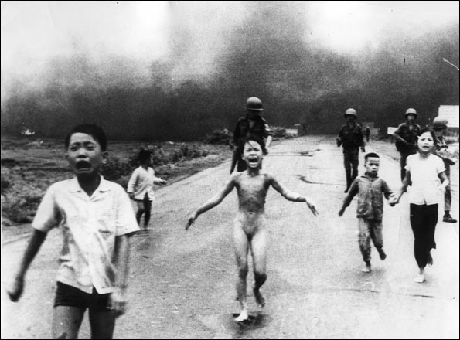
What?
When?
Where?
How?
Who?
Why?

Slide 4
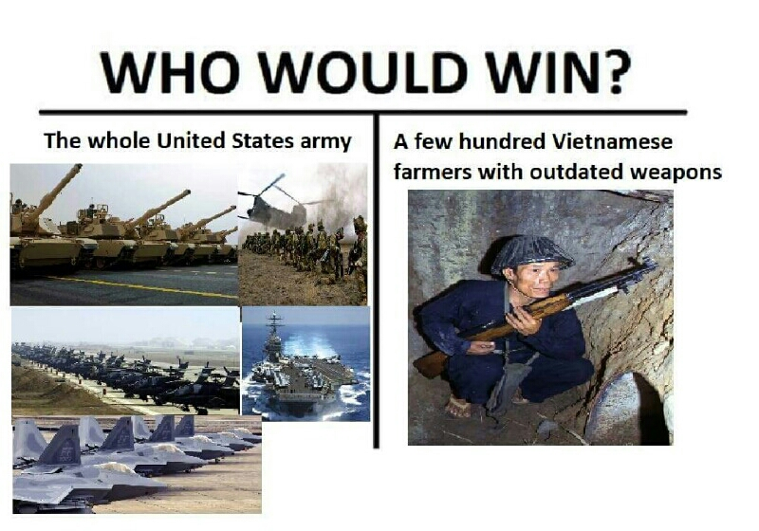
A leading super power with the largest army in the world & the most advanced weapons available & the best technology.
A small, poor country with limited weapons and no real technology.

Slide 5
What were the USA’s tactics? Think – Pair - Share
Air strikes
Napalm and Agent Orange
Operation Ranch Hand
How effective do you think these tactics were?
USA
Tactics
Strategic
Hamlets
Operation Rolling Thunder
Search and Destroy
Why would the USA use these tactics?

Slide 6
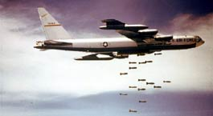
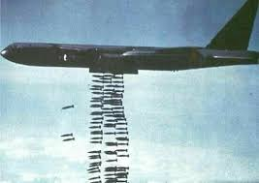
Operation Rolling Thunder 1965-68
A bombing campaign over North Vietnam using B-52 bombers. Targeting industry and the Ho Chi Minh Trail.
The US also dropped napalm and pineapple bombs.
Meant to last 8 weeks lasted for 3 years
Dropped more bombs than in all of WW2. (8 million tonnes).
300 tonnes for every man, woman and child!
75 bombs & 400 artillery for 1 VC killed.
$400,000 to kill one VC.
How effective do you think Operation Rolling Thunder was?
Why do you think this Operation lasted so long?

Slide 7
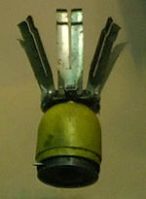
Pineapple bombs
- Anti-personnel bombs - the pineapple.
- The pineapple bomb was made up of 250 metal pellets inside a small canister that explode and shoot pellets everywhere, like bullets.
Gloria Emerson, a reporter in Vietnam, witnessed their use:
"An American plane could drop a thousand pineapples over an area the size of four football fields. In a single air strike two hundred and fifty thousand pellets were spewed in a horizontal pattern over the land below, hitting everything on the ground."
Why would the USA use pineapple bombs?

Slide 8
Operation Rolling Thunder required more US air bases in Vietnam, and these required troops to guard them. Therefore, in 1965 the US sent thousands of ground troops to Vietnam.
Impact of Operation Rolling Thunder
Did cause damage to bridges and roads on the Ho Chi Minh Trail.
Ho Chi Minh Trail was constantly repaired and supplies still got through.
Bombing affected North Vietnam’s industry but not aid from China and the USSR.
The destruction it caused turned the Vietnamese people against the USA.
It killed thousands of civilians, which led to public opposition against the war.
Overall, how successful was Operation Rolling Thunder?

Slide 9
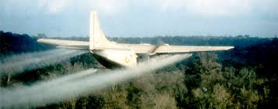
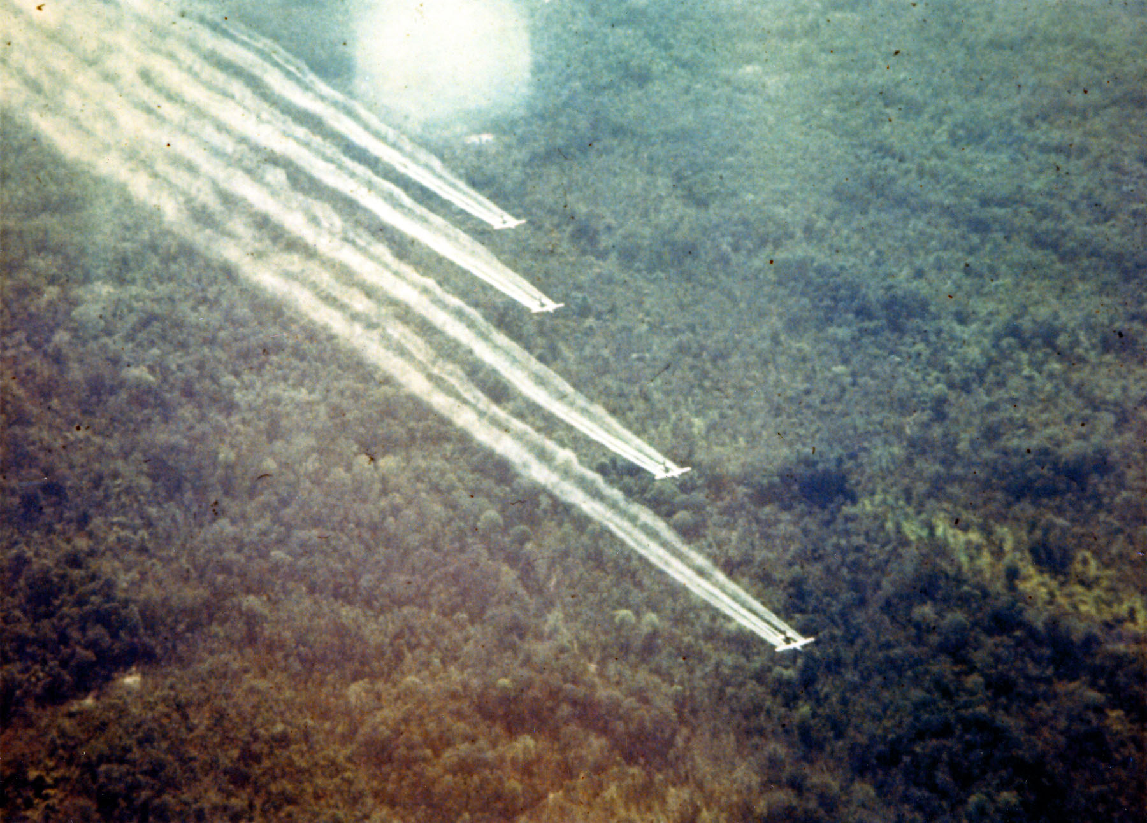
Chemical warfare - Operation Ranch Hand
1964-1970 Vietnam was sprayed with a type of herbicide.
Agent Blue was used to kill crops.
Agent Orange was used to kill jungle forests.
One plane could spray 300 acres in 4 minutes.
The chemicals were very strong. They poisoned the soil and rivers, causing health issues and birth defects.
Killing crops led to starvation.
Why would the USA continue to use this tactic?
Why would this lead to opposition to the war?
People back home in the USA were outraged by the dangerous effects of spraying chemicals. Stopped using them in 1971, but lots of damage had already been done.

Slide 10
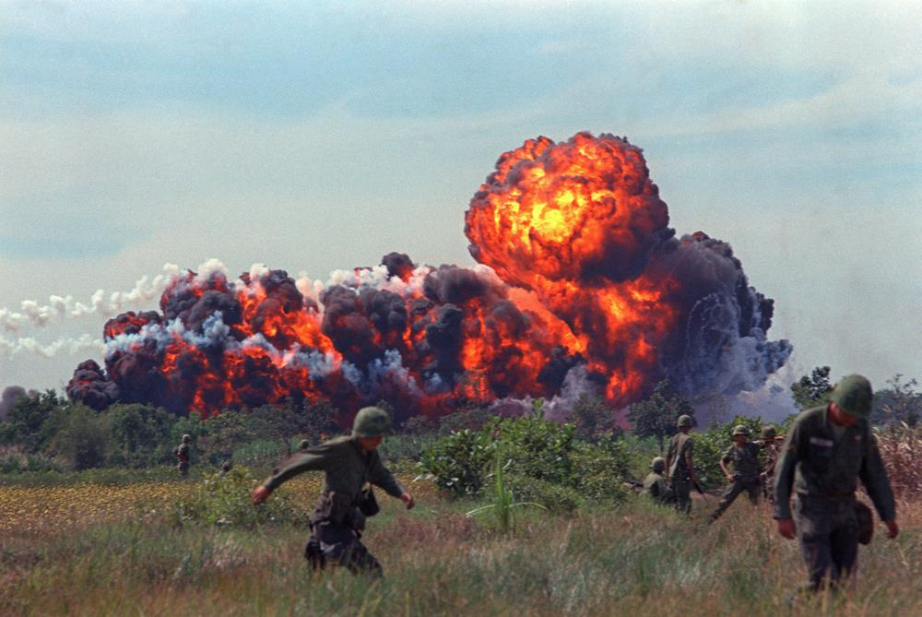
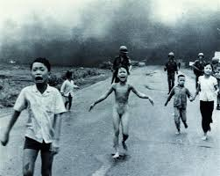
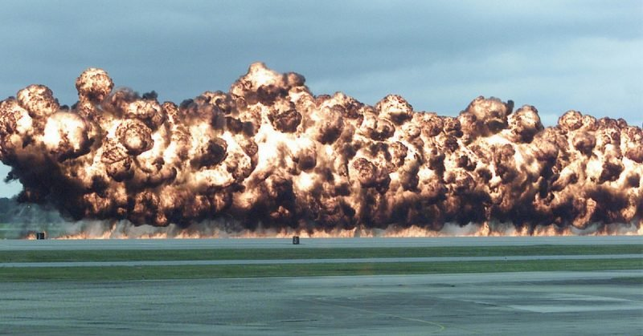
Napalm bombs
- Mix of petrol and chemical thickener (Liquid fire).
- ¾ of all napalm victims burned through to muscle and bone.
- Extremely painful and mostly led to death.
Why would the USA continue to use this tactic?

Slide 11
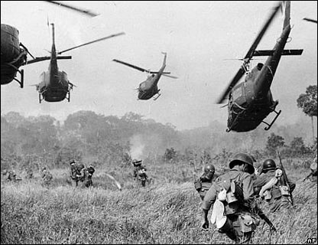
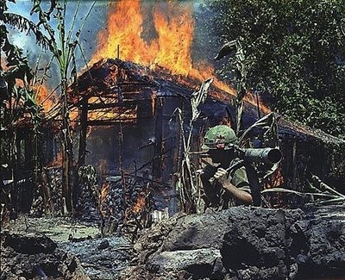
Search and destroy
- Search and destroy patrols went out looking for "Charlie", as they called the Vietcong.
A small unit of US soldiers, checked for weapons and if found, rounded up the villagers and burned the villages down.
Impact of search and destroy
- US thought these mission were successful as they destroyed VC supplies and tunnels. However:
- Once the US left the area the VC move back in.
- The bombings and chemical spraying harmed the local people and turned them against the USA.
How successful were Search and destroy missions?

Slide 12
Operation Cedar Falls 1967
Is an example of how these tactics failed. It caused civilian deaths and destruction to their homes and villages.
- Targeted a VC stronghold area, and helicoptered villagers to refugee camps and burnt the villages down.
- After the US cleared an area it became a ‘free-fire zone’ that could be bombed without warning at anytime.
- In many cases, villagers did not understand this and returned to their homes in the ‘free-fire zones’.
- In other areas, villages were warned by dropped leaflets but many of them could not read.
Why would this lead to opposition to the war?

Slide 13
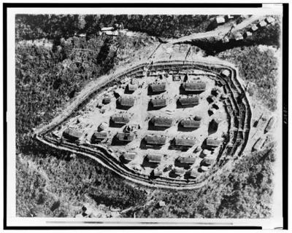
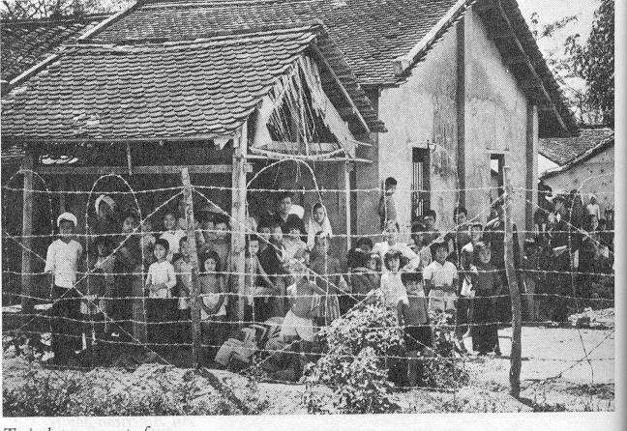
Strategic hamlets
- In the majority of cases the people did not want to move and so the South Vietnamese army often used force. This increased the hostility.
- The people were angry at having to travel longer distances to reach their rice fields. Others were upset for religious reasons as they believed that it was very important to live where their ancestors were buried.
Why would this lead to support for the Vietcong?
Notes:
This has been seen before – maybe just discuss with students – test their recall knowledge.

Slide 14
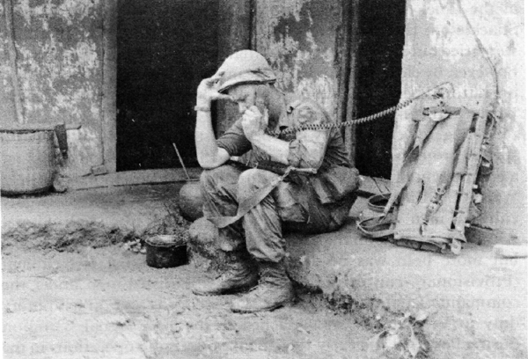
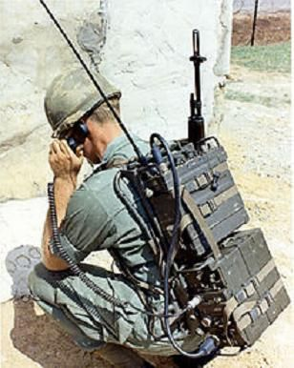
Communication
- Used radios to gain support on the ground.
- Used radios to call in air strikes to reveal or destroy the enemy that they could not see.
- Used for morale purposes - the soldiers would listen to broadcasts on how well the war was going.
Why were radios important for the USA’s tactics?

Slide 15
Watch the clips and record at least 5 points on Vietcong tactics
https://www.bbc.com/bitesize/guides/z89hg82/revision/4
https://www.youtube.com/watch?v=Yl8-dAPCQmQ

Slide 16
Describe the tactics used by the USA in Vietnam (4 marks)
The tactics used by the USA were …
The USA also used …
Another tactic they used ….
Finally, the USA used ….
COPS Complete

Slide 17
Describe the tactics used by the USA in Vietnam (4 marks)
The USA used many different tactics in the Vietnam war. The USA used air strikes and bombing campaigns such as, Operation Rolling Thunder to destroy the enemy and their supplies.
Operation Ranch Hand was a tactic were they sprayed large areas with a type of herbicides like agent orange and napalm to destroy forested jungle areas and crops to stop the enemy from hiding and to starve them.
Another tactic they used was search and destroy were troops went into enemy areas by helicopter, checked for weapons and if found, rounded up the villagers and burned the villages down.
They also created strategic hamlets in an attempt to keep the people safe and away from the enemy by moving them into these new areas which were guarded and fenced off.

Slide 18
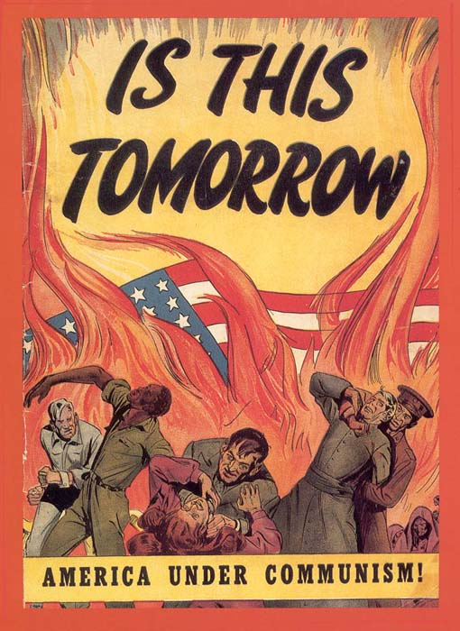
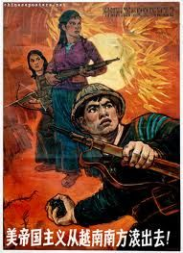
Plenary – Design a propaganda poster
Design a propaganda poster for either the USA or the Vietcong. Include their tactics in your poster!

Slide 19
Exit Ticket
Identify the correct statement
A – The USA used tactics like, air strikes and bombing campaigns such as, Operation Thunder Storm to destroy the enemy and their supplies. Operation Ranch Hand was a tactic were they sprayed large areas with a type of herbicides like agent red and napalm to destroy forested jungle areas and crops.
B – The USA used tactics like, air strikes and bombing campaigns such as, Operation Rolling Thunder to destroy the enemy and their supplies. Operation Ranch Hand was a tactic were they sprayed large areas with a type of herbicides like agent orange and napalm to destroy forested jungle areas and crops.
C – The USA used tactics like, air strikes and bombing campaigns such as, Operation Rolling Thunder to destroy the enemy and their supplies. Operation Ranch Hand was a tactic were they sprayed large areas with a type of herbicides like agent orange and napalm to destroy towns and cities.
Notes:
ANSWER - B

