Slide 1
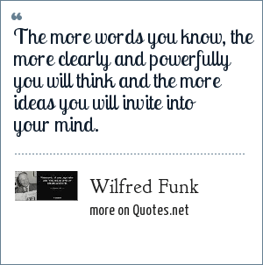
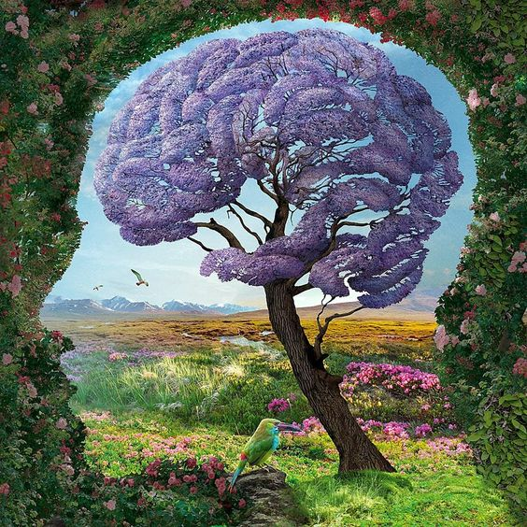
Year 8 LP1 Vocabulary Roadmap
Name:
revolution
context
technology
create
image
physical
ideology
abandon
isolate Phenomenon encounter
negative
consequence
inevitable
debate
Wilfred Funk - writer, poet, lexicographer - American

Slide 2
Revolution (Word class:___________). Meaning:
Etymology (word origin)
Transform it!
Draw a picture/symbol/object/logo - that reminds you of this word and it’s meaning or how you can use it!
Use it!
Use the word in different sentences - better still use it in your own work!
1.
2.
In which subjects will I use this word? Where is it relevant? Where have I heard it before?
“The Industrial Revolution and its consequence have been a disaster for the human race”
Link it!
List vocabulary you know associated to this word...
Debate it!
There is a quote to the left of this page. What are your thoughts on this?
Take it further!
How does this word link to ‘Frankenstein’?
Theodore Kaczynski- an American domestic terrorist, anarchist and former mathematics professor.
Notes:
On the next slide i have filled one out like the kids would in purple

Slide 3
Context (Word class:___________). Meaning:
Etymology (word origin)
Transform it!
Draw a picture/symbol/object/logo - that reminds you of this word and it’s meaning or how you can use it!
Use it!
Use the word in different sentences - better still use it in your own work!
1.
2.
In which subjects will I use this word? Where is it relevant? Where have I heard it before?
“Context shapes who you are”
Link it!
List vocabulary you know associated to this word...
Debate it!
There is a quote to the left of this page. What are your thoughts on this?
Take it further!
How does this word link to ‘Frankenstein’?
Cornel West- an American philosopher, author, social critic and political activist.
Notes:
On the next slide i have filled one out like the kids would in purple

Slide 4
Technology (Word class:___________). Meaning:
Etymology (word origin)
Transform it!
Draw a picture/symbol/object/logo - that reminds you of this word and it’s meaning or how you can use it!
Use it!
Use the word in different sentences - better still use it in your own work!
1.
2.
In which subjects will I use this word? Where is it relevant? Where have I heard it before?
“Technology is a useful servant, but a dangerous master.”
Link it!
List vocabulary you know associated to this word...
Debate it!
There is a quote to the left of this page. What are your thoughts on this?
Take it further!
How does this word link to ‘Frankenstein’?
Christian Lous Lange- political scientist
Notes:
On the next slide i have filled one out like the kids would in purple

Slide 5
Create (Word class:___________). Meaning:
Etymology (word origin)
Transform it!
Draw a picture/symbol/object/logo - that reminds you of this word and it’s meaning or how you can use it!
Use it!
Use the word in different sentences - better still use it in your own work!
1.
2.
In which subjects will I use this word? Where is it relevant? Where have I heard it before?
“It is better to create than to learn! Creating is the essence of life”
Link it!
List vocabulary you know associated to this word...
Debate it!
There is a quote to the left of this page. What are your thoughts on this?
Take it further!
How does this word link to ‘Frankenstein’?
Julius Caesar- Roman general and statesman
Notes:
On the next slide i have filled one out like the kids would in purple

Slide 6
Image (Word class:___________). Meaning:
Etymology (word origin)
Transform it!
Draw a picture/symbol/object/logo - that reminds you of this word and it’s meaning or how you can use it!
Use it!
Use the word in different sentences - better still use it in your own work!
1.
2.
In which subjects will I use this word? Where is it relevant? Where have I heard it before?
“Image is what people think we are; integrity is what we really are”
Link it!
List vocabulary you know associated to this word...
Debate it!
There is a quote to the left of this page. What are your thoughts on this?
Take it further!
How does this word link to ‘Frankenstein’?
John Calvin Maxwell- American author, speaker and pastor
Notes:
On the next slide i have filled one out like the kids would in purple

Slide 7
Physical (Word class:___________). Meaning:
Etymology (word origin)
Transform it!
Draw a picture/symbol/object/logo - that reminds you of this word and it’s meaning or how you can use it!
Use it!
Use the word in different sentences - better still use it in your own work!
1.
2.
In which subjects will I use this word? Where is it relevant? Where have I heard it before?
“Don’t judge a book by its cover”
Link it!
List vocabulary you know associated to this word...
Debate it!
There is a quote to the left of this page. What are your thoughts on this?
Take it further!
How does this word link to ‘Frankenstein’?
Mary Ann Evans, known by her pen name George Eliot, was an English novelist, poet, journalist, translator and one of the leading writers of the Victorian era.
Notes:
On the next slide i have filled one out like the kids would in purple

Slide 8
Ideology (Word class:___________). Meaning
Etymology (word origin)
Transform it!
Draw a picture/symbol/object/logo - that reminds you of this word and it’s meaning or how you can use it!
Use it!
Use the word in different sentences - better still use it in your own work!
1.
2.
In which subjects will I use this word? Where is it relevant? Where have I heard it before?
“An idea is something you have; an ideology is something that has you”
Link it!
List vocabulary you know associated to this word...
Debate it!
There is a quote to the left of this page. What are your thoughts on this?
Take it further!
How does this word link to ‘Frankenstein’?
Morris Berman- American historian and social critic.
Notes:
On the next slide i have filled one out like the kids would in purple

Slide 9
Abandon (Word class:___________). Meaning:
Etymology (word origin)
Transform it!
Draw a picture/symbol/object/logo - that reminds you of this word and it’s meaning or how you can use it!
Use it!
Use the word in different sentences - better still use it in your own work!
1.
2.
In which subjects will I use this word? Where is it relevant? Where have I heard it before?
Link it!
List vocabulary you know associated to this word...
Debate it!
There is a quote to the left of this page. What are your thoughts on this?
Take it further!
How does this word link to ‘Frankenstein’?
“When you abandon making choice, you enter the vast world of excuses”
Wayne Dyer- American self-help author and a motivational speaker.
Notes:
On the next slide i have filled one out like the kids would in purple

Slide 10
Isolate (Word class:___________). Meaning:
Etymology (word origin)
Transform it!
Draw a picture/symbol/object/logo - that reminds you of this word and it’s meaning or how you can use it!
Use it!
Use the word in different sentences - better still use it in your own work!
1.
2.
In which subjects will I use this word? Where is it relevant? Where have I heard it before?
Link it!
List vocabulary you know associated to this word...
Debate it!
There is a quote to the left of this page. What are your thoughts on this?
Take it further!
How does this word link to ‘Frankenstein’?
“With technology, there is so much isolation with people now, that there are very few places where you can connect”
Mireille Guiliano- French-American author
Notes:
On the next slide i have filled one out like the kids would in purple

Slide 11
Phenomenon (Word class:___________). Meaning:
Etymology (word origin)
Transform it!
Draw a picture/symbol/object/logo - that reminds you of this word and it’s meaning or how you can use it!
Use it!
Use the word in different sentences - better still use it in your own work!
1.
2.
In which subjects will I use this word? Where is it relevant? Where have I heard it before?
“No phenomenon is a real phenomenon until it is an observed phenomenon”
Link it!
List vocabulary you know associated to this word...
Debate it!
There is a quote to the left of this page. What are your thoughts on this?
Take it further!
How does this word link to ‘Frankenstein’?
John Archibald Wheeler- American theoretical physicist.
Notes:
On the next slide i have filled one out like the kids would in purple

Slide 12
Encounter (Word class:___________). Meaning
Etymology (word origin)
Transform it!
Draw a picture/symbol/object/logo - that reminds you of this word and it’s meaning or how you can use it!
Use it!
Use the word in different sentences - better still use it in your own work!
1.
2.
In which subjects will I use this word? Where is it relevant? Where have I heard it before?
“We may encounter many defeats, but we must not be defeated”
Link it!
List vocabulary you know associated to this word...
Debate it!
There is a quote to the left of this page. What are your thoughts on this?
Take it further!
How does this word link to ‘Frankenstein’?
Maya Angelou- American author and poet
Notes:
On the next slide i have filled one out like the kids would in purple

Slide 13
Negative (Word class:___________). Meaning:
Etymology (word origin)
Transform it!
Draw a picture/symbol/object/logo - that reminds you of this word and it’s meaning or how you can use it!
Use it!
Use the word in different sentences - better still use it in your own work!
1.
2.
In which subjects will I use this word? Where is it relevant? Where have I heard it before?
“Negative people need drama like oxygen”
Link it!
List vocabulary you know associated to this word...
Debate it!
There is a quote to the left of this page. What are your thoughts on this?
Take it further!
How does this word link to ‘Frankenstein’?
Tony Gaskins - motivational speaker, author and life coach.
Notes:
On the next slide i have filled one out like the kids would in purple

Slide 14
Consequence (Word class:___________). Meaning:
Etymology (word origin)
Transform it!
Draw a picture/symbol/object/logo - that reminds you of this word and it’s meaning or how you can use it!
Use it!
Use the word in different sentences - better still use it in your own work!
1.
2.
In which subjects will I use this word? Where is it relevant? Where have I heard it before?
“While we are free to choose our actions, we are free to choose the consequences of those actions”
Link it!
List vocabulary you know associated to this word...
Debate it!
There is a quote to the left of this page. What are your thoughts on this?
Take it further!
How does this word link to ‘Frankenstein’?
Stephen Richards Covey - American educator, author, businessman and keynote speaker.
Notes:
On the next slide i have filled one out like the kids would in purple

Slide 15
Inevitable (Word class:___________). Meaning:
Etymology (word origin)
Transform it!
Draw a picture/symbol/object/logo - that reminds you of this word and it’s meaning or how you can use it!
Use it!
Use the word in different sentences - better still use it in your own work!
1.
2.
In which subjects will I use this word? Where is it relevant? Where have I heard it before?
“Change is inevitable. Growth is optional”
Link it!
List vocabulary you know associated to this word...
Debate it!
There is a quote to the left of this page. What are your thoughts on this?
Take it further!
How does this word link to ‘Frankenstein’?
John Calvin Maxwell is an American author, speaker, and pastor
Notes:
On the next slide i have filled one out like the kids would in purple

Slide 16
Debate (Word class:___________). Meaning
Etymology (word origin)
Transform it!
Draw a picture/symbol/object/logo - that reminds you of this word and it’s meaning or how you can use it!
Use it!
Use the word in different sentences - better still use it in your own work!
1.
2.
In which subjects will I use this word? Where is it relevant? Where have I heard it before?
“You cannot argue or debate with ignorance”
Link it!
List vocabulary you know associated to this word...
Debate it!
There is a quote to the left of this page. What are your thoughts on this?
Take it further!
How does this word link to ‘Frankenstein’?
Martin Summerhayes- author and mindfulness practitioner
Notes:
On the next slide i have filled one out like the kids would in purple

Slide 17
Definition
Write the word in a sentence
Definition
Write the word in a sentence
Word class
Word class
Word
Word
Synonyms
Antonyms
Synonyms
Antonyms
Definition
Word class
Write the word in a sentence
Definition
Word class
Write the word in a sentence
Word
Word
Synonyms
Antonyms
Synonyms
Antonyms

Slide 18
Definition
Write the word in a sentence
Definition
Write the word in a sentence
Word class
Word class
Word
Word
Synonyms
Antonyms
Synonyms
Antonyms
Definition
Word class
Write the word in a sentence
Definition
Word class
Write the word in a sentence
Word
Word
Synonyms
Antonyms
Synonyms
Antonyms

Slide 19
Definition
Write the word in a sentence
Definition
Write the word in a sentence
Word class
Word class
Word
Word
Synonyms
Antonyms
Synonyms
Antonyms
Definition
Word class
Write the word in a sentence
Definition
Word class
Write the word in a sentence
Word
Word
Synonyms
Antonyms
Synonyms
Antonyms

Slide 20
Definition
Write the word in a sentence
Definition
Write the word in a sentence
Word class
Word class
Word
Word
Synonyms
Antonyms
Synonyms
Antonyms
Definition
Word class
Write the word in a sentence
Definition
Word class
Write the word in a sentence
Word
Word
Synonyms
Antonyms
Synonyms
Antonyms

