Slide 1
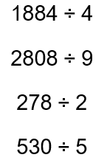
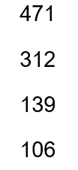
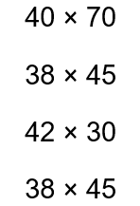
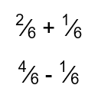
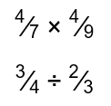
Year 10F Starter LP1
LP1/ Monday 4

Slide 2
Week 4
Underlined dates and titles?
Examples in red bubbles?
Completed feedback?
Correct spellings?
Completed unfinished work?
Updated tracker?
Marked classwork?
COPS COMPLETE

Slide 3
Estimate

Slide 4
Read it:
Estimate
Define it:
To estimate is to find an approximate answer to a more difficult problem.
Deconstruct it:
Long before the terminology stabilized around estimation the activity was called calculation, determination or fitting.
Example:
An estimate of
31.2 x 5.94 is
30 x 6 = 180.
Digging Deeper:
A written statement indicating the likely price that will be charged for specified work or repairs.
‘compare costs by getting estimates from at least two firms’.
Link it:
Approximate, Guess, Judge, Rate

Slide 5
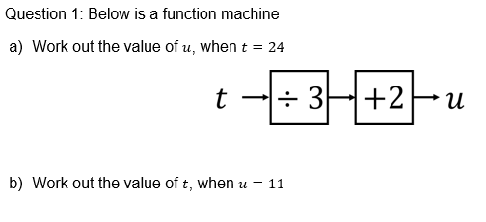
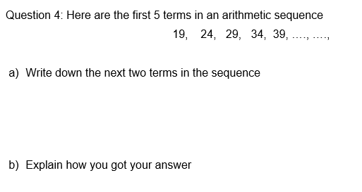
Year 10F Starter LP1
LP1/ Tuesday 4
Simplify:
$2p−p+7p$
$6v+5k+2v$
3) $5xy−3x+7xy+x$
If y=7 find the value of:
Y-3
3y+10

Slide 6
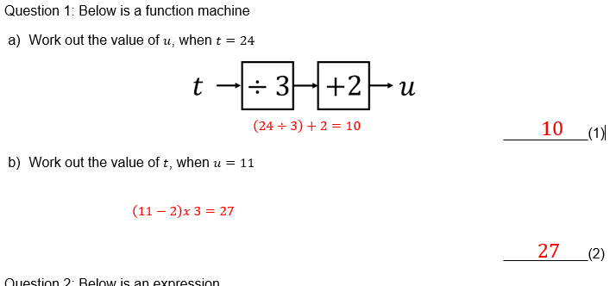
Year 10F Starter LP1
LP1/ Tuesday 4
Simplify:
$8p$
$8v+5k$
3) $12xy−2x$
If y=7 find the value of:
4
31

Slide 7
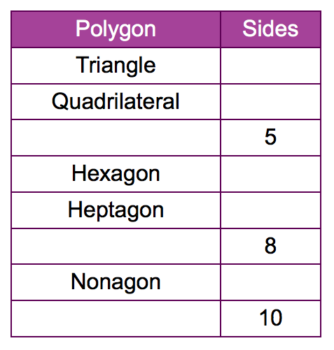
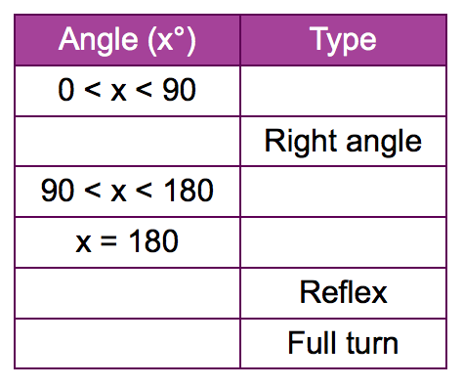
Angles in Polygons
Starter
To understand how to find the interior angles in triangles, quadrilaterals and regular polygons.
Keywords: Interior angle, Exterior angle, sum, product, triangle, 180º, Regular

Slide 8
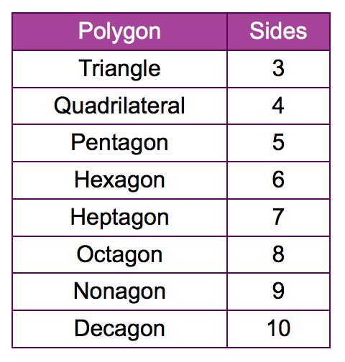
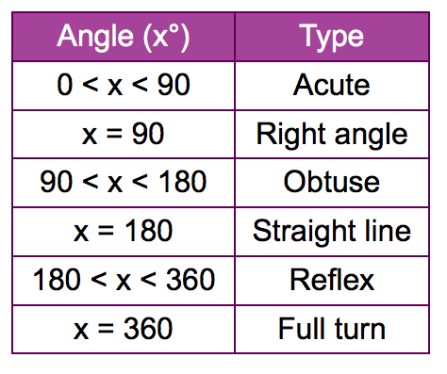
Angles in Polygons
Starter
To understand how to find the interior angles in polygons and apply this skill when solving problems
Keywords: Interior angle, Exterior angle, sum, product, triangle, 180º, Regular

Slide 9
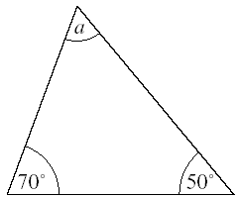
Increasing Sequences
Angles in Polygons
Worked Example

Slide 10
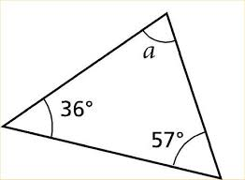
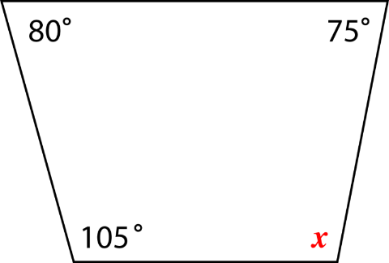
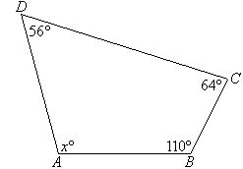
Practice Questions
Practice Question

Slide 11
Angles in Polygons

Slide 12
Increasing Sequences
Angles in Polygons
Worked Example: SUM Regular

Slide 13
Increasing Sequences
Angles in Polygons
Worked Example: Each angle Regular

Slide 14
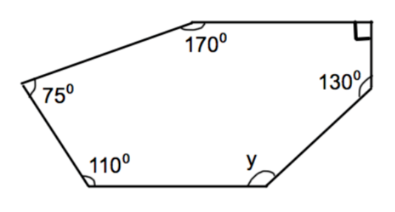
My Question
Practice Question
Calculate the sum of the interior angles of an octagon.
Calculate the sum of the interior angles of a decagon. Then calculate the value of each angle.

Slide 15
Angles in Polygons

Slide 16
Purple Problem

Slide 17
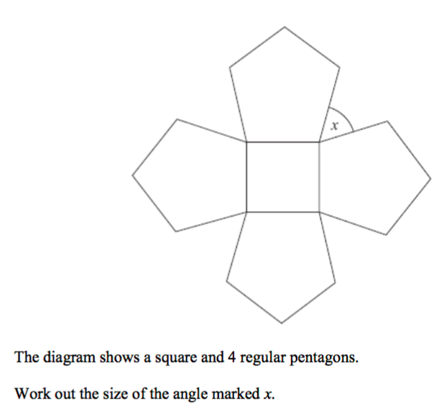
Purple Problem
Give reasons for your answer

Slide 18
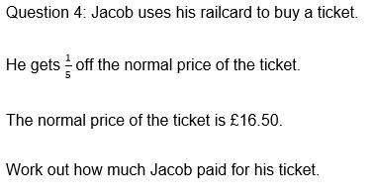
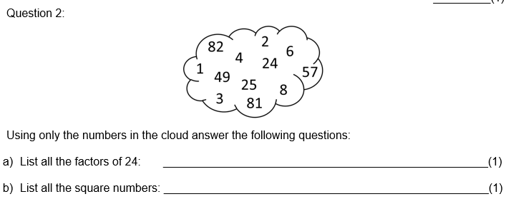
Year 10F Starter LP1
LP1/ Wednesday 4
Simplify:
$\frac{12}{36}$
$\frac{7}{77}$
Work out the following:
10% of £200
5% of £200
1% of £200

Slide 19
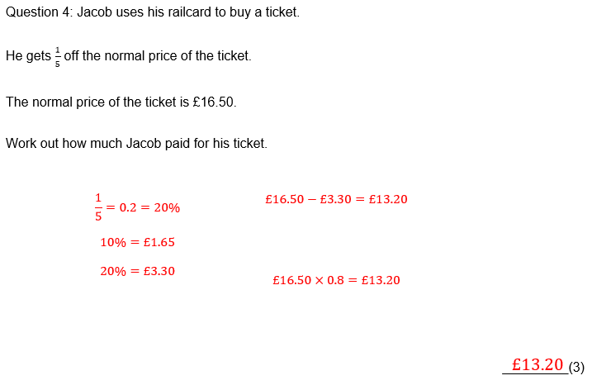
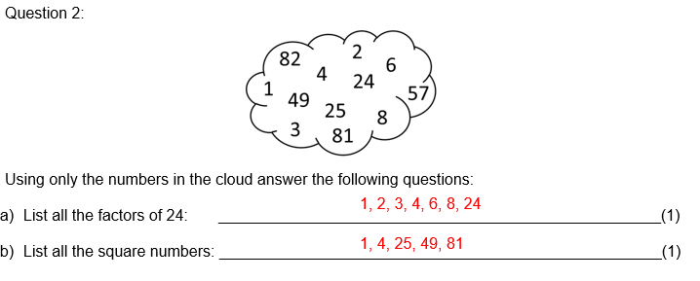
Year 10F Starter LP1
LP1/ Wednesday 4
Simplify:
$\frac{1}{3}$
$\frac{1}{11}$
Work out the following:
£20
£10
£2

Slide 20
Improper Fractions and Mixed Numbers
To be able to convert between mixed numbers and improper fractions.
To be able to add, subtract, multiply and divide fractions.
To be able to calculate with mixed numbers.
Key words
Fraction, improper, mixed number, integer, numerator, denominator, common, add, subtract, multiply, divide, equivalent

Slide 21
Improper Fractions and Mixed Numbers
Discussion
Improper Fraction
Mixed Numbers

Slide 22
Improper Fractions and Mixed Numbers
Worked Example

Slide 23
Improper Fractions and Mixed Numbers
Worked Example
THINK….
How could be convert a mixed number into an improper fraction?

Slide 24
My Question

Slide 25
Progress Pit stop
.
I don’t understand
I nearly understand
I fully understand

Slide 26
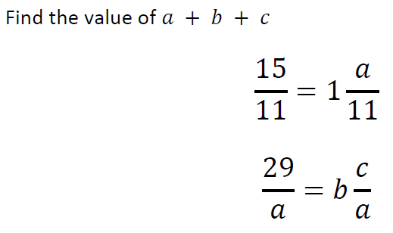
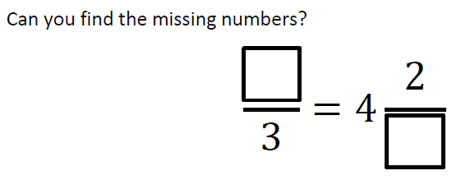
Practice Questions

Slide 27
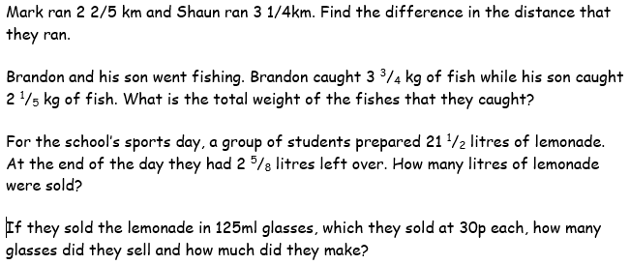
Purple Problem

Slide 29
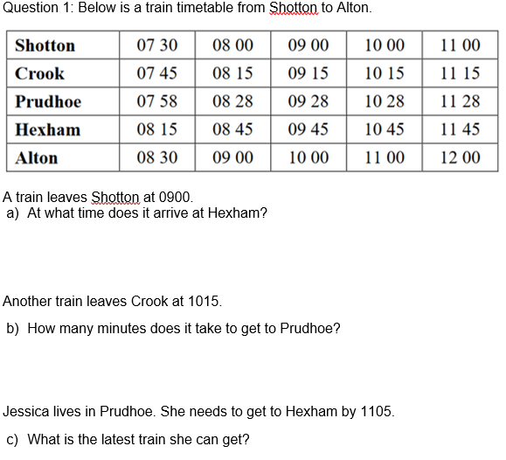
Year 10F Starter LP1
LP1/ Thursday 4

Slide 30
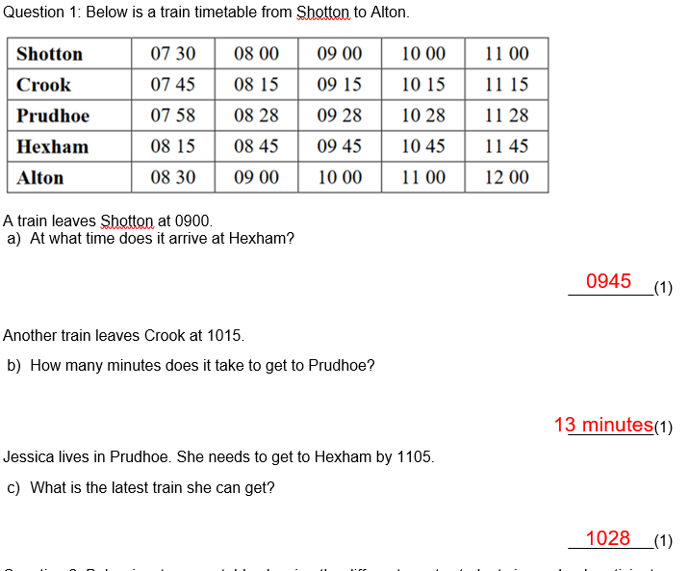
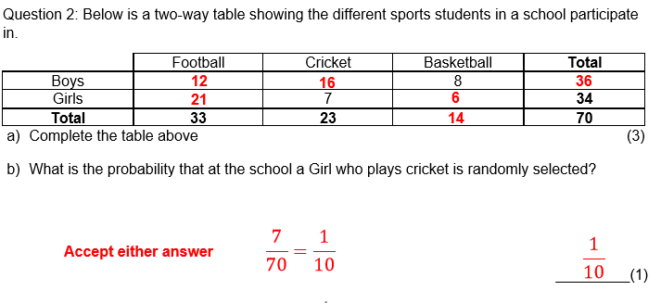
Year 10F Starter LP1
LP1/ Thursday 4

Slide 31
Dan, Harry and Regan sell cars.
Dan sells x cars. Harry sells 5 more cars than Dan. Regan sells twice as many cars as Dan.
Write an expression, in terms of x, for the total number of cars Dan, Harry and Regan sell.
Dan = x
Harry = x + 5
Regan = 2x
Total = x + x + 5 + 2x
= 4x + 5

Slide 32
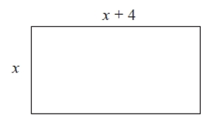

Slide 33
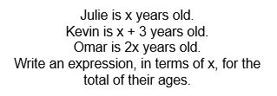
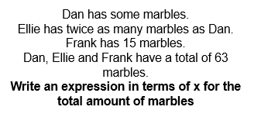
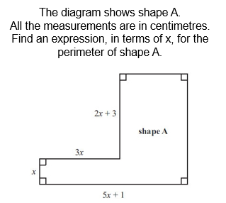

Slide 34
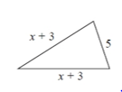

Slide 35
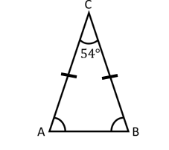
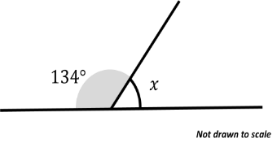
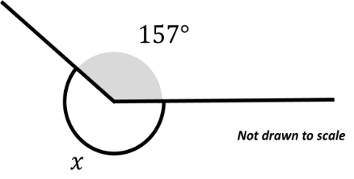
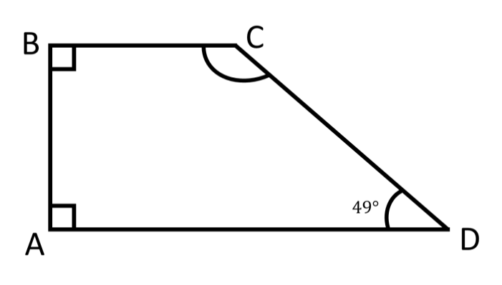
Year 10F Starter LP1
LP1/ Friday 4
Convert:
11.2m into cm
353cm into m
10.3kg into g
Find the missing angles in the following diagrams:
Bill and Tony share money in the ratio 1:2. Tony gets £40. How much will Bill receive?
2) Simplify 8:32
Find the missing angles in the following diagram:

Slide 36
Year 10F Starter LP1
LP1/ Friday 5
Convert:
1120cm
3.53m
10,030g
Find the missing angles in the following diagrams:
46
63
203
Bill and Tony share money in the ratio 1:2. Tony gets £40. How much will Bill receive?
2) Simplify 8:32
Find the missing angles in the following diagram:
131
£20
1:4

Slide 37
Steak cooking instructions
Medium Roast 25 mins per 450g + 25mins
These are all real-life examples of using worded formulae

Slide 38
This rule can be used to work out the time, in minutes, it takes to make microchips.
(a) Work out the time it takes to make 100 microchips.
Time = number of microchips ÷ 20 + 4
BIDMAS!
Time
= 100 ÷ 20 + 4
= 5 + 4
= 9 minutes

Slide 39
Here is a rule to work out the time it takes to cook a piece of meat.
A piece of meat has a weight of 4 kg.
(a) Use the rule to work out the time, in minutes, it takes to cook this piece of meat.
Time in minutes = 36 x weight in kg + 30
BIDMAS!
Time in minutes
= 36 x 4 + 30
= 144 + 30
= 174 minutes

Slide 40
This rule can be used to work out the time, in minutes, it takes to make microchips.
(b) Work out the greatest number of microchips that can be made in 60 minutes.
Time = number of microchips ÷ 20 + 4
60 = number of microchips ÷ 20 + 4
- 4
- 4
56 = number of microchips ÷ 20
x 20
x 20
1120 = number of microchips

Slide 41
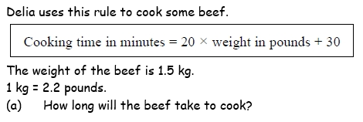
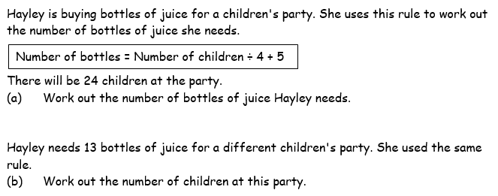

Slide 43
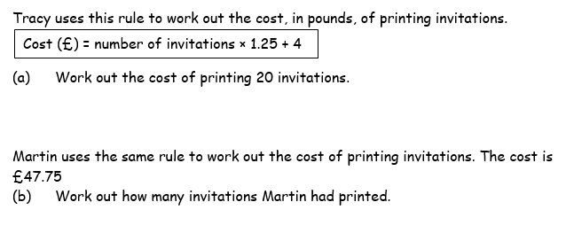
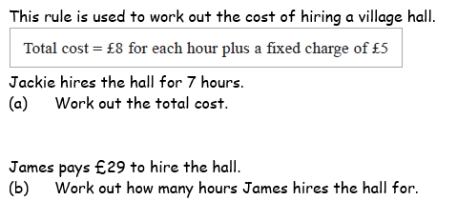

Slide 44
Answers
1. (a) 96 minutes
2. (a) 11 bottles
(b) 32 children
3. (a) £29
(b) 35 invitations
8. (a) £61
(b) 3 hours

